Slide 1
BIODIVERSITY RISK Management
IN AGRICULTURAL SUPPLY CHAINS
June 2022
    Jared Hardner
    Consulting Biodiversity Specialist

Slide 2
Learning Objectives
Upon completion of this presentation, IFC (and FI) staff should be able to evaluate their clients’ compliance with Performance Standard 6 as it applies to agricultural supply chains or develop a plan of action to ensure they are prepared for IFC financing.

Slide 3
Module 1: Overview
Notes:
This module provides an overview of the processes of managing a PS6 compliant supply chain structure.

Slide 4
Module Learning Objectives
Upon completion of the module, you should understand:
The risks to biodiversity from agricultural supply chains
Key concepts including traceability, verification and supply chain controls
IFC Performance Standard 6 requirements for supply chains

Slide 5
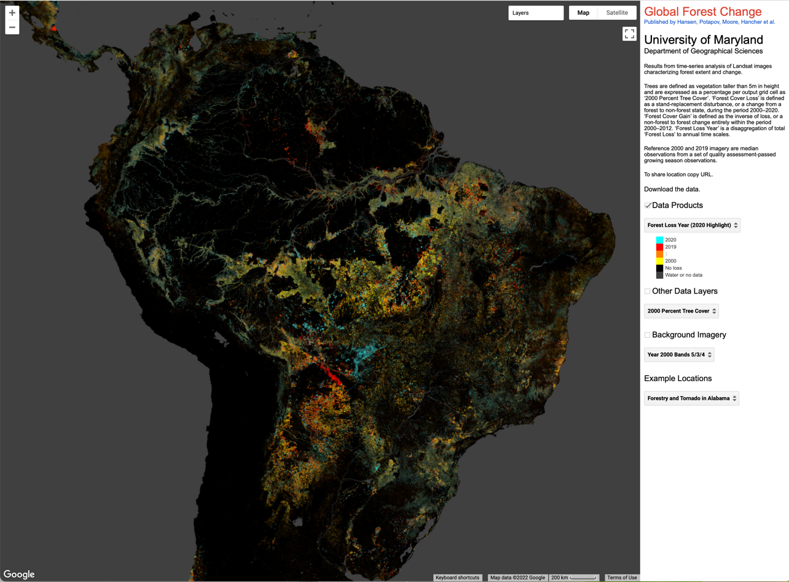
Risk to Biodiversity in Agricultural Supply Chains
Habitat loss from agriculture is the largest driver of land use change on the planet.
The principal driver of deforestation (color-coded by year) in this image of South America is caused by cattle and crop expansion by independent business entities that sell into national and global supply chains.

Slide 6
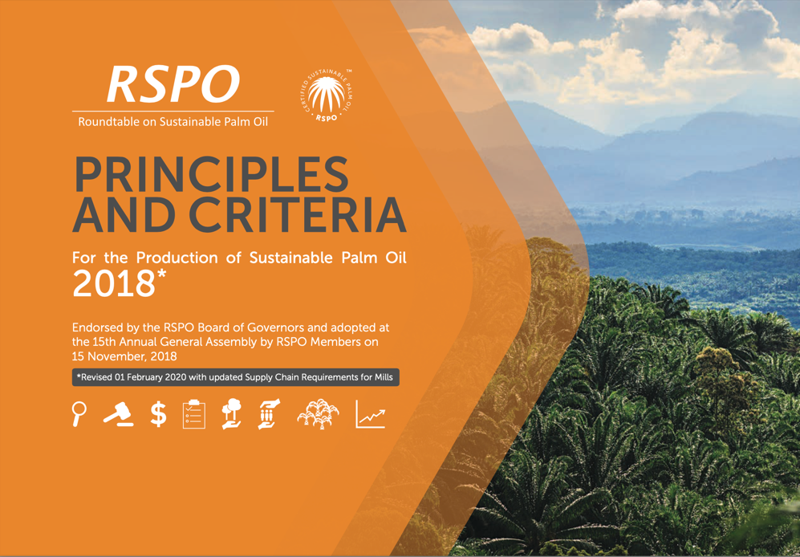

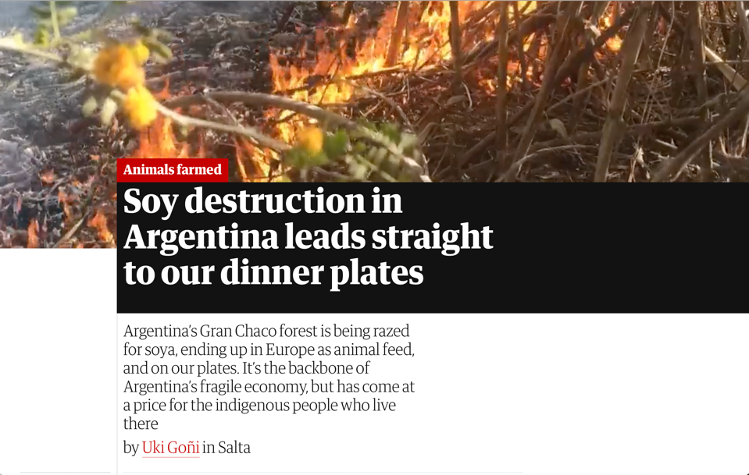
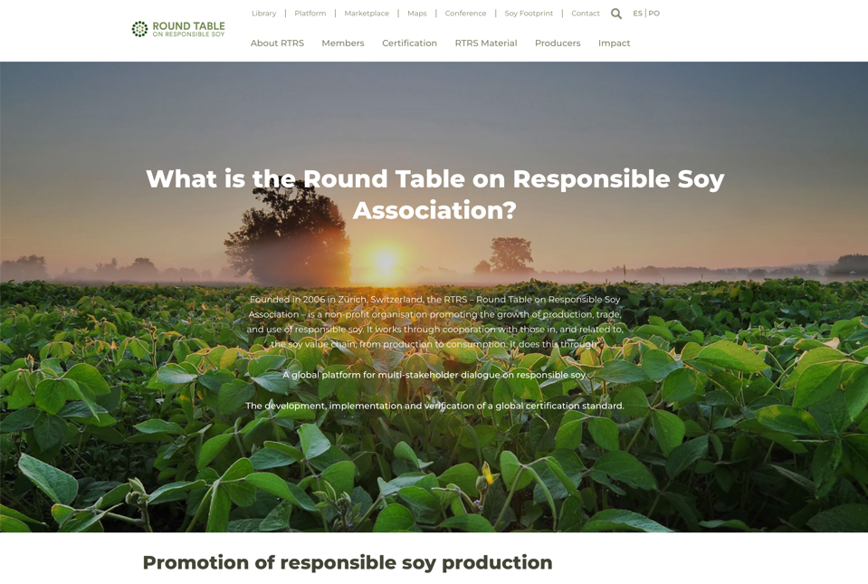
Risk to Biodiversity in Agricultural Supply Chains
The impact of agriculture is a concern among governments, industry, lenders, and environmental groups. Cutoff dates for habitat conversion are becoming common.

Slide 7
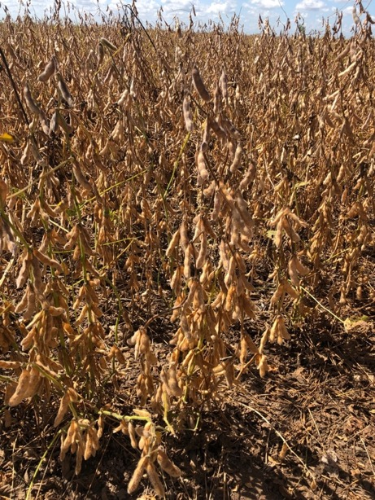
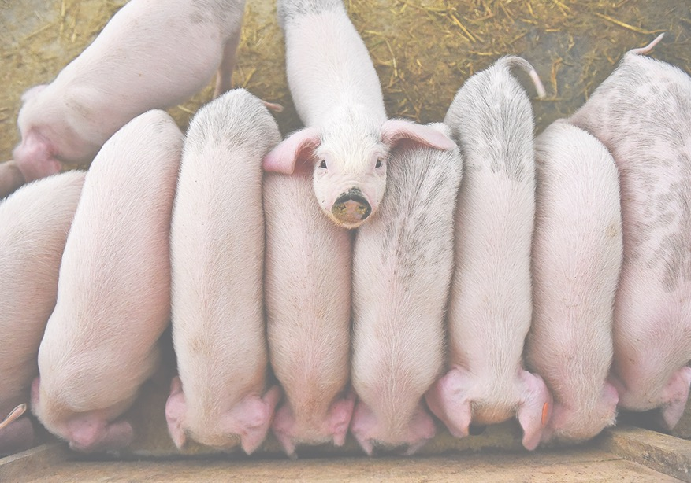
Risk to Biodiversity in Supply Chains
If an entity purchases staple crops, animals, or fibers that are an input to their business, they may have biodiversity risk in their supply chain.
Notes:
This includes products that have undergone initiation processing such as conversion of crops to meal and oils, the slaughter of livestock to make meat, leather and derivatives from rendering, and the milling of lumber and veneers or production of pulp and fiber.

Slide 8
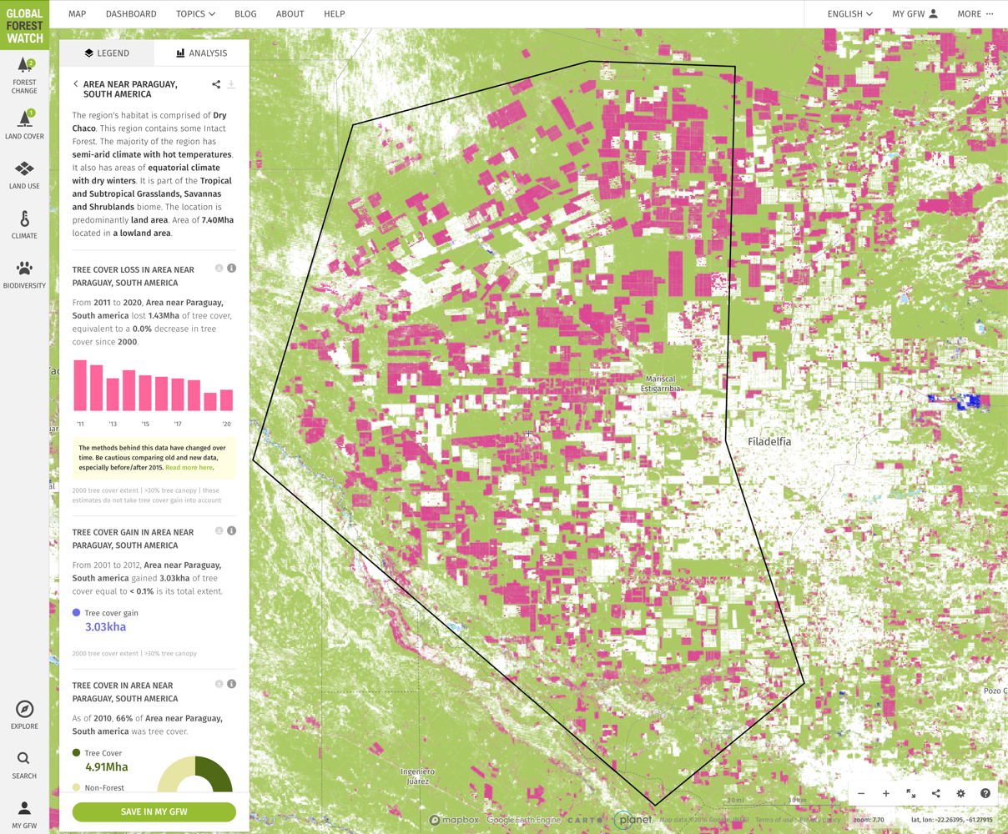
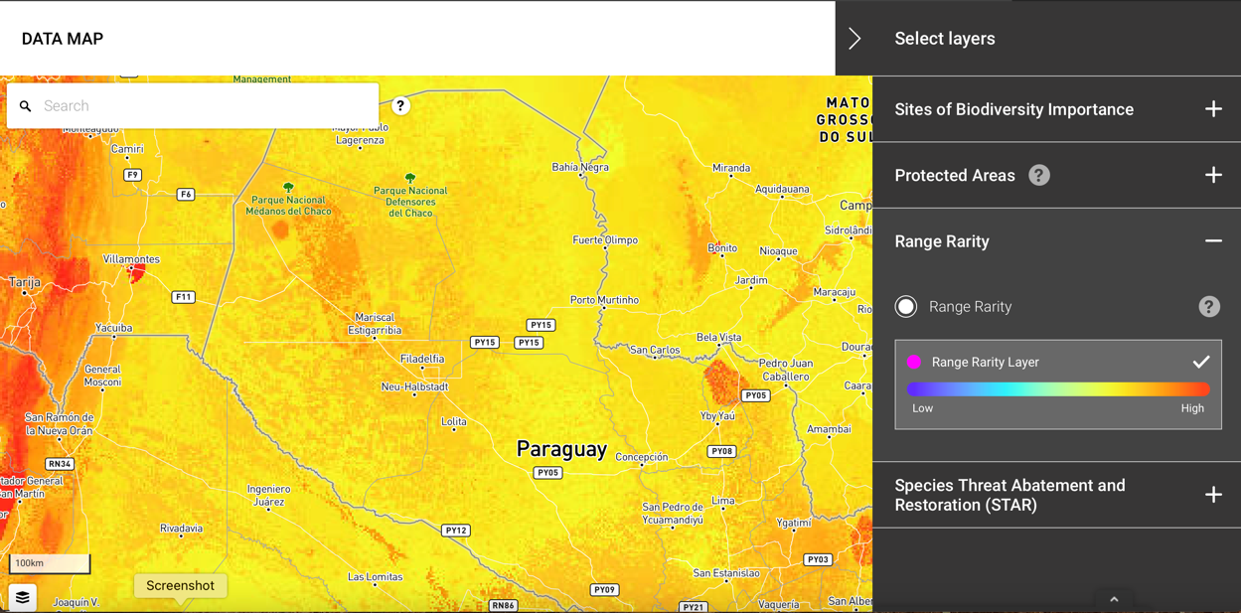
Risk to Biodiversity in Supply Chains
That entity should understand the magnitude and speed of habitat loss where its inputs are produced, and the sensitivity of that habitat, to determine if there are significant risks.

Slide 9
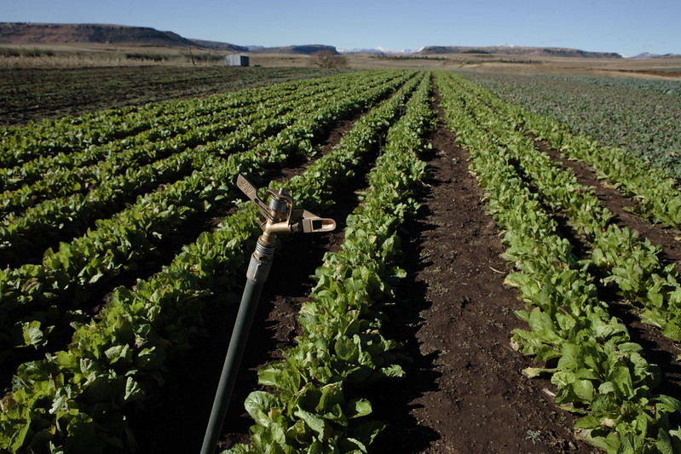
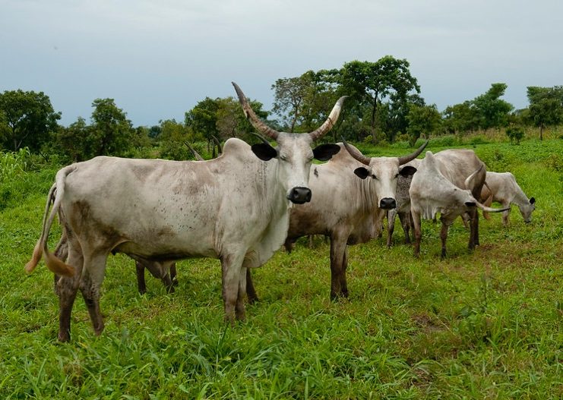
Traceability of Agricultural Inputs
Tracing agricultural inputs to their sites of production is key to assessing and managing risk.
Sites of production might be farms, ranches, plantations, natural forests, or aquaculture operations.
In the simplest case, this may be a single farm that grows grains, or an area of an estuary modified for shrimp aquaculture.
In more complex cases, this may include a series of multiple sites where individual cattle spend periods of only months over their lifetime.

Slide 10
Traceability of Agricultural Inputs
Supply chains may have multiple points of purchase and sale. It is not always possible to trace supply all the way to the sites of production, as some intermediate actors may not be able to, or wish to, share information on their suppliers.

Slide 11
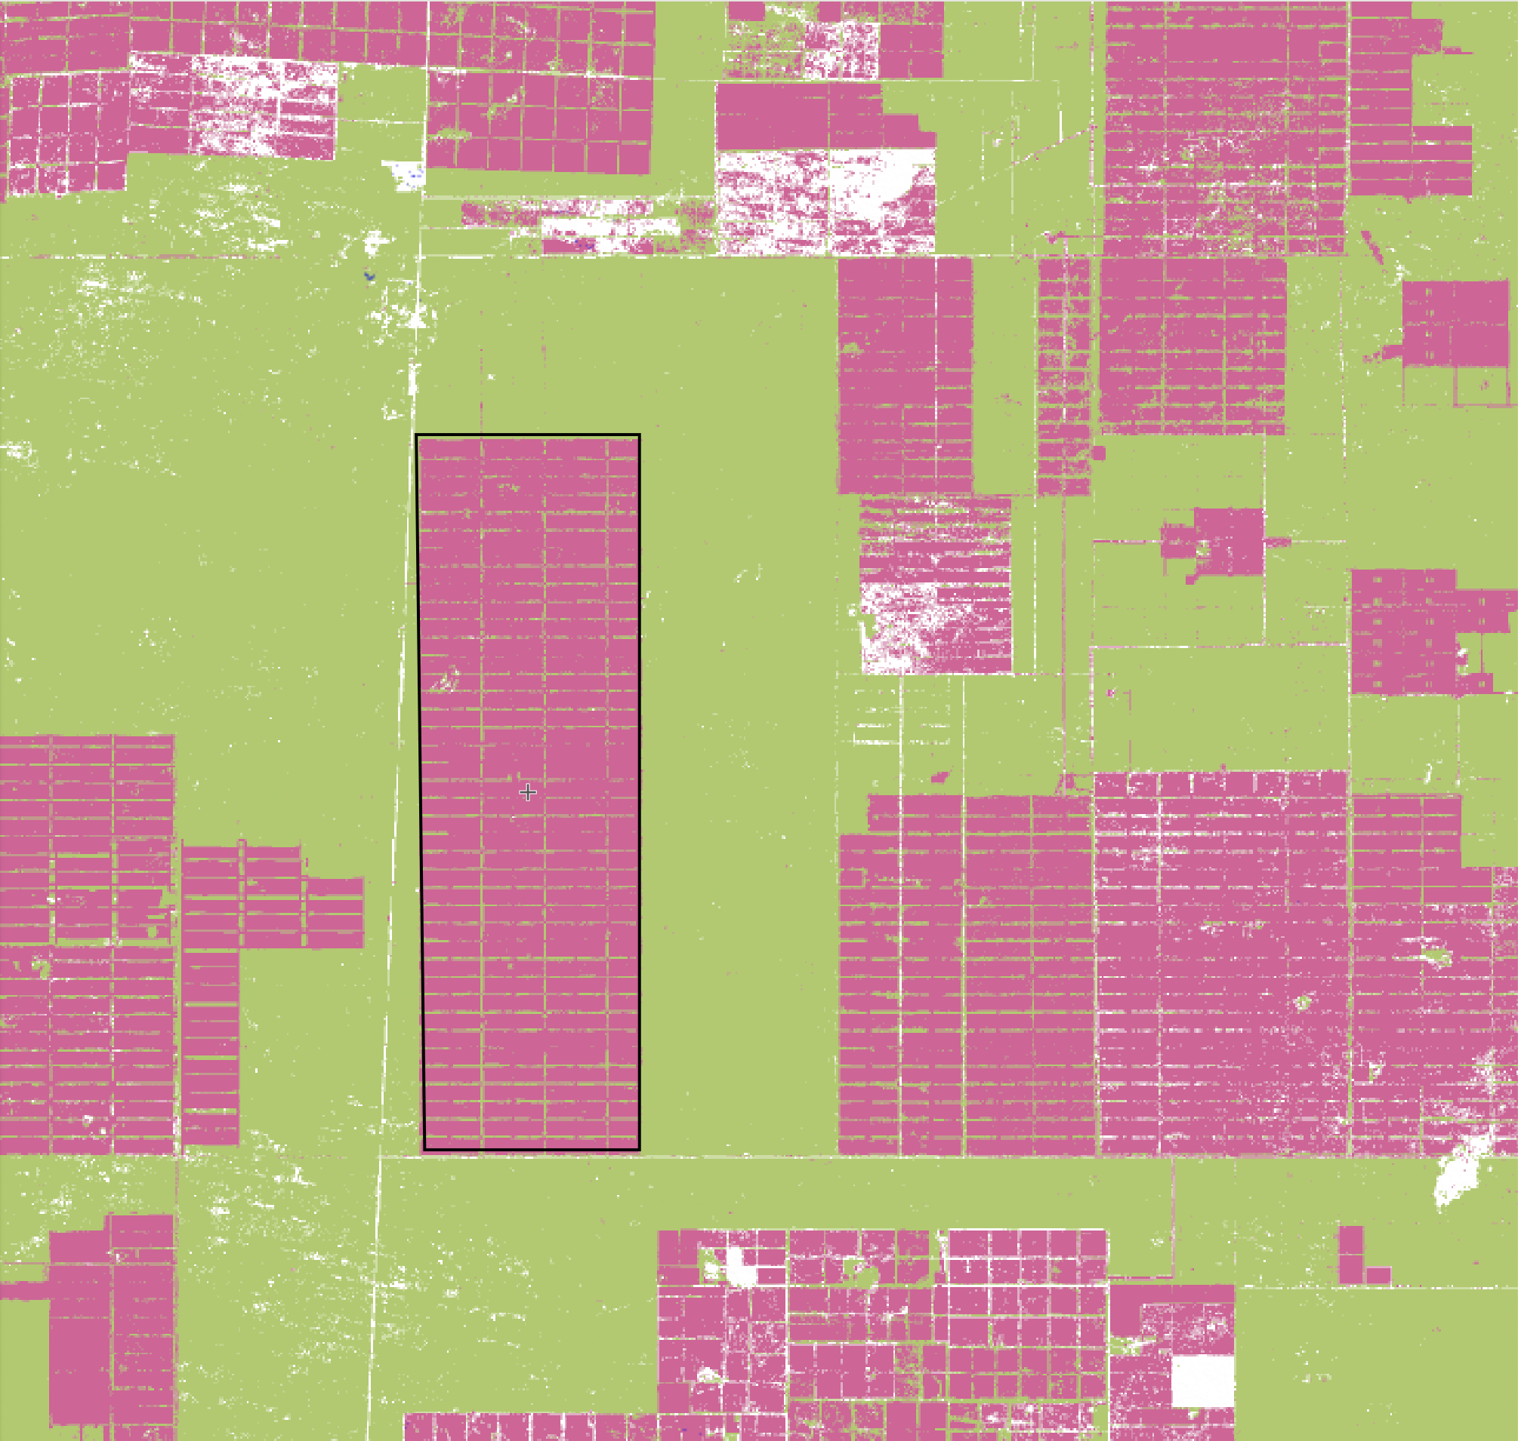
Verification of Agricultural Inputs
When production is traceable, it is possible to verify whether habitat conversion is occurring at those sites of production.
Placing GIS polygons on areas of production allows the use of widely-available land use change-detection software.

Slide 12
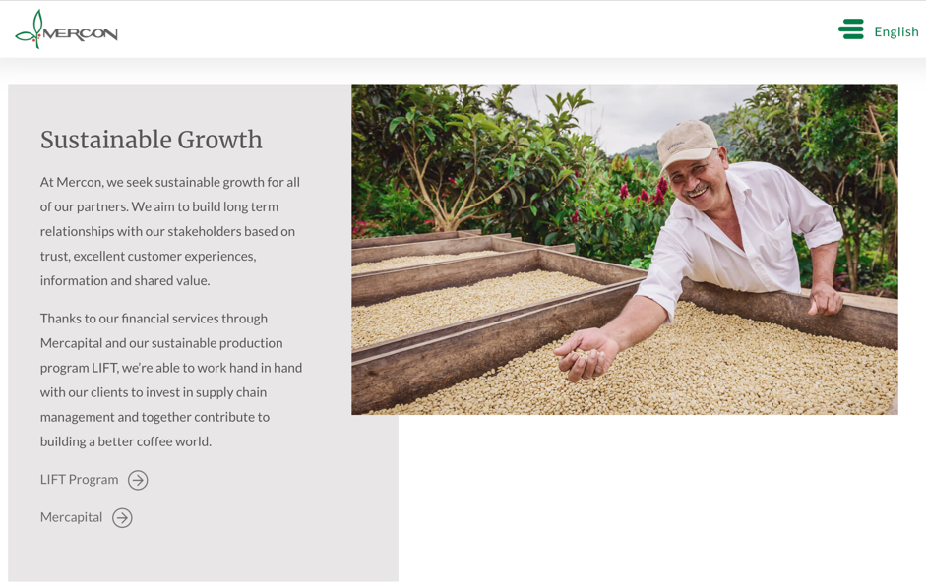
Supply Chain Controls
Suppliers can be influenced to reduce habitat conversion.
This may be accomplished via supplier codes of practice, technical assistance programs, financial incentives such as favorable credit terms or product pricing, or the purchase of certified products.

Slide 13
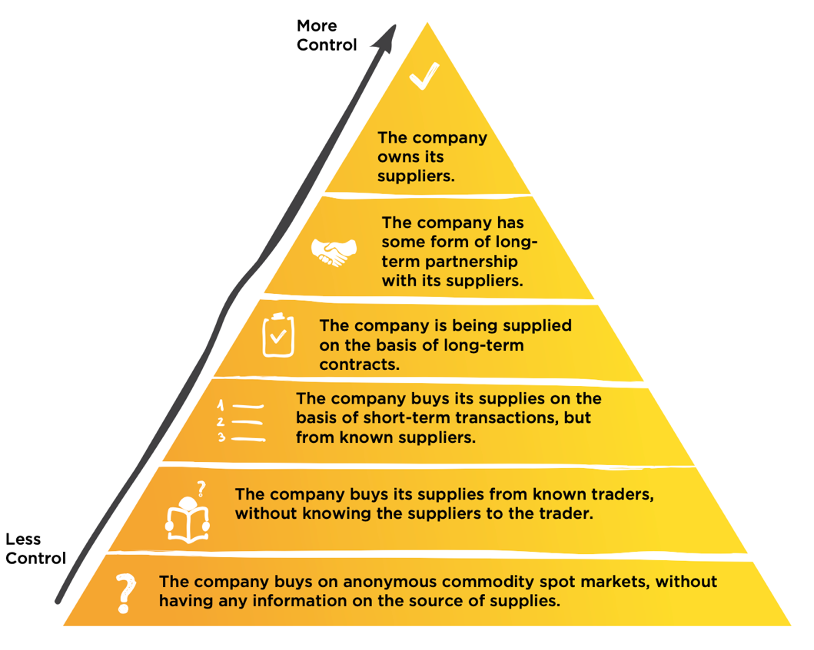
Supply Chain Controls
However, a company’s leverage to influence its suppliers varies according to their commercial relationship.
Source: CAO 2018, Supply Chain Business Opportunities and Risks.

Slide 14
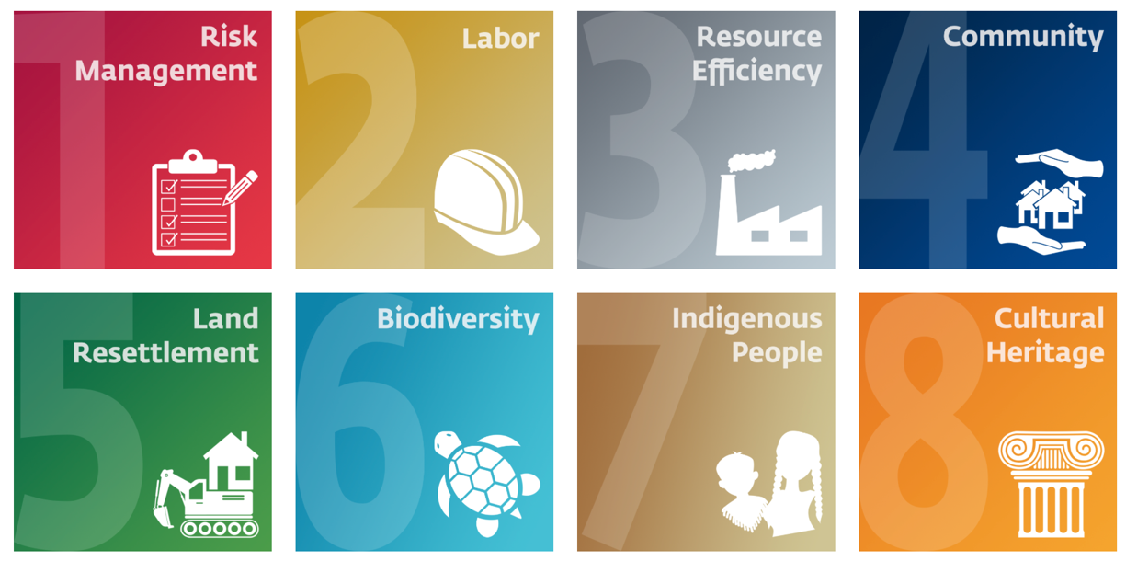
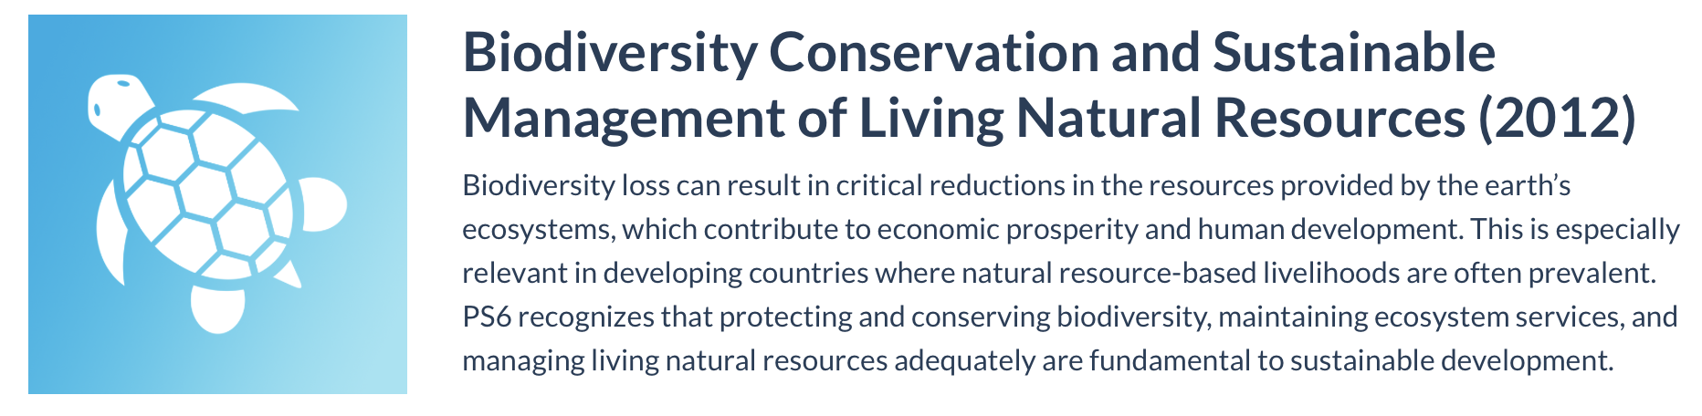
IFC Performance Standard 6 Requirements for Supply Chains
IFC seeks to ensure that its investments do not stimulate further habitat loss through its clients’ agricultural supply chains.
It manages this risk via Performance Standard 6 (PS6).

Slide 15
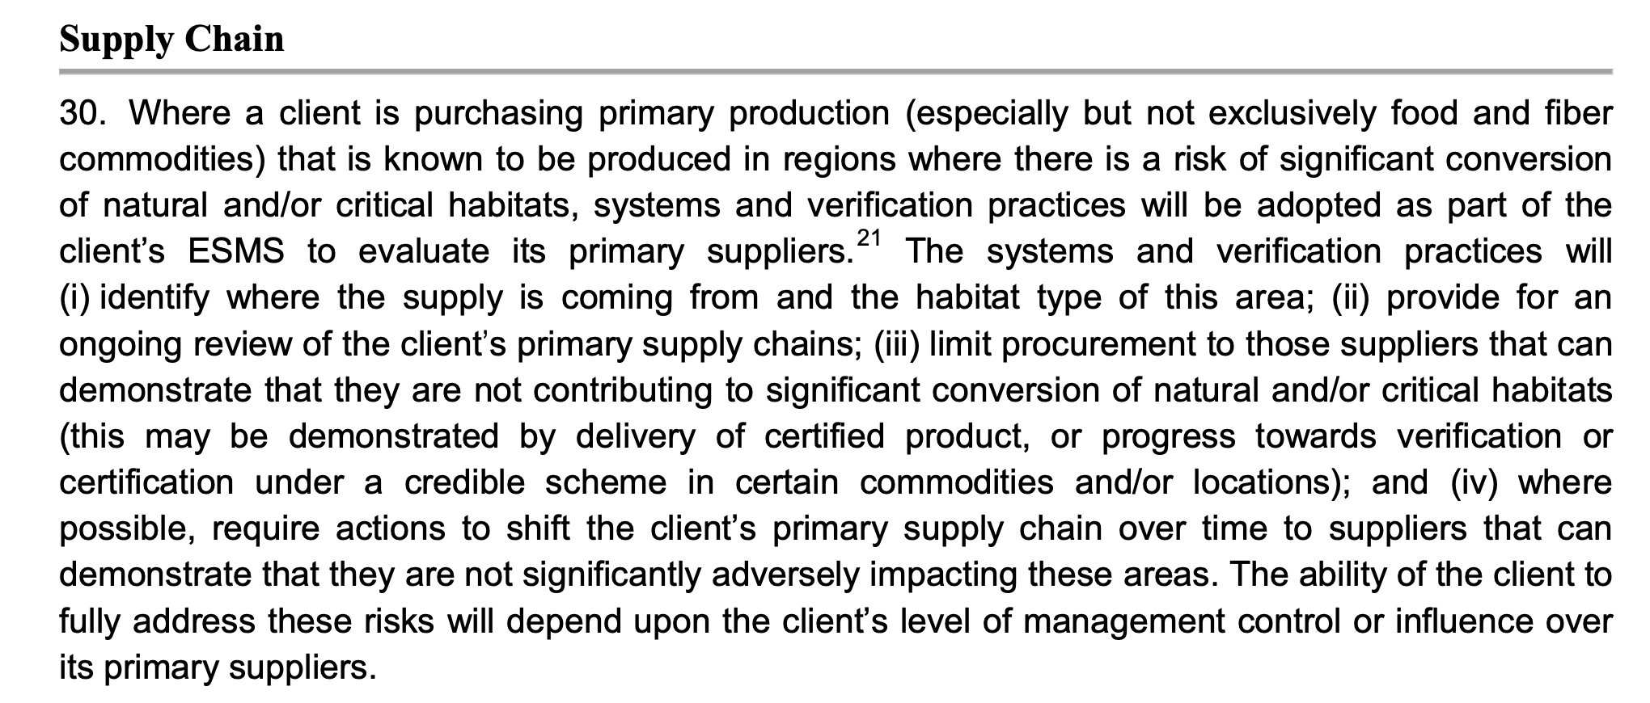
IFC Performance Standard 6 Requirements for Supply Chains

Slide 16
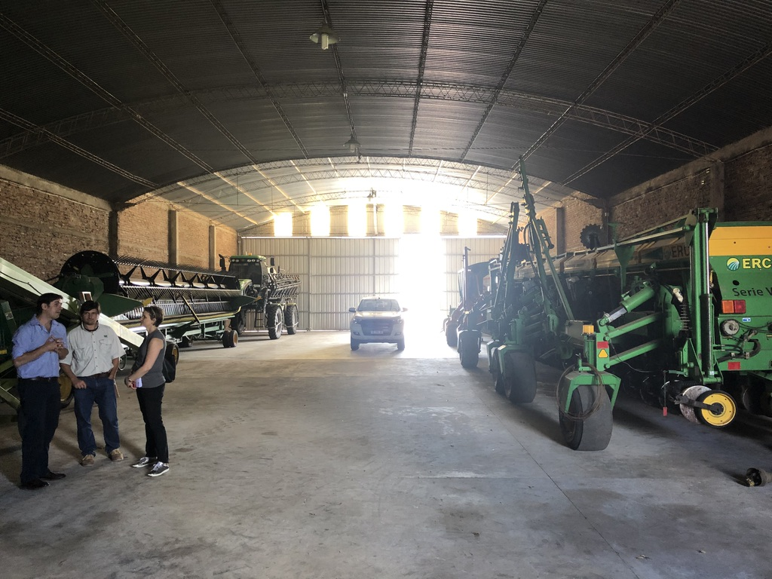
IFC Due Diligence for Supply Chains
PS6 requires clients to manage the risk of suppliers causing significant conversion of natural habitats to agriculture.
Proposed investments must undergo due diligence. Where there are manageable gaps that can be addressed, IFC may require clients to agree to an action plan to be executed once an investment is made. However, major gaps may result in a decision by IFC not to invest.

Slide 17
IFC Due Diligence for Supply Chains
Identify the origin of client’s supply
Determine if the origin is an area of significant habitat conversion
If so, determine if the client can find alternative suppliers
If this is not possible, confirm that the client can trace, verify, and control suppliers
Agree with client on necessary actions to address gaps in supply chain management, but only where gaps can be addressed in a reasonable timeframe

Slide 18
Module Summary
You should now understand:
The risks to biodiversity from agricultural supply chains
Key concepts including traceability, verification and supply chain controls
IFC Performance Standard 6 requirements for supply chains

Slide 19
Module 2: Case Studies

Slide 20
Module Learning Objectives
Upon completion of the module, you should understand:
A range of supply chain assessment issues for different contexts and commodities

Slide 21
Case Study Purpose
Case studies will cover:
  Traceability of primary production
  Significance of habitat conversion in the supply chain
  Verification and certification
  Management of risks

Slide 22
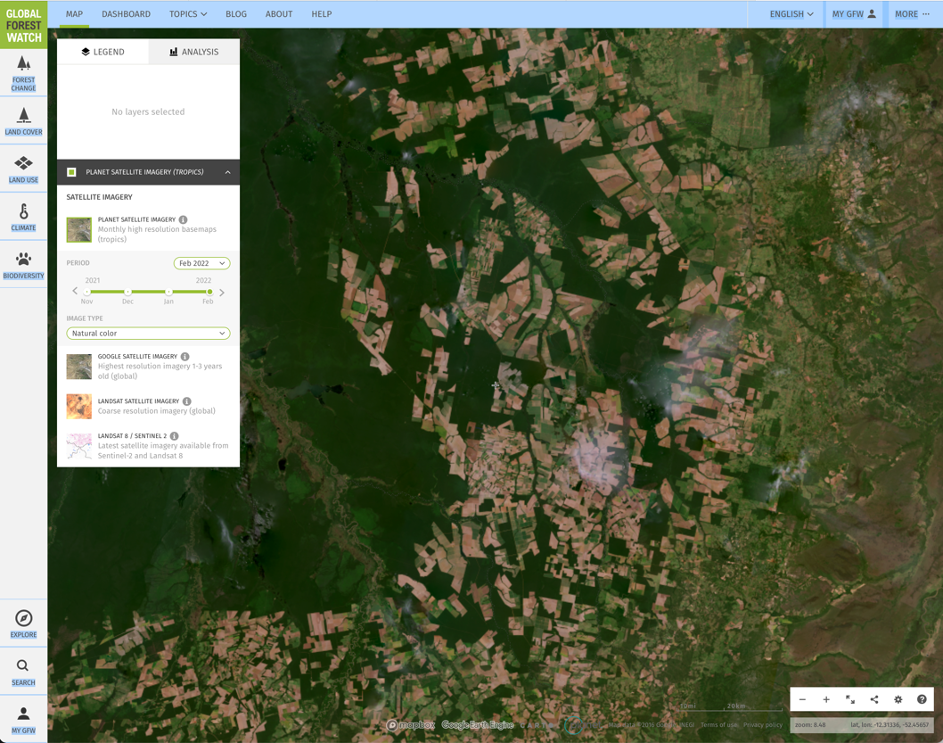
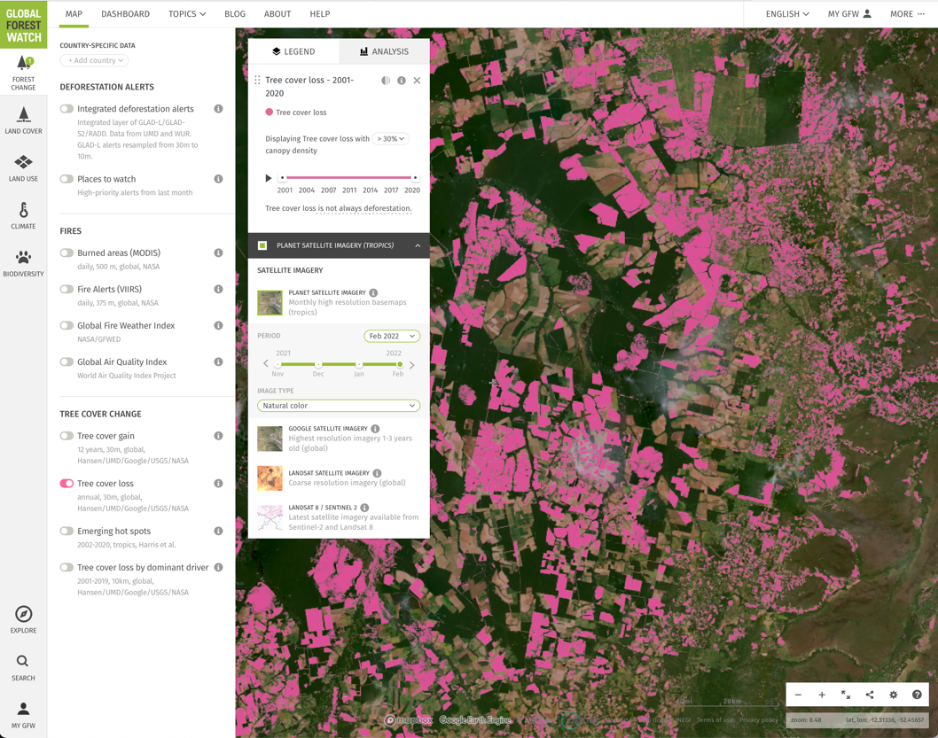
Case Study 1: Purchasing from large-scale producers of soy in Brazil
Soy is a major global commodity, generally produced on large-scale commercial farms.
In Latin America it has been a principal driver of habitat conversion in the Cerrado ecoregion of Brazil.

Slide 23
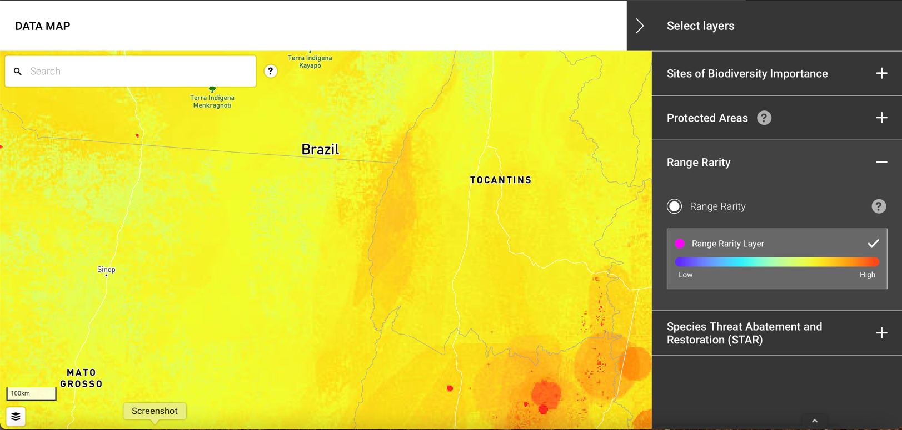
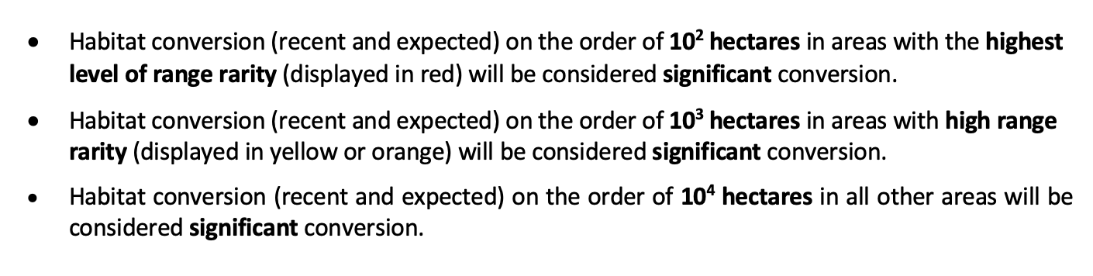
Case Study 1: Purchasing from large-scale producers of soy in Brazil
The Cerrado is a region of moderately high – to high importance for biodiversity. The scale of recent loss of natural habitat in this ecoregion is considered significant.
Therefore, PS6 requires client supply chains in this region to prohibit further clearing of natural habitat.

Slide 24
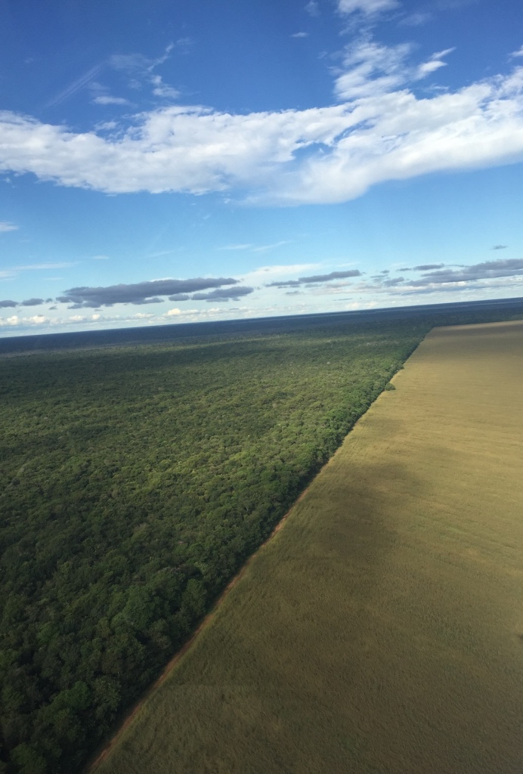
Case Study 1: Purchasing from large-scale producers of soy in Brazil
Additionally, clients must ensure that their suppliers are complying with local laws.
In Brazil, landowners must maintain a portion of their land in natural habitat (Legal Forest Reserve) as well as certain features such as riparian vegetation (Areas of Permanent Protection).

Slide 25
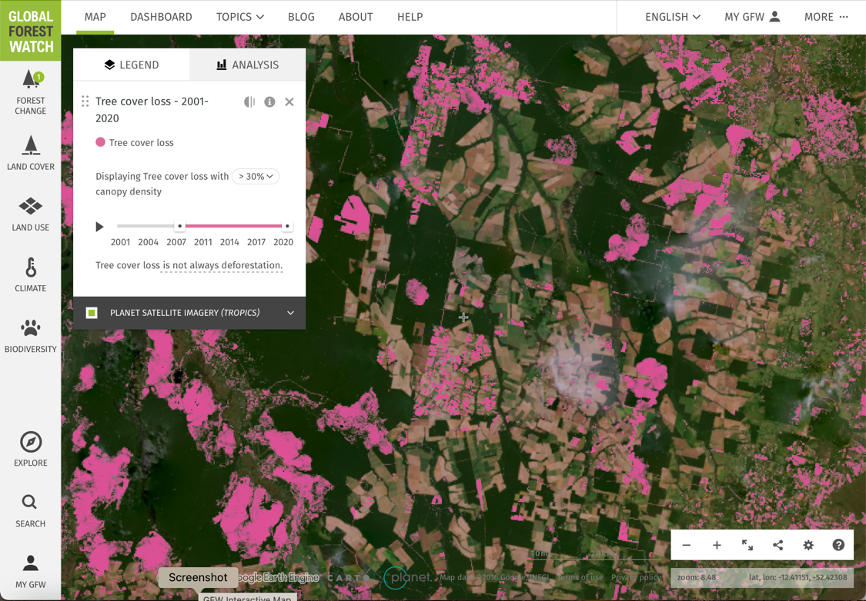
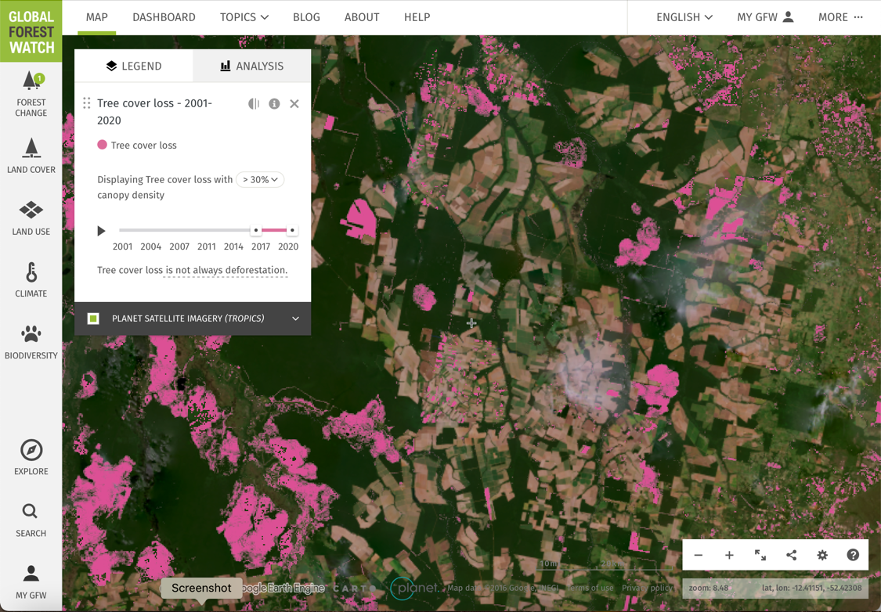
Case Study 1: Purchasing from large-scale producers of soy in Brazil
Habitat conversion after 2006
Habitat conversion after 2016
Finally, major voluntary cutoff dates for habitat conversion should be respected.
In Brazil, this includes:
Soy Moratorium cutoff date of 2006
Round Table on Sustainable Soy cutoff date of 2016

Slide 26
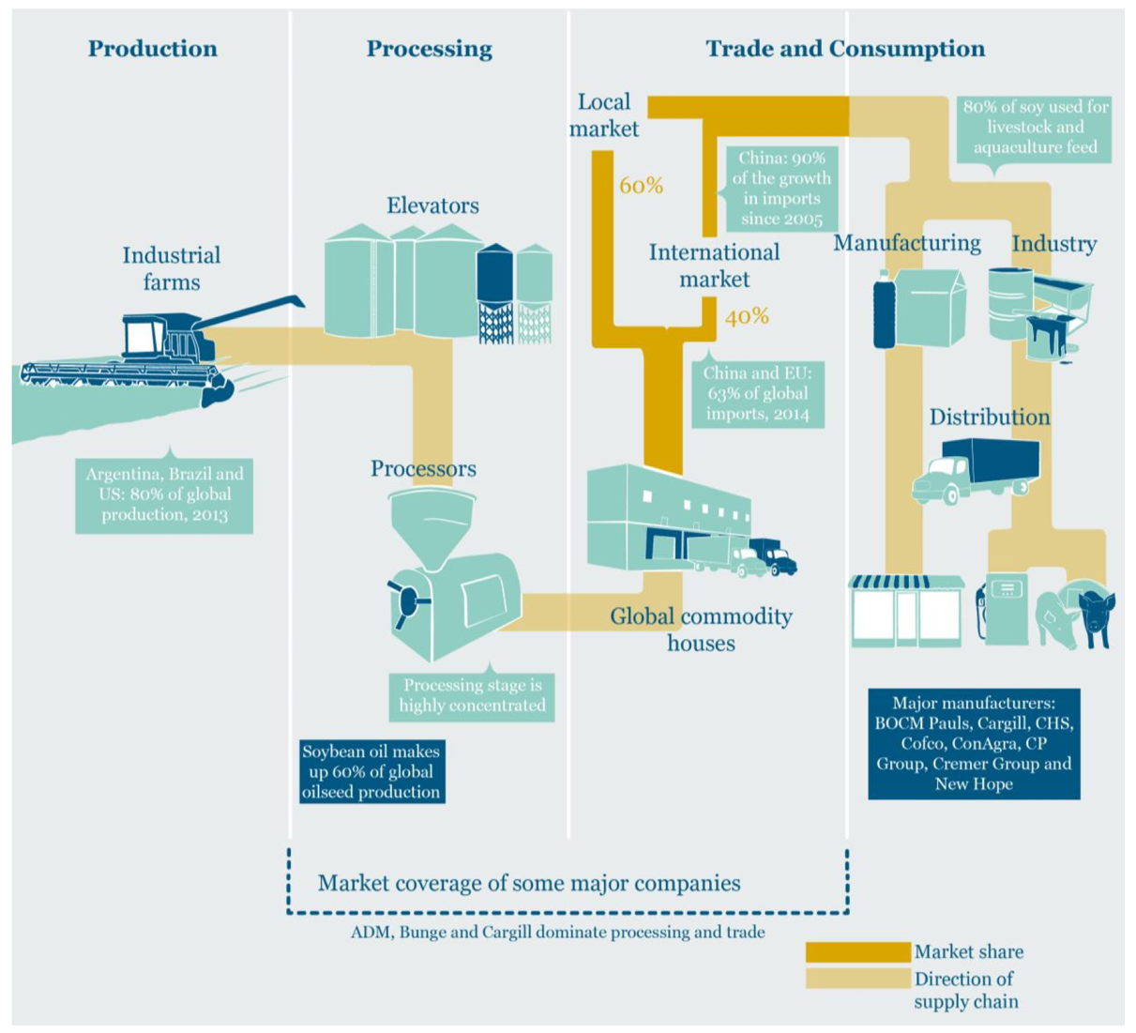
Case Study 1: Purchasing from large-scale producers of soy in Brazil
A challenge in the soy supply chain is traceability.
Intermediaries such as cooperatives, processors and traders may not record or share the origin of soy supplies.
Certification can resolve this issue, but only a small fraction of producers are certified.
To address this problem, the major commodity houses must require traceability. This is easiest where the buyer pre-finances purchases or is a provider of farm inputs. In the context of this relationship, the buyer can introduce a required code of practice that prohibits habitat conversion.
Source: Brack et al, 2016. Agricultural Commodity Supply Chains: Trade, Consumption and Deforestation.
Chatham House.

Slide 27
Case Study 1: Purchasing from large-scale producers of soy in Brazil
Once traceability is in place, site-level monitoring can be deployed to verify compliance with producer requirements.

Slide 28
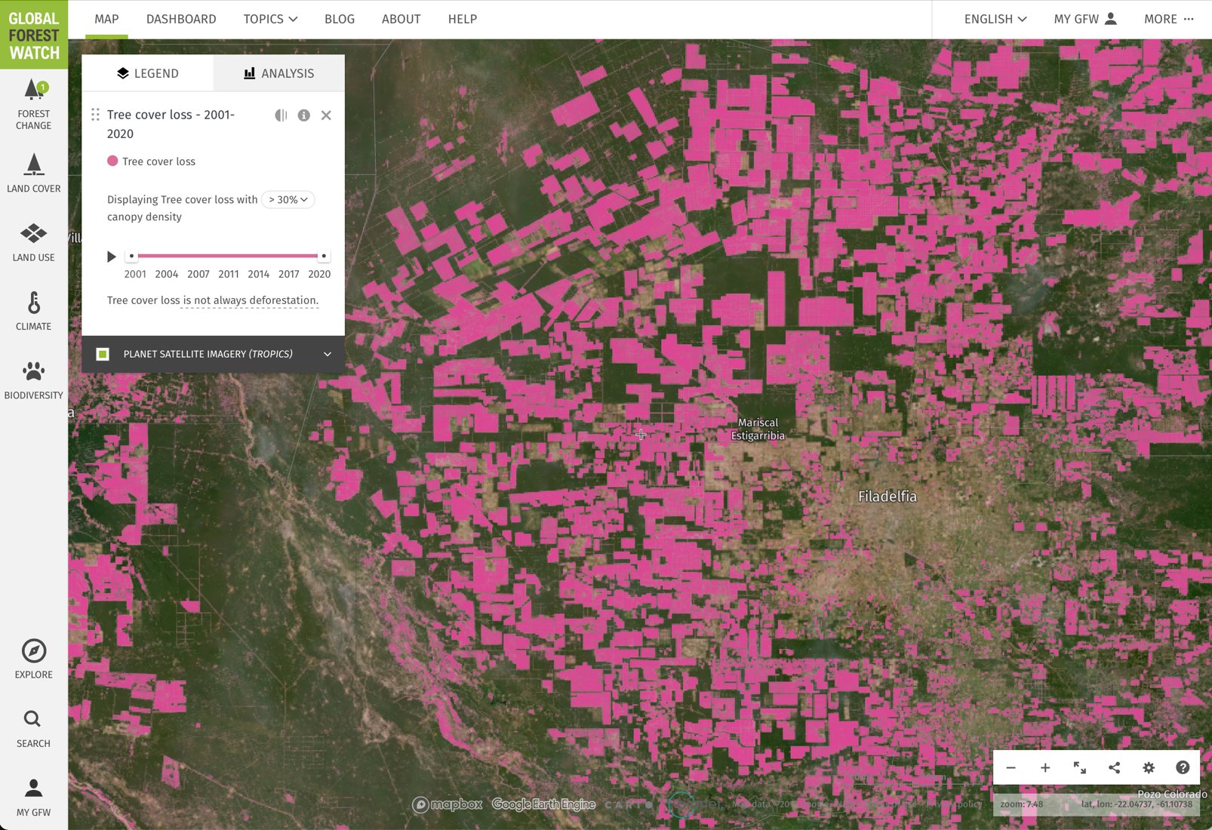
Case Study 2: Purchasing from large-scale producers of beef in Paraguay
Beef is a major global commodity, produced on ranches.
In Latin America it has often been at the vanguard of habitat conversion and has been the principal driver of dramatic biodiversity loss over the past 20 years in Paraguay’s Gran Chaco ecoregion.

Slide 29

Case Study 2: Purchasing from large-scale producers of beef in Paraguay
The Gran Chaco in Paraguay is a region of moderately high – to high importance for biodiversity. The scale of recent loss of natural habitat in this ecoregion is considered significant.
Therefore, PS6 requires client supply chains in this region to prohibit further clearing of natural habitat.

Slide 30
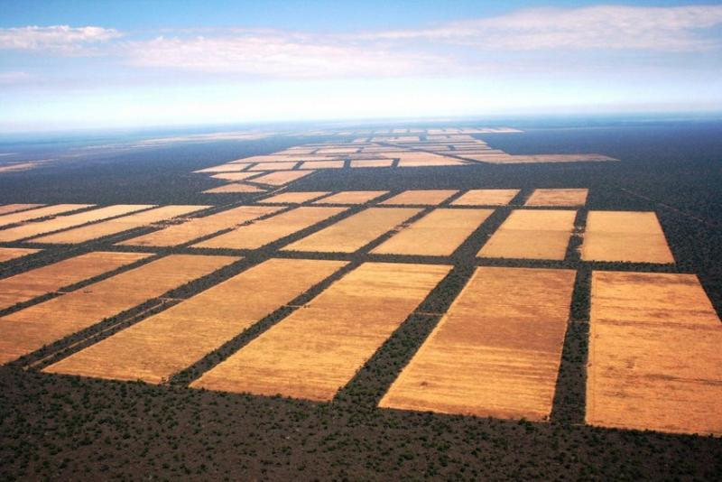
Case Study 2: Purchasing from large-scale producers of beef in Paraguay
Additionally, clients must ensure that their suppliers are complying with local laws.
In Paraguay, landowners must maintain a portion of their land in the Gran Chaco in natural habitat.
Source: World Land Trust

Slide 31
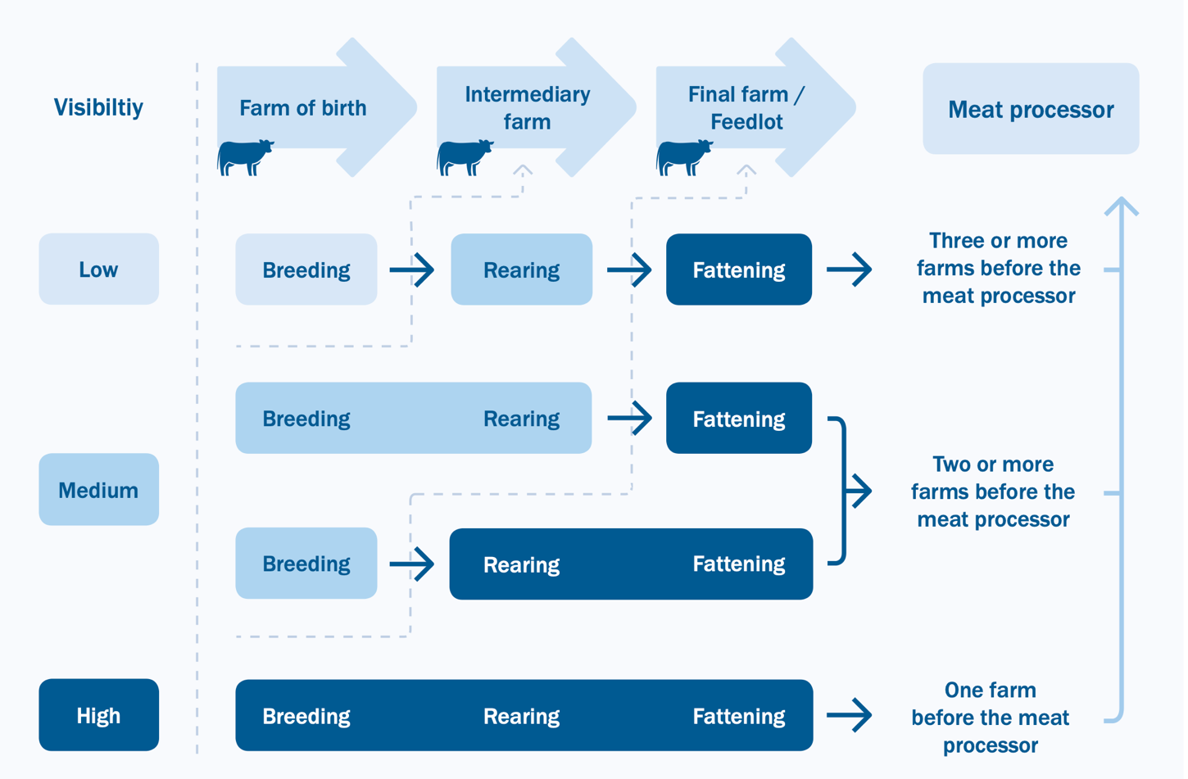
Case Study 2: Purchasing from large-scale producers of beef in Paraguay
A challenge in the beef supply chain is traceability.
Cattle may reside at a number of different ranches between birth and slaughter, requiring a system to track them along multiple suppliers.
Certification can resolve this issue, but only a small fraction of producers are certified.
To address this problem, existing cattle tracking systems used to control disease and ensure quality in other countries could potentially be adapted and used.
Source: ProForest, 2017. Socio-environmental monitoring of the cattle sector in Brazil.

Slide 32
Case Study 2: Purchasing from large-scale producers of beef in Paraguay
Once traceability is in place, site-level monitoring can be deployed to verify compliance with producer requirements.

Slide 33
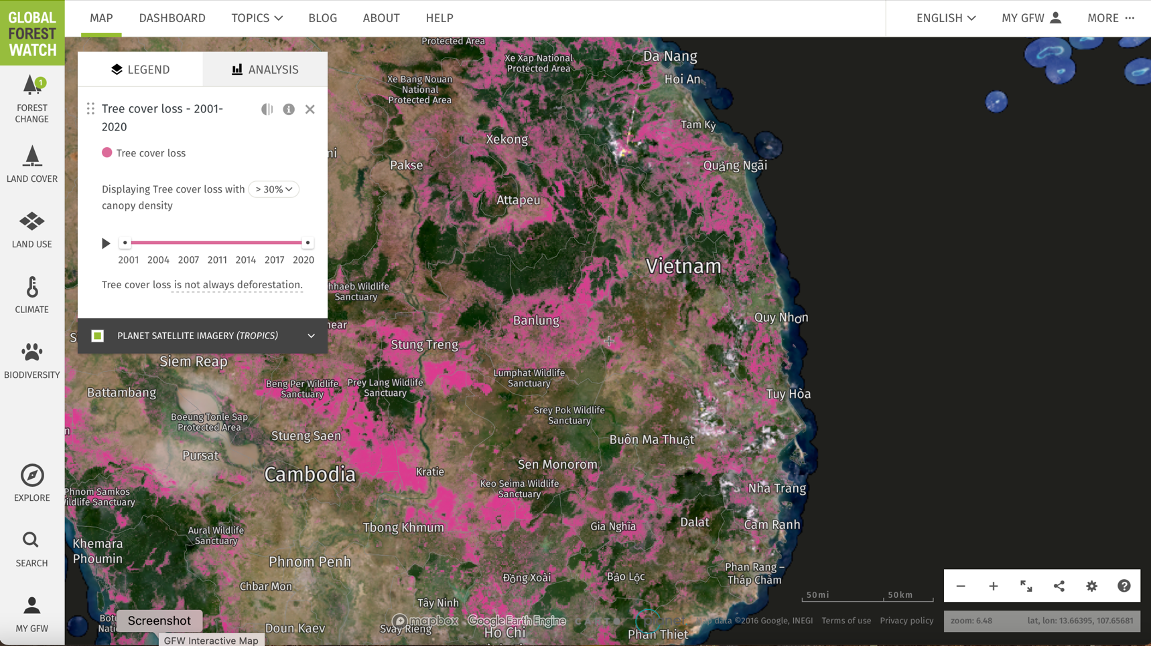
Case Study 3: Purchasing from small-scale producers of coffee in Vietnam
Coffee is a major global commodity, often produced on small farms.
High quality Arabica coffee is produced at higher elevations in the tropics, in landscapes that often have high levels of species diversity and endemism.
In the worst-case scenario, natural habitat is converted to full-sun coffee production. The impacts of coffee production can be reduced through organic methods and agro-forestry, but this still results in some degradation of natural ecosystems.

Slide 34
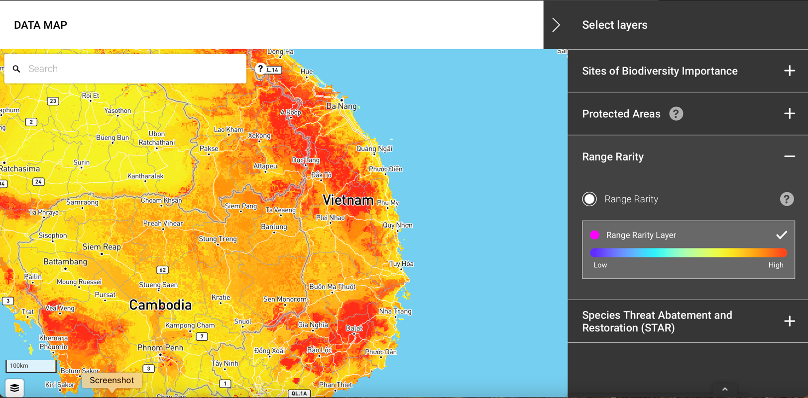
Case Study 3: Purchasing from small-scale producers of coffee in Vietnam
Vietnam is a region of high importance for biodiversity. The scale of recent loss of natural habitat in this ecoregion is considered significant.
Therefore, PS6 requires client supply chains in this region to prohibit further clearing and degradation of natural habitat.

Slide 35
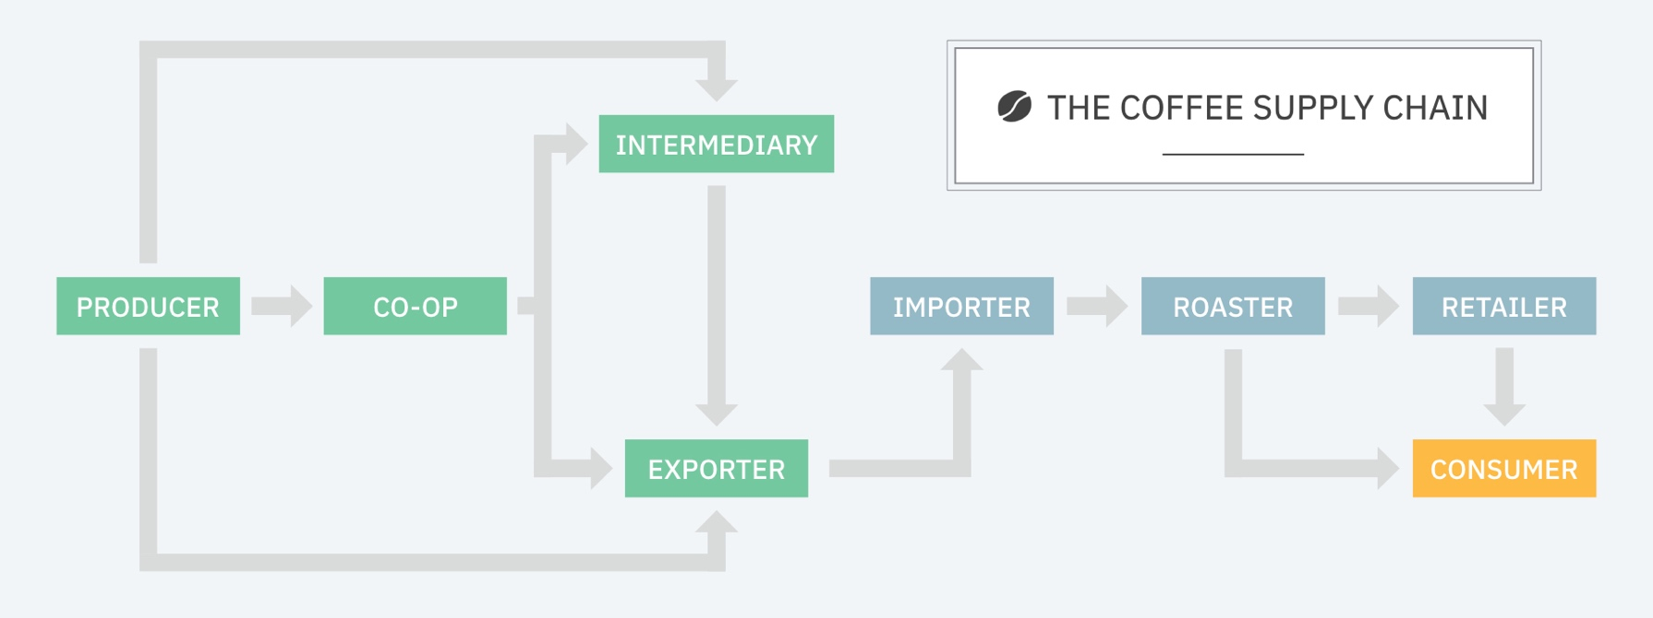
Case Study 3: Purchasing from small-scale producers of coffee in Vietnam
Source: Widdifield, 2018. Brewing Blockchain: Tracing ethically sourced coffee. IBM.
A challenge in the coffee supply chain is traceability.
Coffee beans may pass through many hands before arriving at the more visible players, such as importers, roasters, and retailers.
Certification can resolve this issue, but only a small fraction of producers are certified.

Slide 36
Case Study 3: Purchasing from small-scale producers of coffee in Vietnam
To address this problem, exporters can engage with small producers via the offering of financial and technical services to support their operations. In this context, producer codes of practice can be introduced.

Slide 37
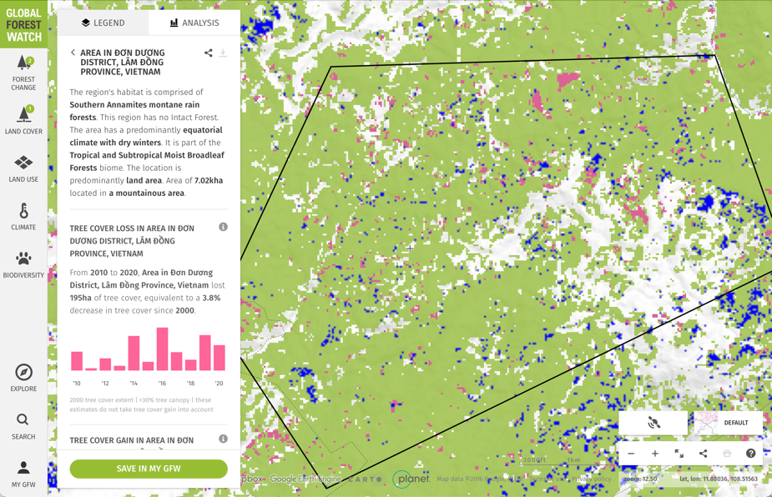
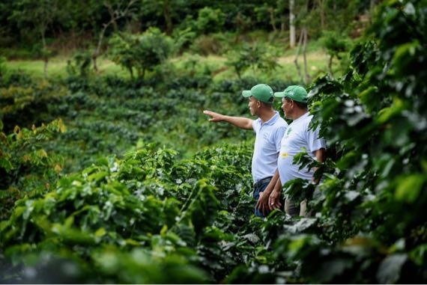
Case Study 3: Purchasing from small-scale producers of coffee in Vietnam
Once traceability is in place, site-level monitoring can be deployed to verify compliance with producer requirements.
The small scale of farms may require on-the-ground verification.
Source: Mercon

Slide 38
Module Learning Objectives
You should now understand:
A range of supply chain assessment issues for different contexts and commodities

Slide 39
Remember: IFC Due Diligence Process
IFC Due Diligence
Identify the origin of client’s supply
Determine if the origin is an area of significant habitat conversion
If so, determine if the client can find alternative suppliers
If this is not possible, confirm that the client can trace, verify, and control suppliers
Agree with client on necessary actions to address gaps in supply chain management, but only where gaps can be addressed in a reasonable timeframe

Slide 40
Course Summary
You should now understand:
The risks to biodiversity from agricultural supply chains
Key concepts including traceability, verification and supply chain controls
IFC Performance Standard 6 requirements for supply chains
A range of supply chain assessment issues for different contexts and commodities
You should be able to evaluate your client’s compliance with Performance Standard 6 as it applies to agricultural supply chains or develop a plan of action to ensure they are prepared for IFC financing.

Slide 41
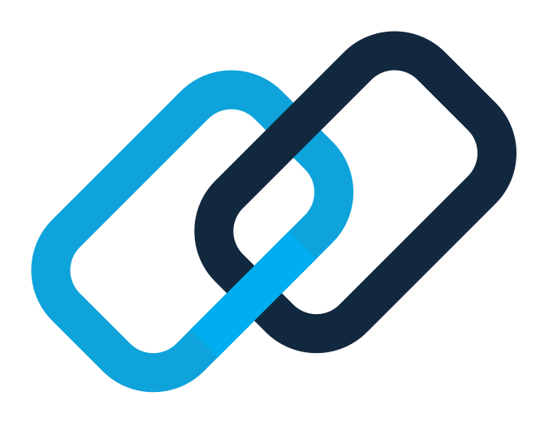

Thank you!
For more information:
www.ifc.org/sustainability
asksustainability@ifc.org

