Slide 1
RETHINKING HATCHERIES
A REVIEW OF THE COSTS AND BENEFITS
DAVID PHILIPP
JULIE CLAUSSEN

Slide 2
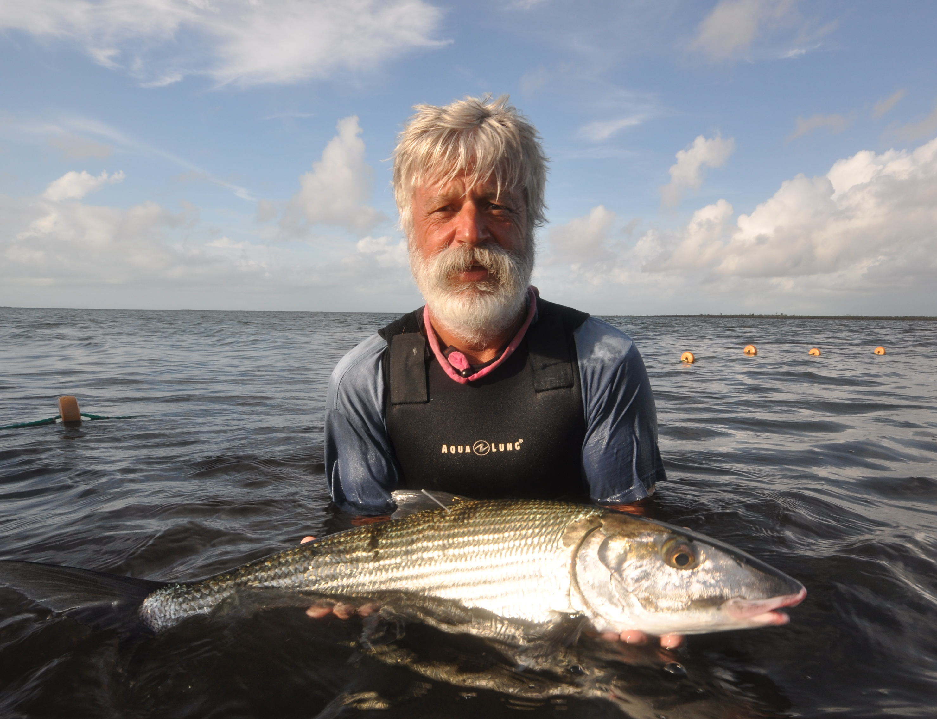
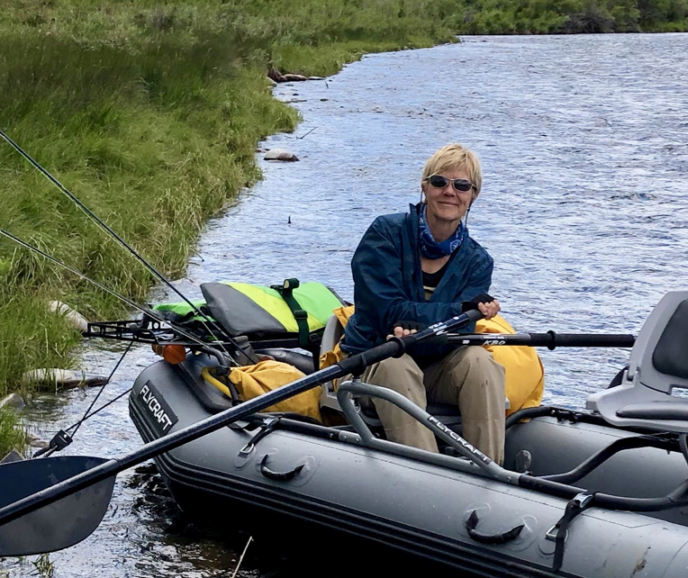

DAVID PHILIPP
Fisheries Conservation Foundation • Chair, Board of Directors
Professor Emeritus, University of Illinois
JULIE CLAUSSEN
Fisheries Conservation Foundation • Director of Operations
Fisheries Biologist, University of Illinois
David Philipp and Julie Claussen

Slide 3
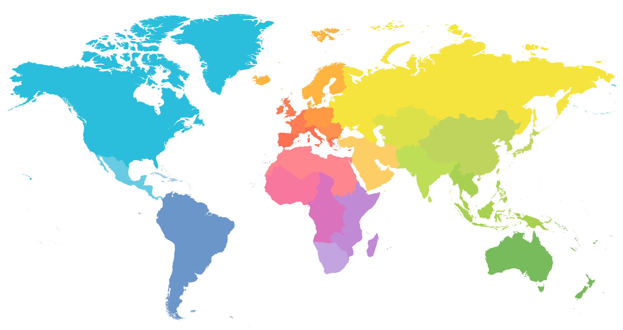
FCF works with strategic partners around the world to
generate science-based solutions for today’s complex
freshwater and marine resource challenges.
V
V
V
V
V
V
V
V
V
V
V
David Philipp and Julie Claussen

Slide 4
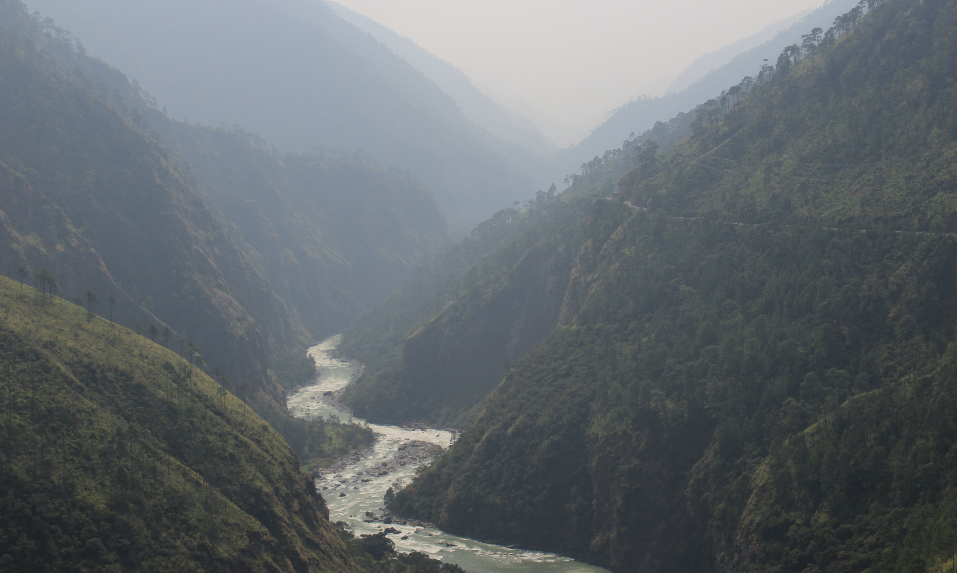

Bhutan’s Golden Mahseer Research and Conservation Project:
Using Radio Telemetry to Define Spawning Migrations
David Philipp and Julie Claussen

Slide 5
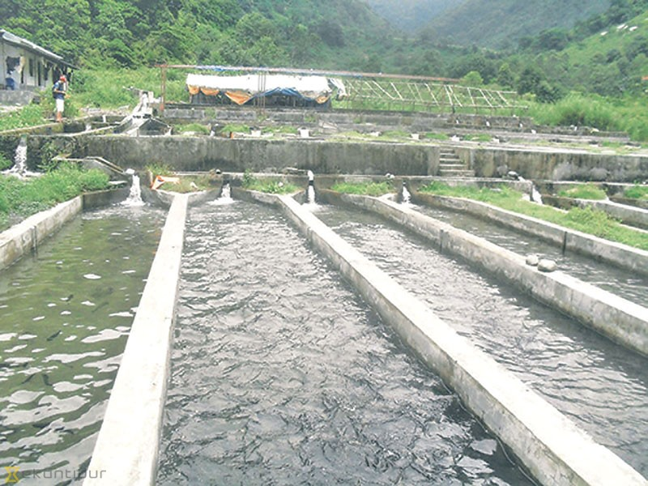
Bhutan’s Mitigation Options
David Philipp and Julie Claussen

Slide 6

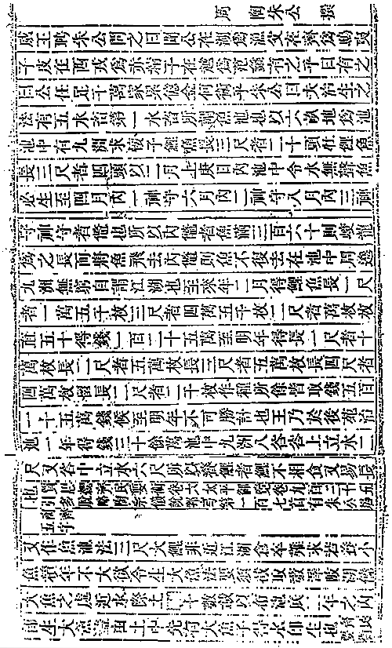
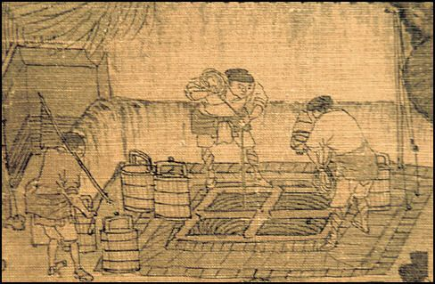
HISTORY OF FISH CULTURE
The first record is from 475 BC, a Chinese man Fan Lai wrote a book to teach others how to raise fish for food.
The Classic of Fish Culture
David Philipp and Julie Claussen

Slide 7
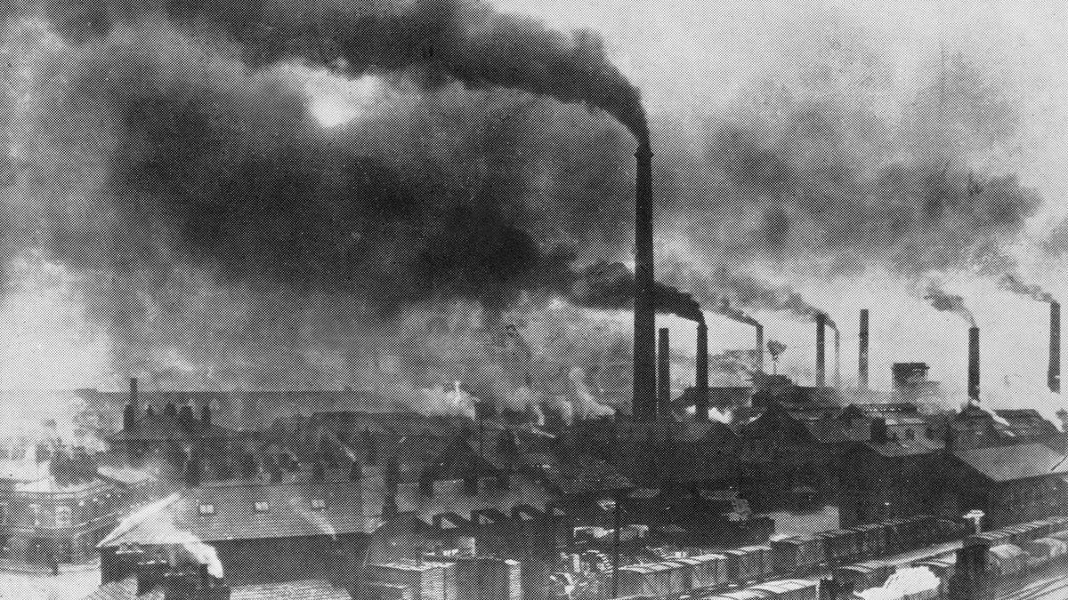
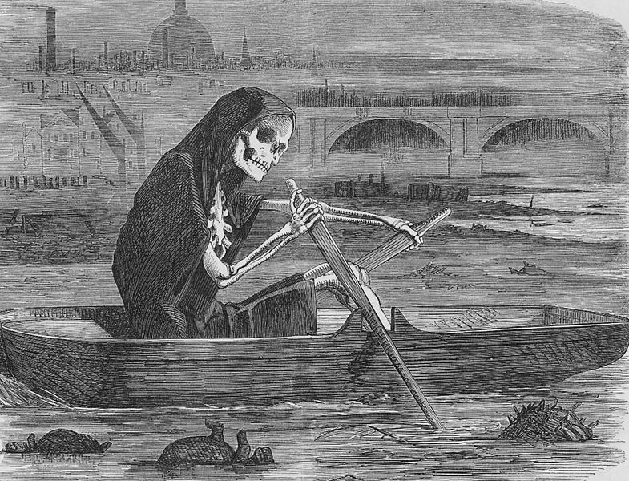
HISTORY OF FISH CULTURE
Impact of the Industrial Revolution
David Philipp and Julie Claussen

Slide 8
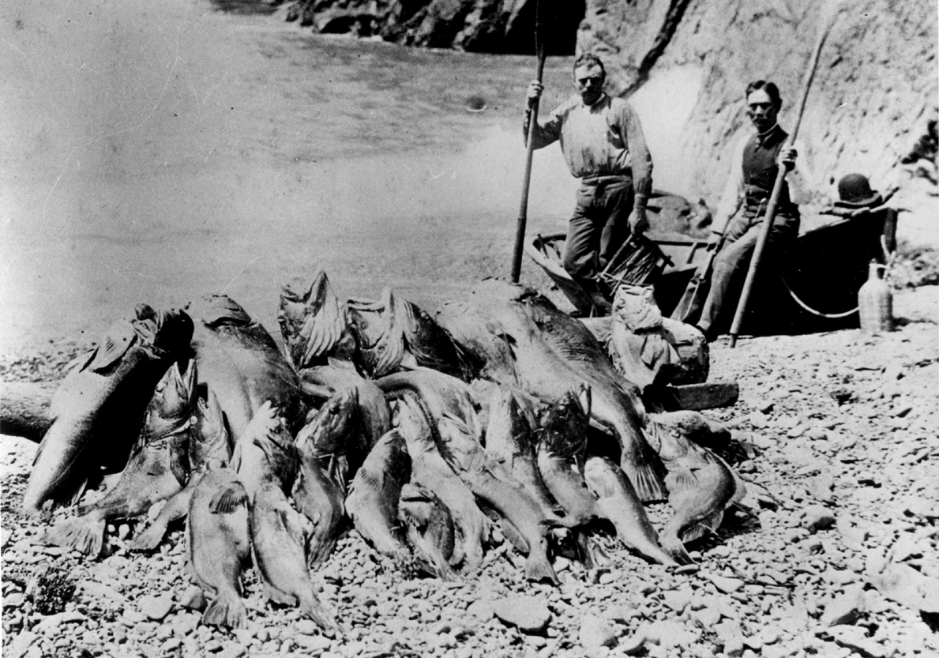
HISTORY OF FISH CULTURE
David Philipp and Julie Claussen

Slide 9
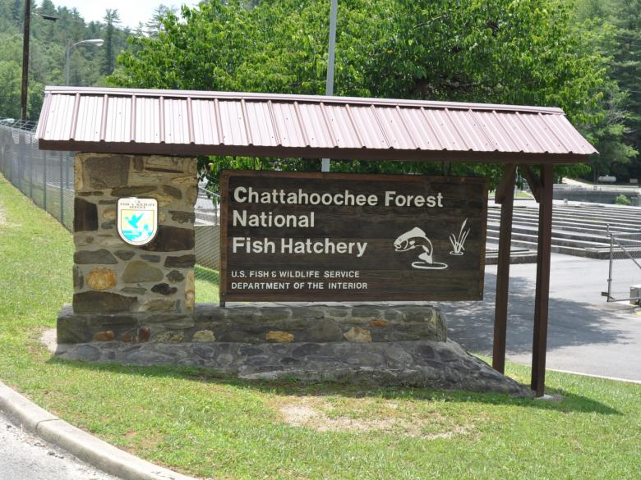
HISTORY OF FISH CULTURE
The National Fish Hatchery System was established in the U.S. in 1871.
The request for 2019 budget for the National Fish Hatchery System operation and maintenance was $82.2 million.
David Philipp and Julie Claussen

Slide 10
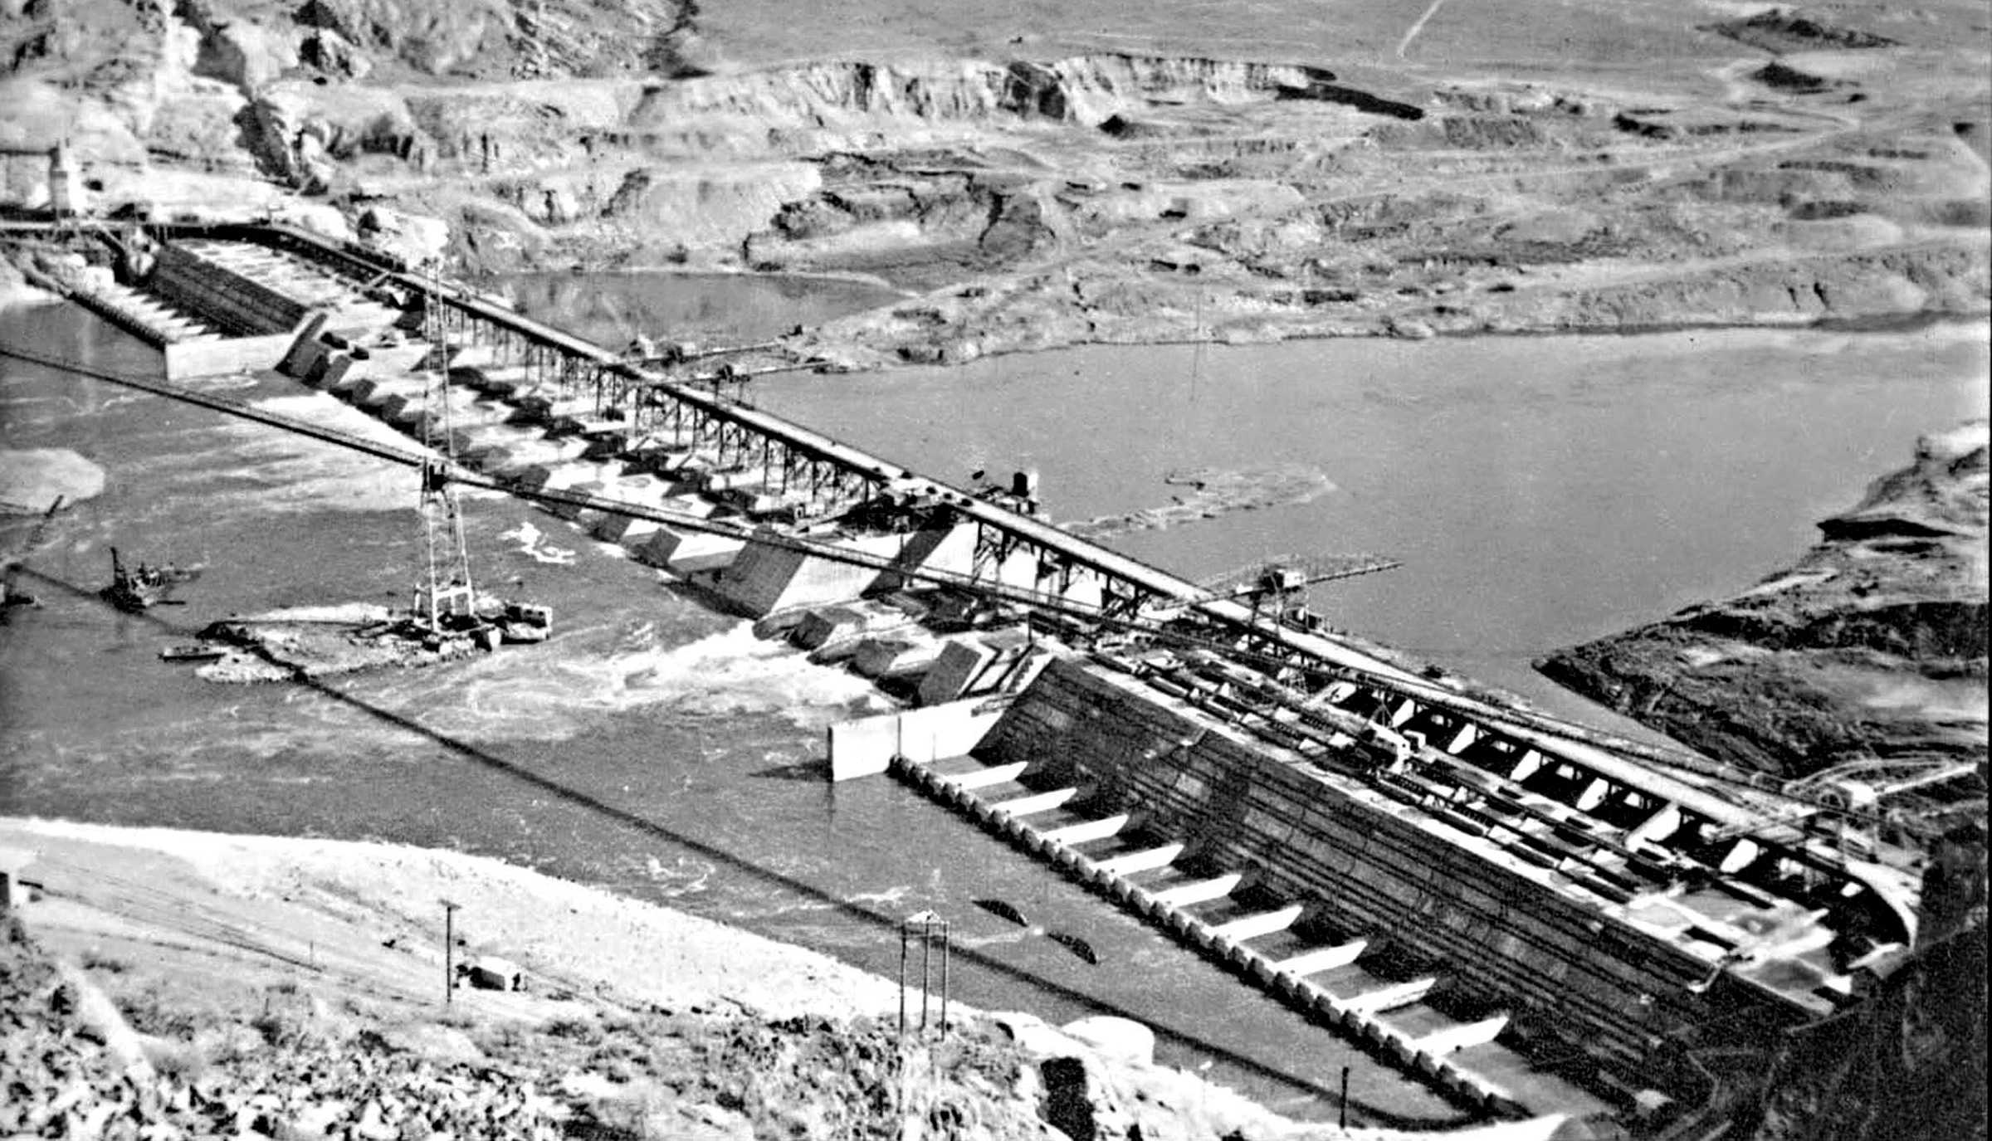
HISTORY OF FISH CULTURE
DAM CONSTRUCTION IN EARLY 1940’S-60’S CAUSED GROWTH IN HATCHERIES
David Philipp and Julie Claussen

Slide 11
HISTORY OF FISH CULTURE
TRANSFER GRAPHIC
Map of US with arrows showing fish transfers.
DEMAND FOR RECREATIONAL FISHING IN 1970’S FUELED FISH TRANSFERS
David Philipp and Julie Claussen

Slide 12
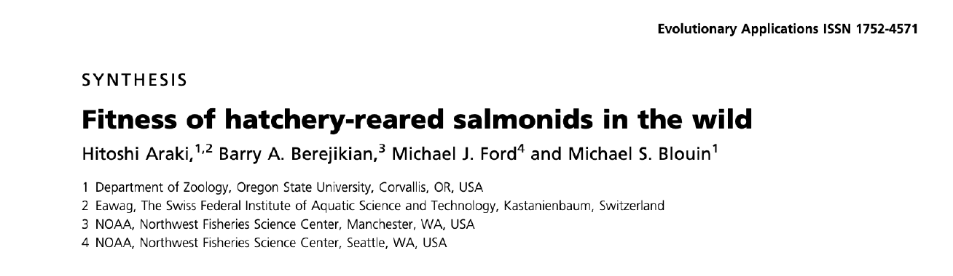
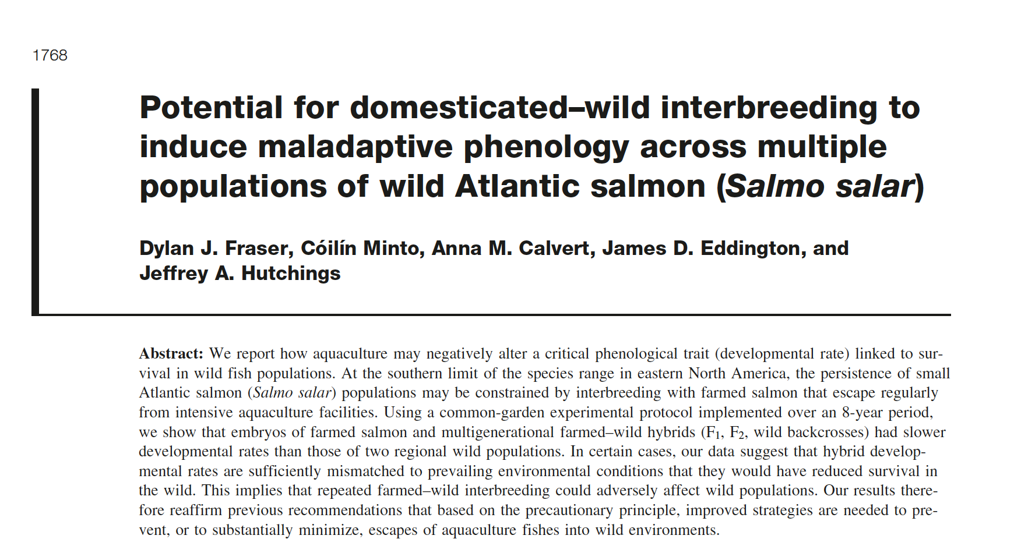
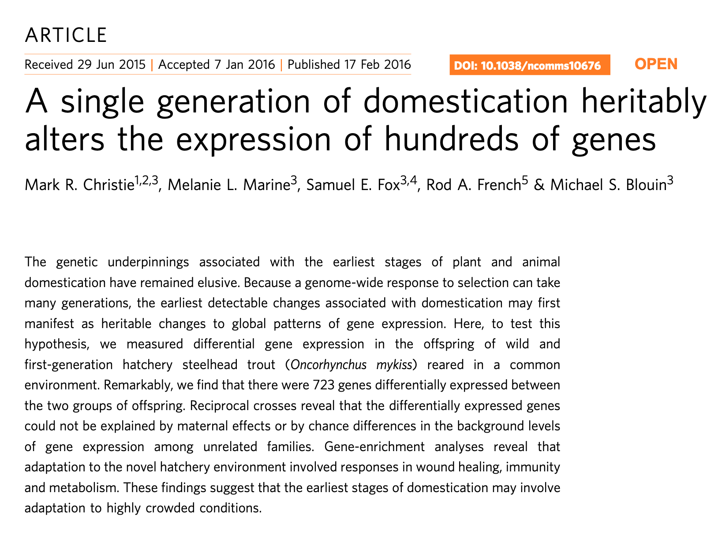
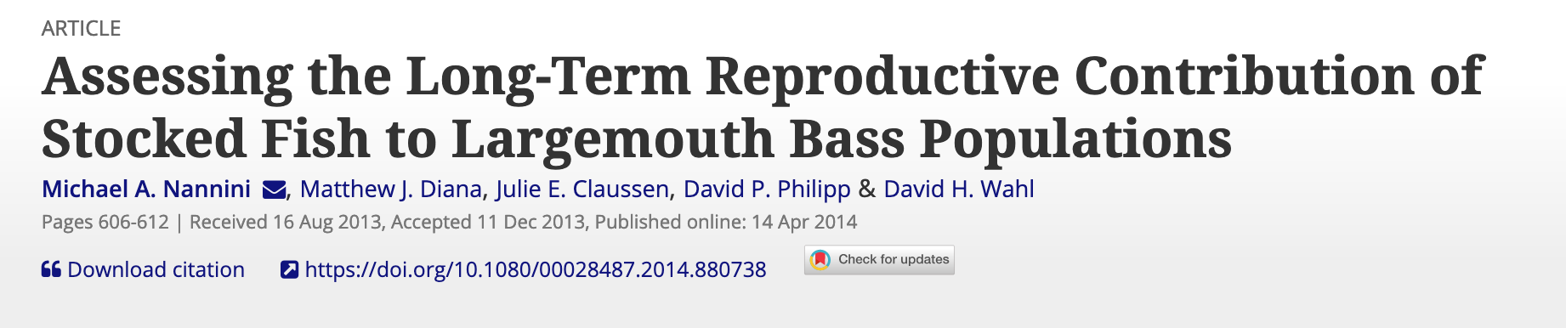
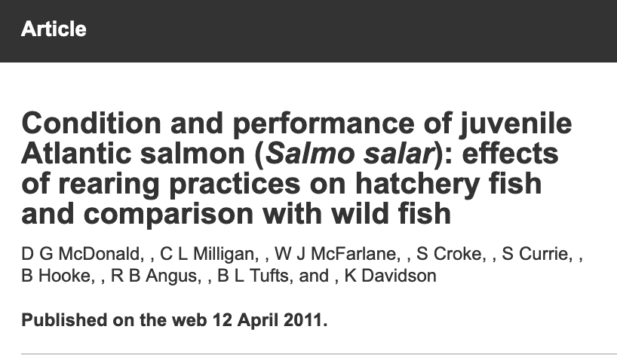
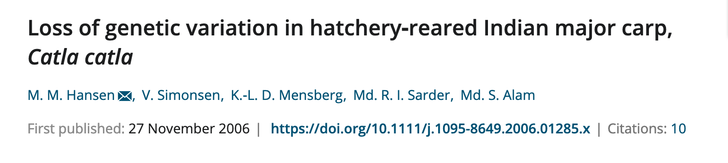
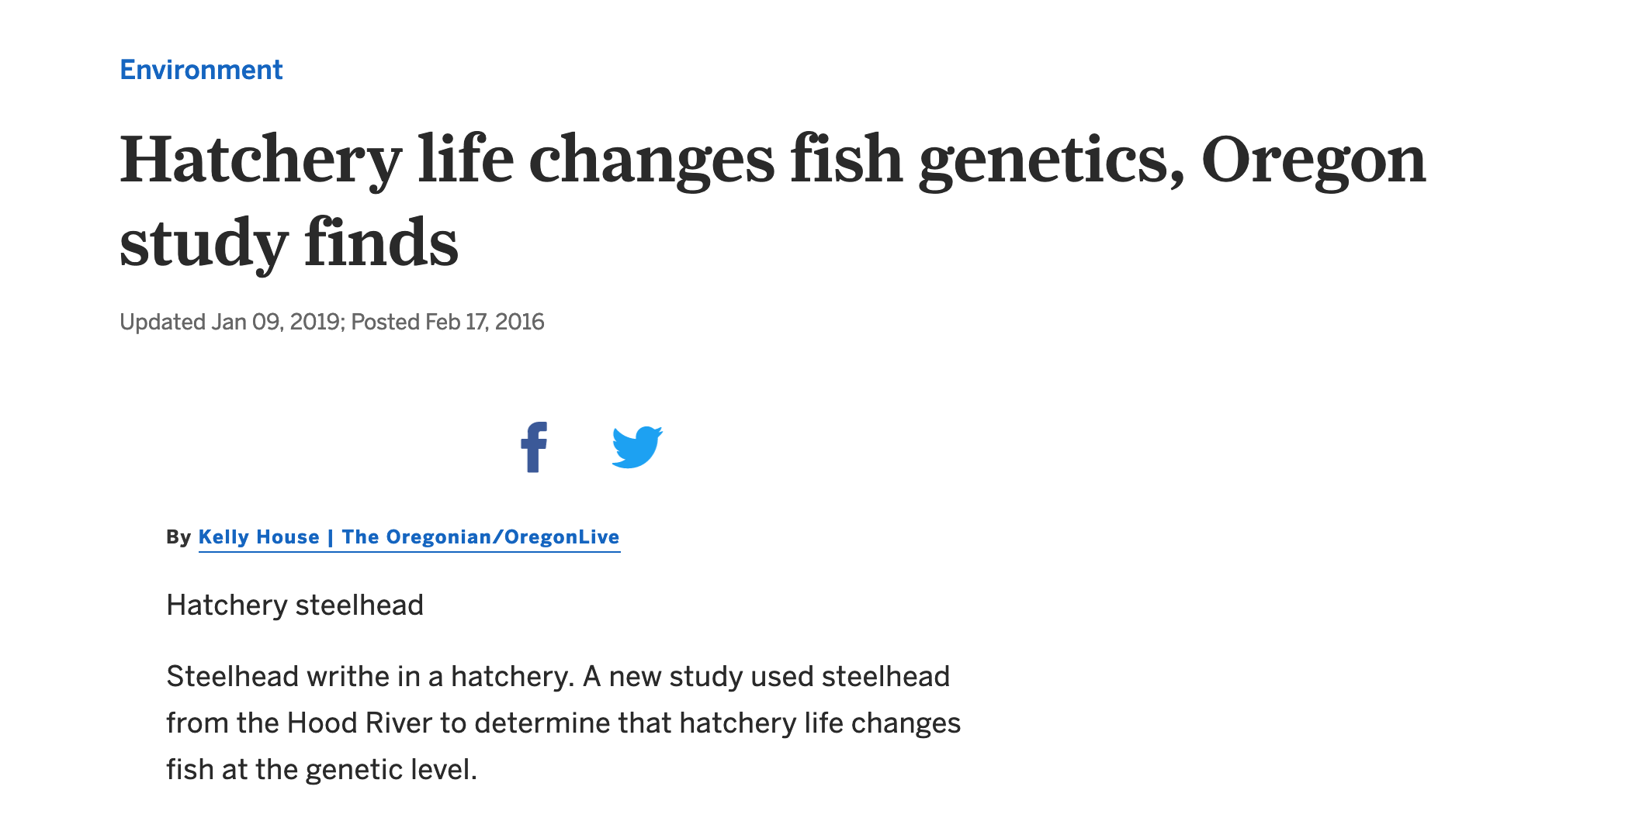
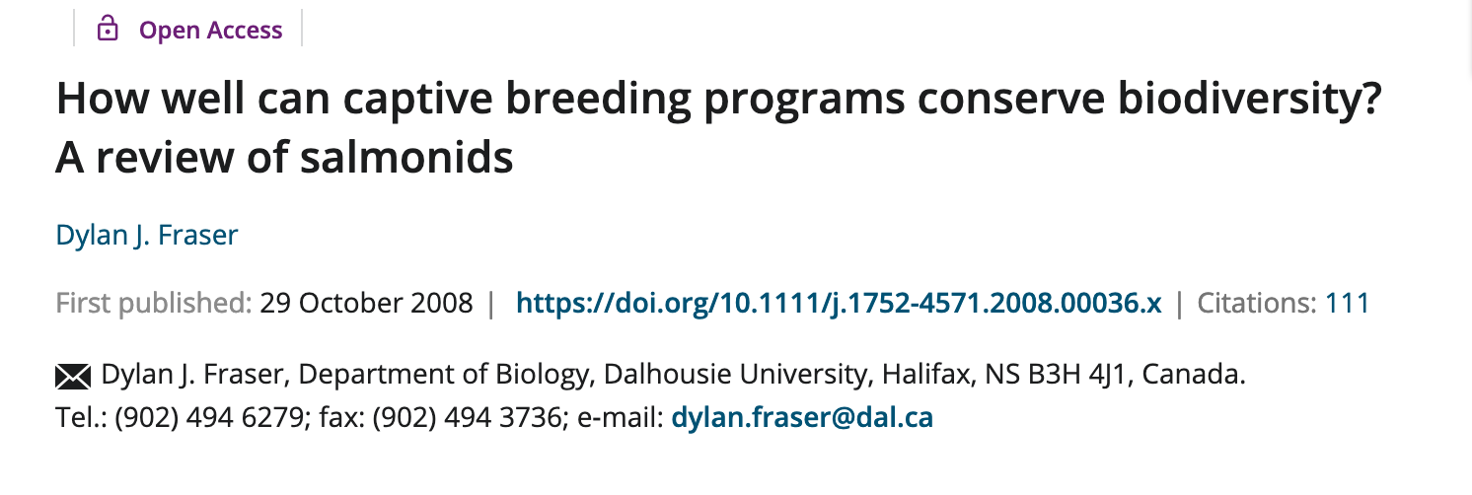
RESEARCH ON THE CONSEQUENCES

Slide 13
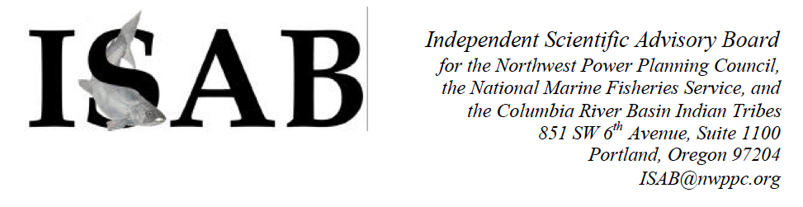

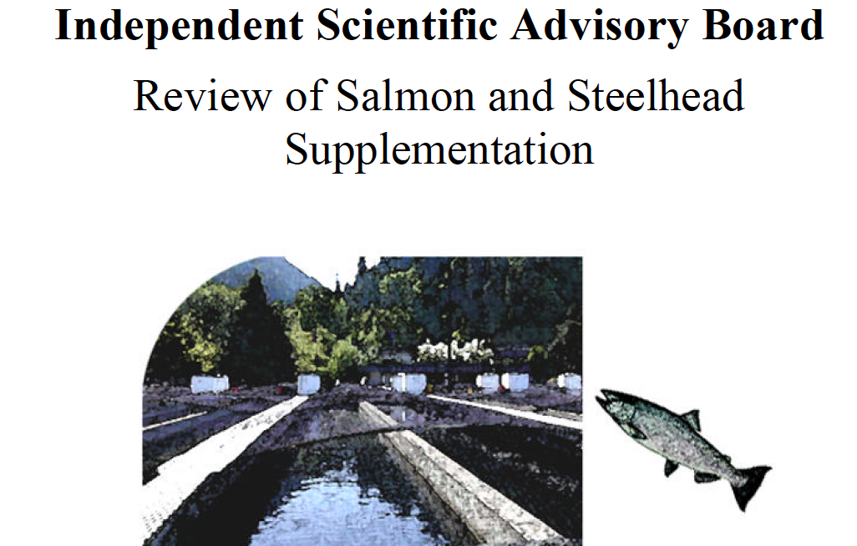
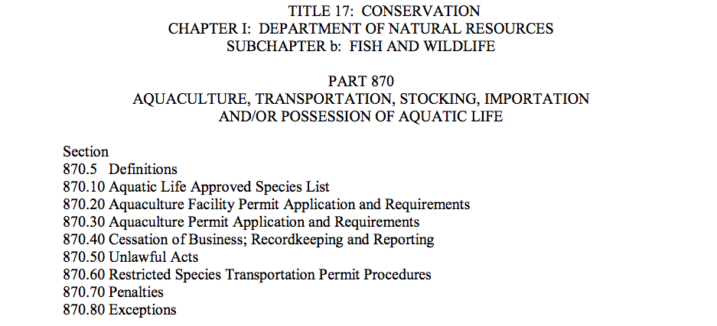
POLICY ACTIONS
ILLINOIS FISH CULTURE ADVISORY COMMITTEE

Slide 14
HISTORY OF FISH CULTURE
AFTER 150 YEARS – WHERE ARE WE?
THEN
FISH CULTURE = FISHERIES MANAGEMENT
NOW
FISHERIES MANAGEMENT = RANGE OF TOOLS
Habitat Conservation
Monitoring of Populations
Ecosystem Approaches
TRANSFER GRAPHIC
David Philipp and Julie Claussen

Slide 15
DEFINITIONS
WHY STOCK FISH?
OBJECTIVES:
Supplement a Depressed Population
Re-introduce an Extirpated Population
Establish a New Population
STRATEGY:
Produce Fish Outside of the Target Environment
Raise Fish in a Facility that Minimizes Mortality
Introduce Fish into the Target Environment in Large Numbers
Stocked Juveniles Grow up to be Adults that Enhances Numbers
…it all seems so easy!
David Philipp and Julie Claussen

Slide 16
RETHINKING THE NEED FOR HATCHERIES
PRESENTATION TODAY
COMMON VOCABULARY – WHAT IS A HATCHERY
NATURAL REPRODUCTION VS HATCHERY REPRODUCTION
ECOLOGICAL RISKS
GENETIC RISKS
HOW TO DECIDE IF HATCHERIES ARE THE BEST CHOICE
DISCUSSION
David Philipp and Julie Claussen

Slide 17
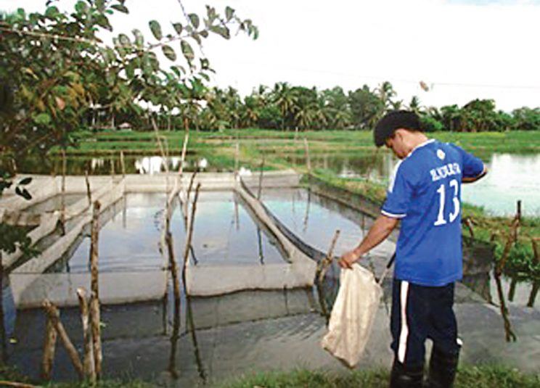
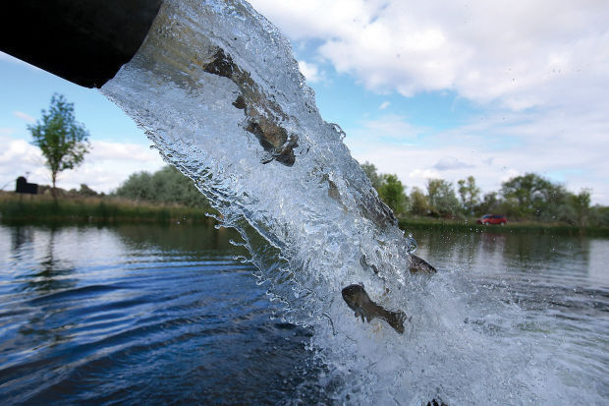
DEFINITIONS
WHY ARE FISH CULTURED?
AQUACULTURE
SUPPLEMENTAL STOCKING
David Philipp and Julie Claussen

Slide 18
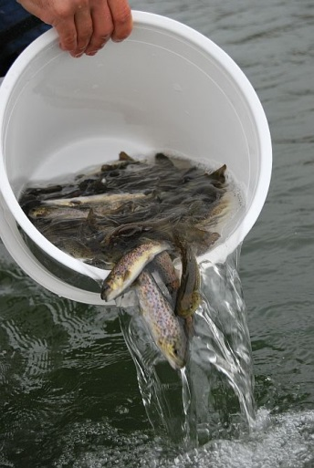
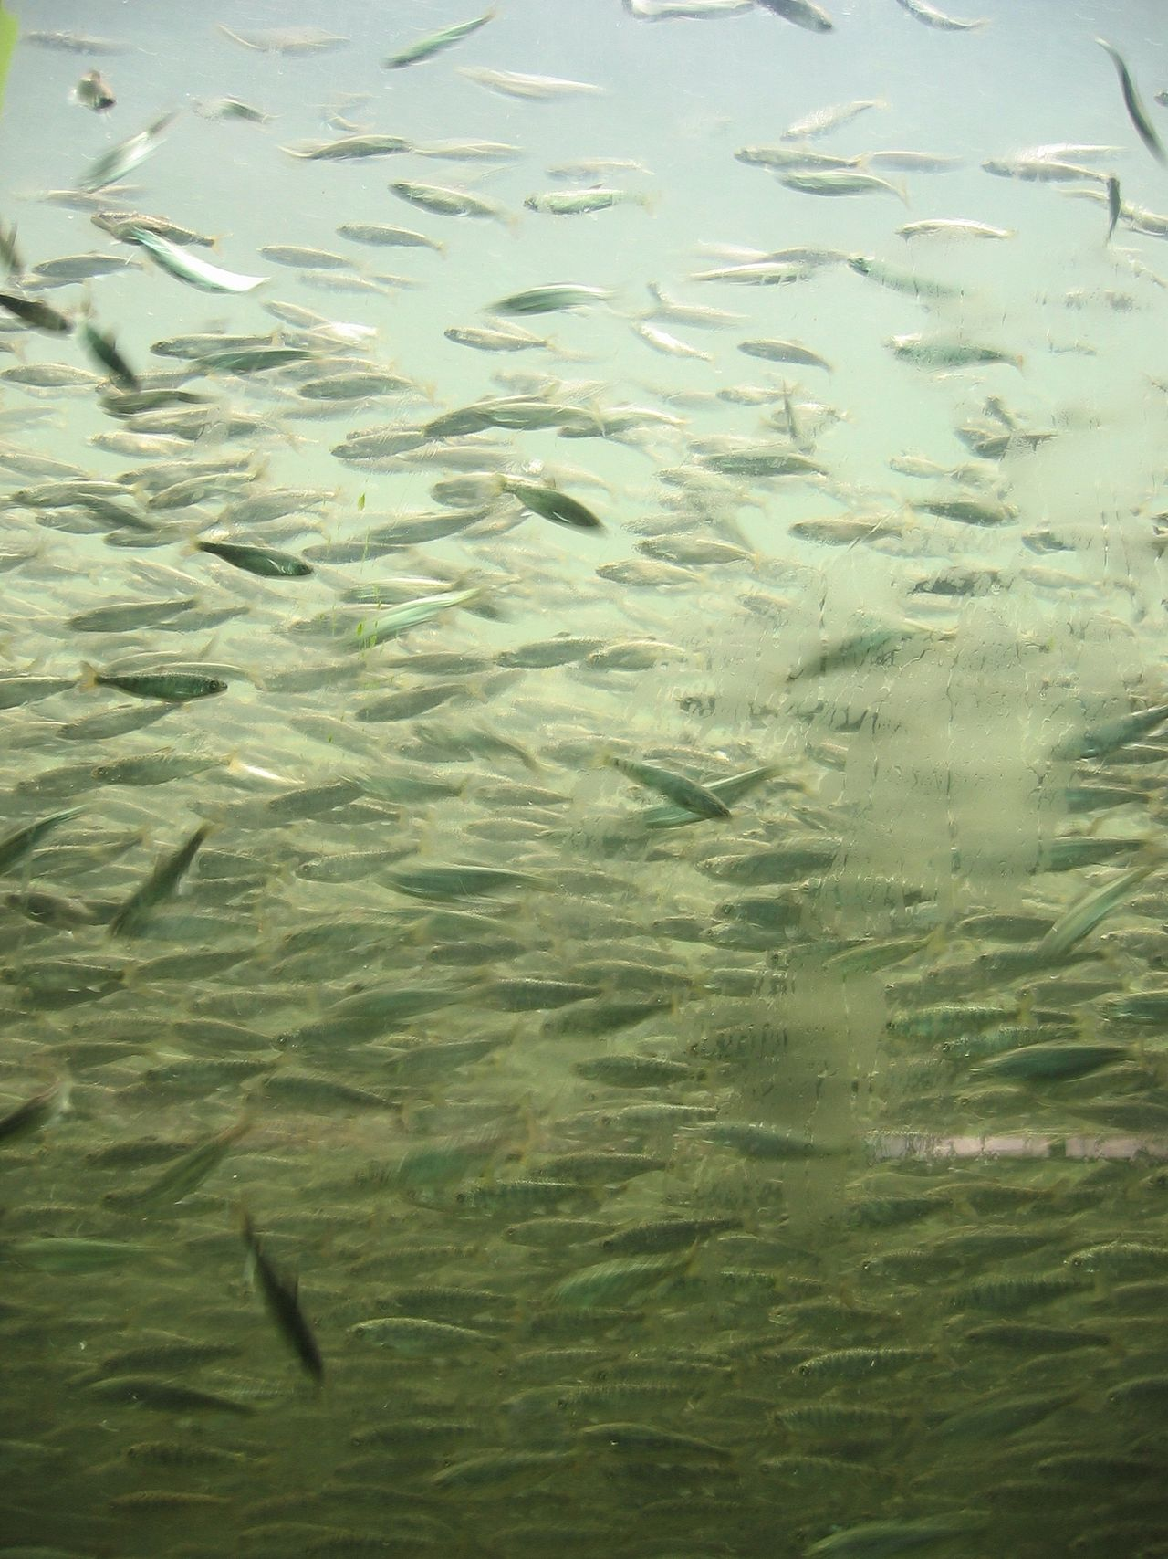
DEFINITIONS
David Philipp and Julie Claussen

Slide 19
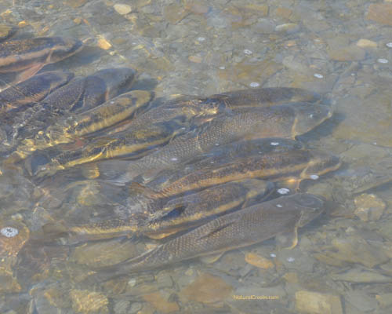
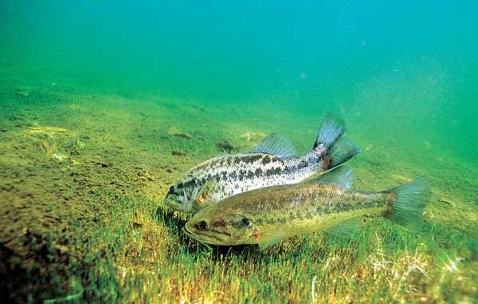
NATURAL REPRODUCTION
Natural production of offspring vs
hatchery production of offspring
David Philipp and Julie Claussen

Slide 20
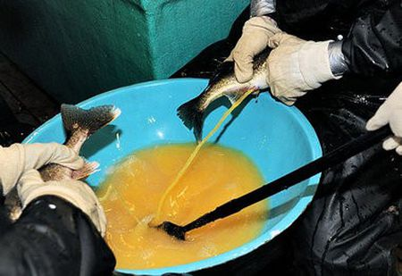
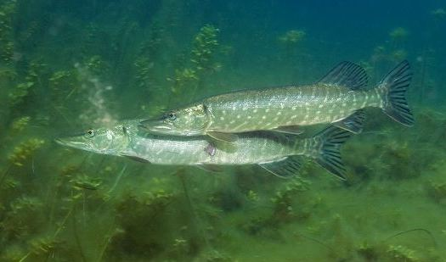
NATURAL REPRODUCTION
Often assumed that that fish produced in a hatchery are equal to fish that naturally spawn in the wild.
In the wild, the reproductive biology of fish is complex.

Slide 21






Slide 23



Slide 24
IN THE WILD HIGH COMPETITION
David Philipp and Julie Claussen

Slide 25
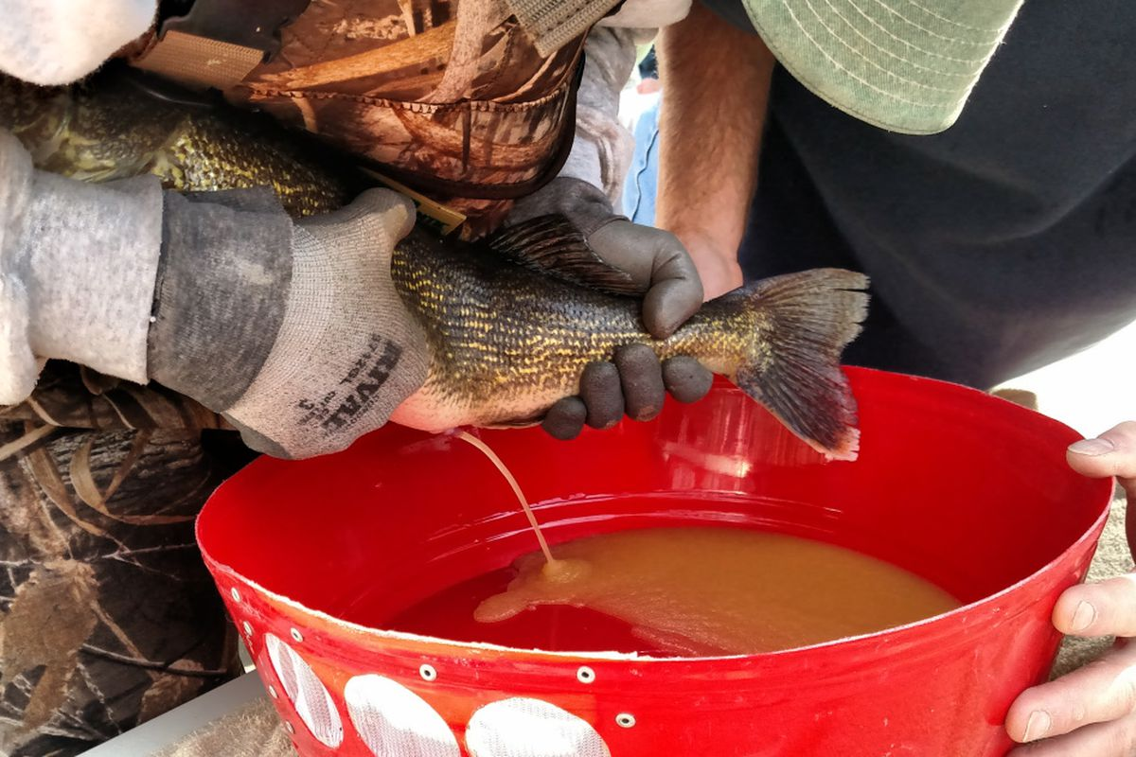
NATURAL VS HATCHERY REPRODUCTION
IN A HATCHERY NO COMPETITION

Slide 26
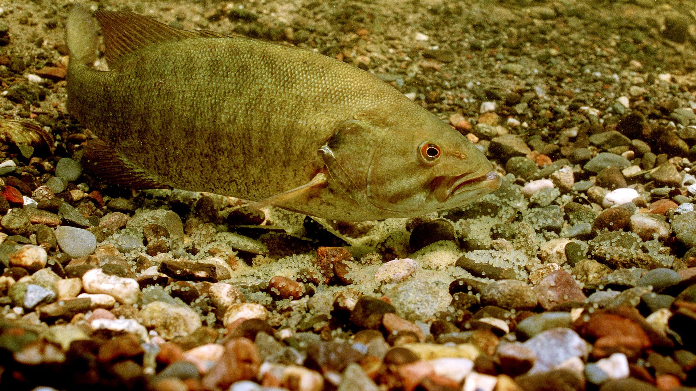
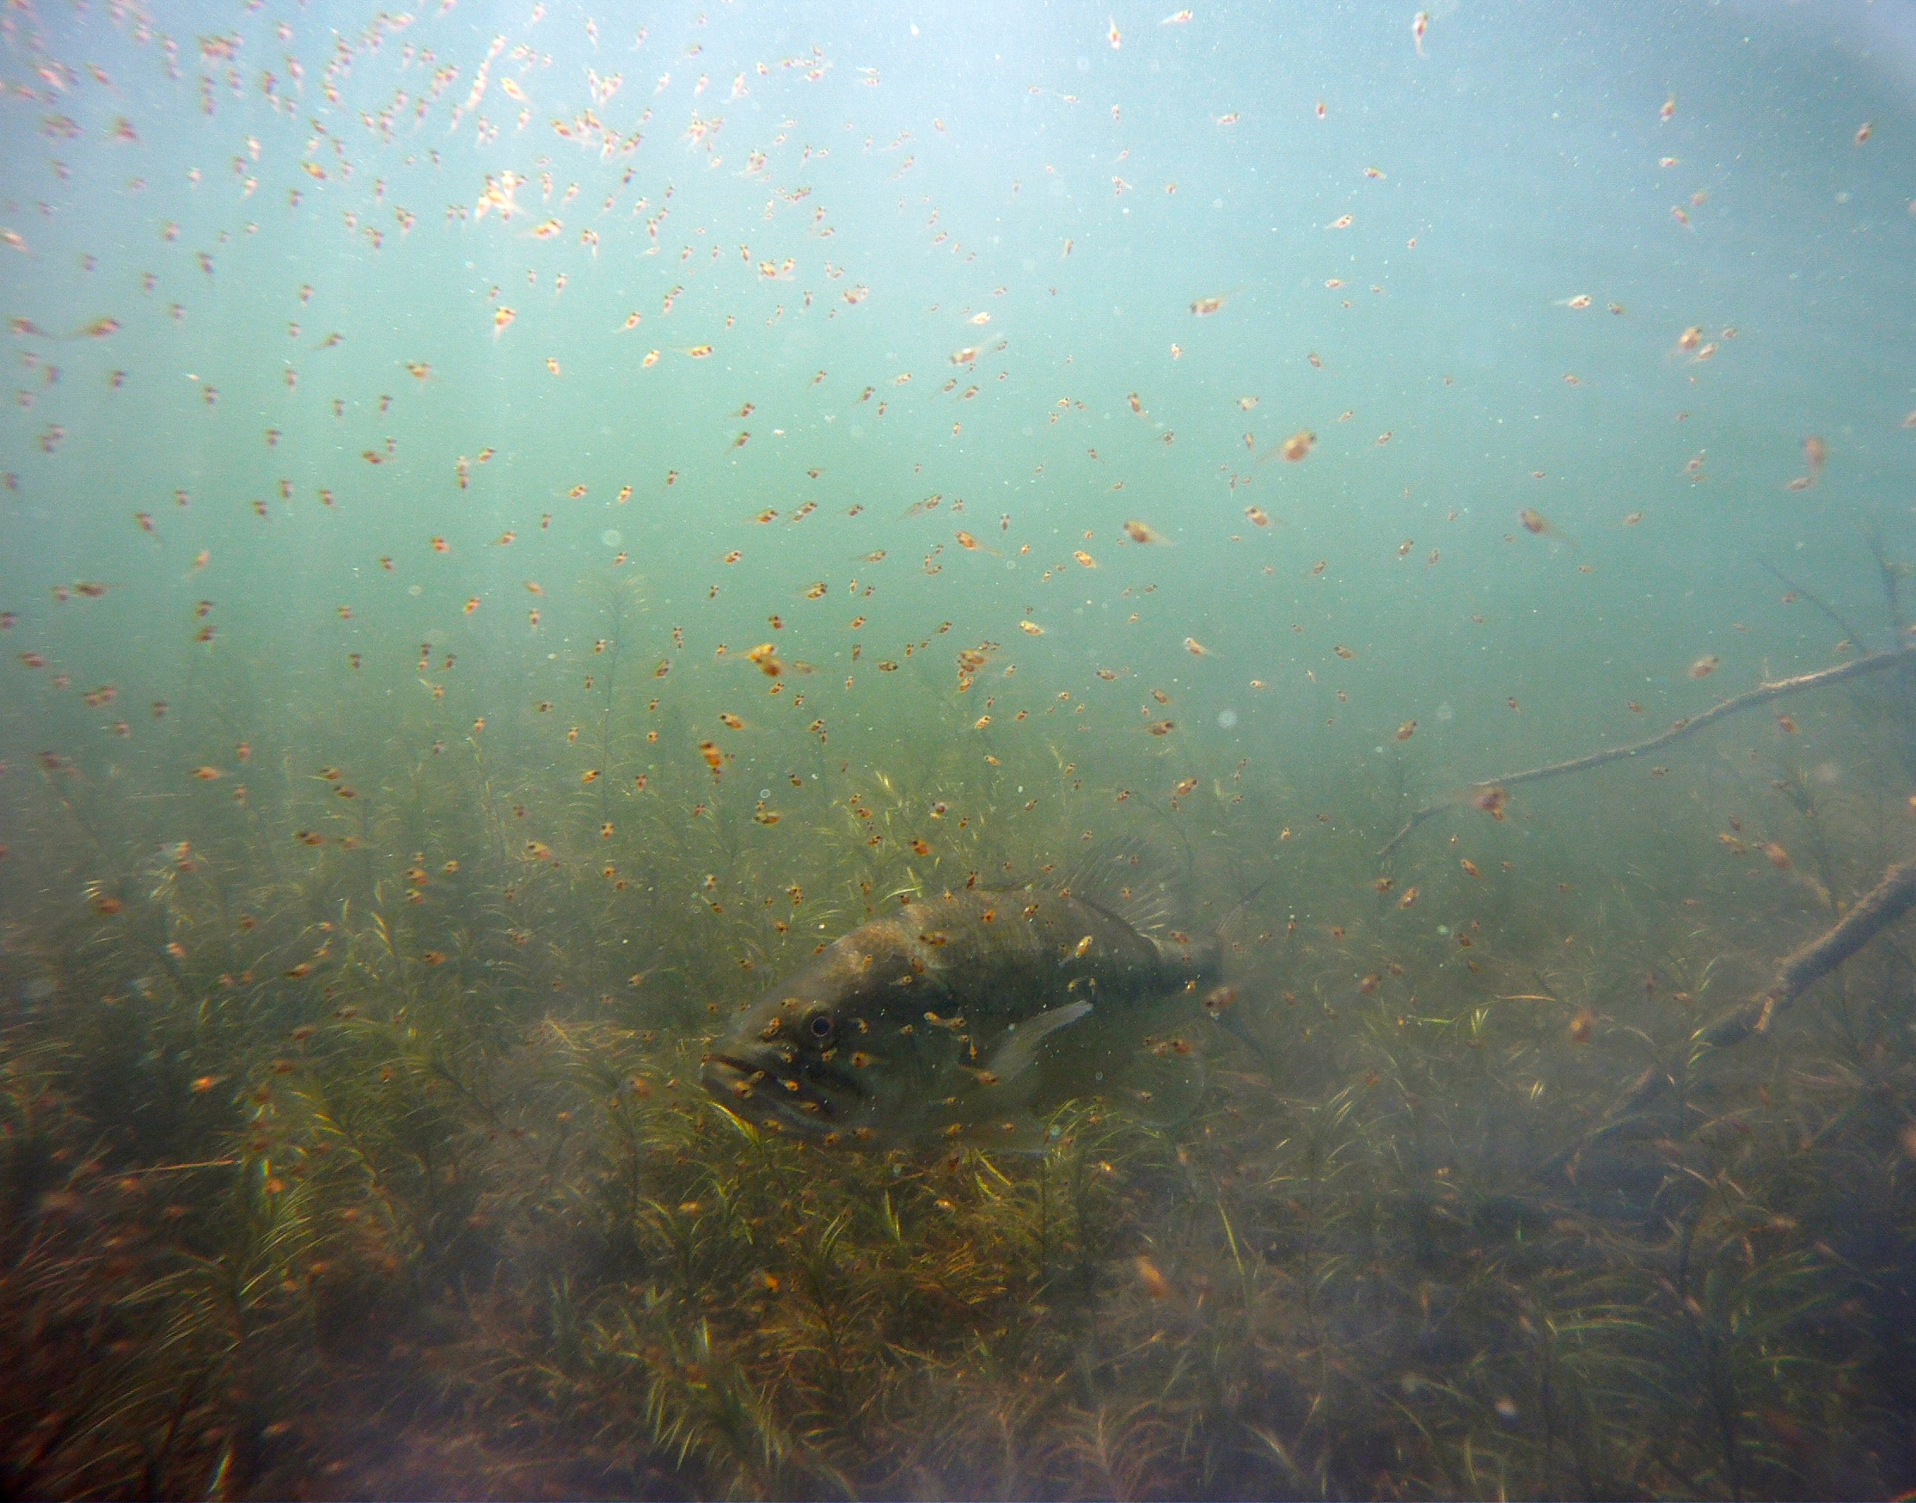
NATURAL VS HATCHERY REPRODUCTION
In the wild, egg and fry development and survival depend on
water temperature, fungus, and predation.
IN THE WILD
LESS THAN 0.001% OF FRY
SURVIVE TO ADULTS
David Philipp and Julie Claussen

Slide 27
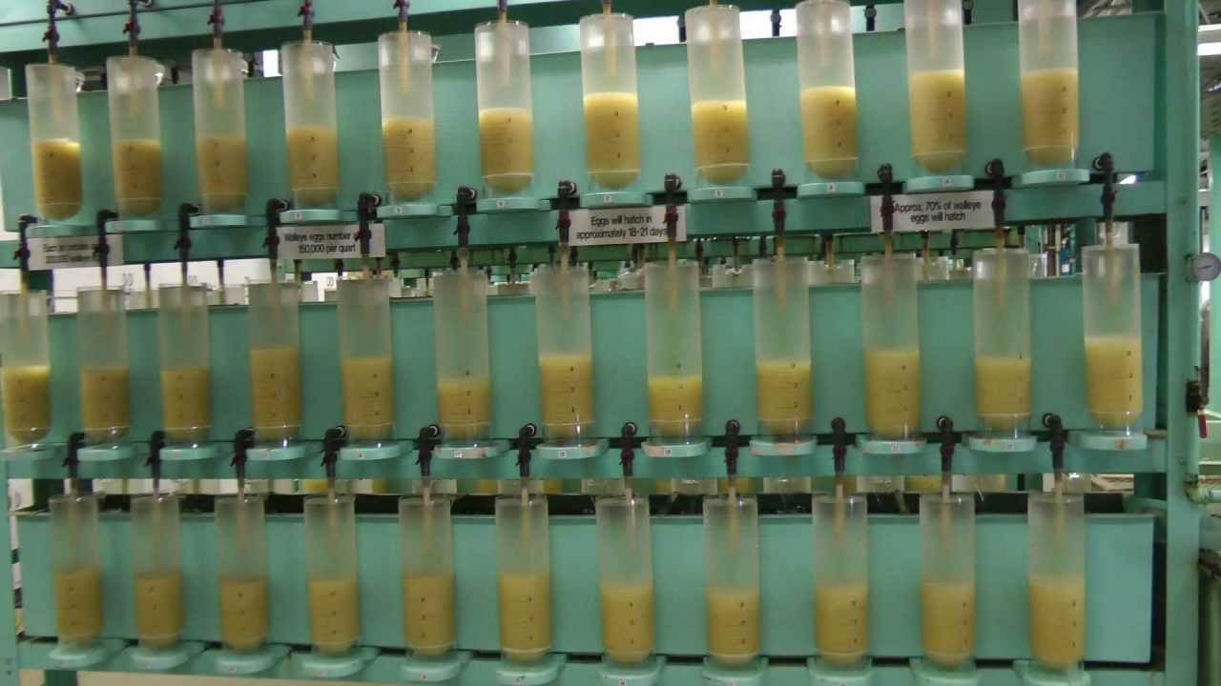
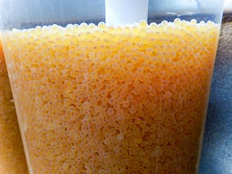
NATURAL VS HATCHERY REPRODUCTION
IN A HATCHERY OPTIMIZE SURVIVAL
David Philipp and Julie Claussen

Slide 28
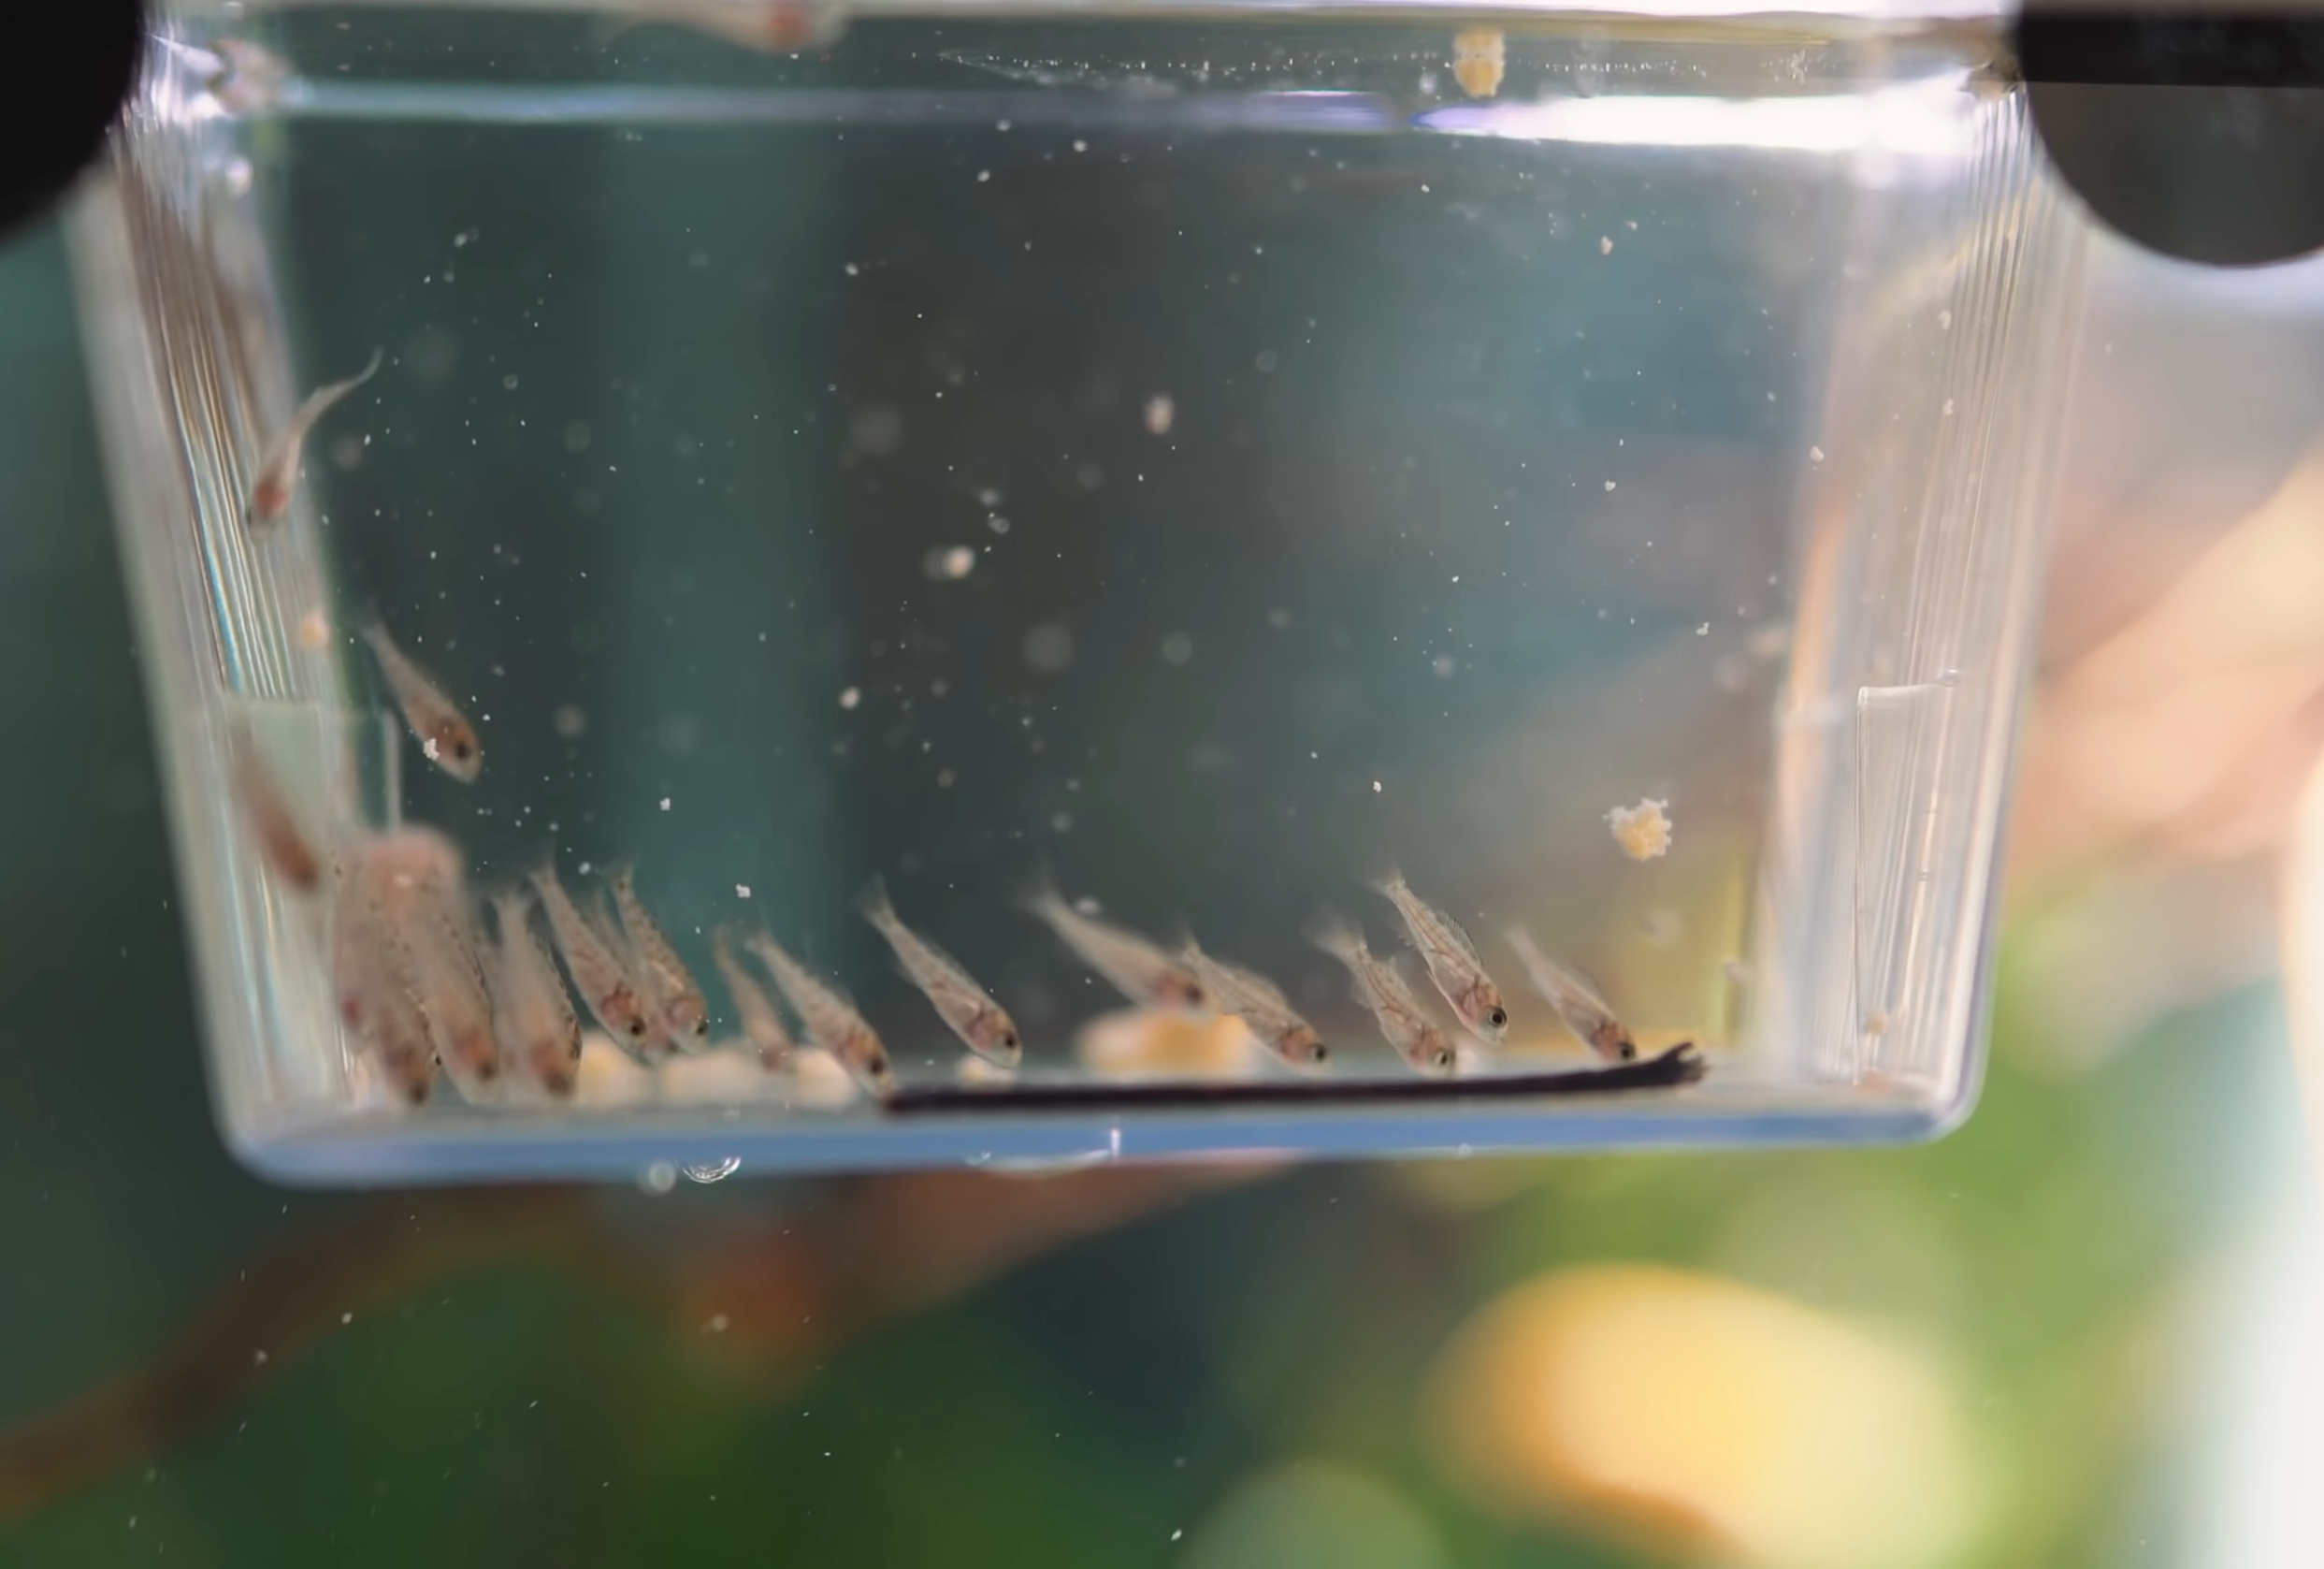
NATURAL VS HATCHERY REPRODUCTION
IN A HATCHERY OPTIMIZE SURVIVAL
David Philipp and Julie Claussen

Slide 29
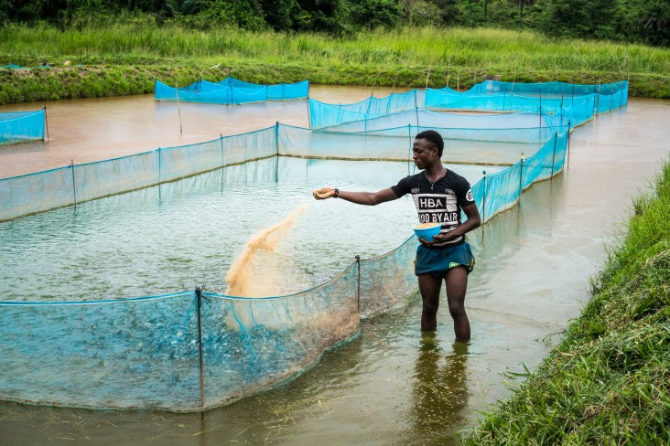
NATURAL VS HATCHERY REPRODUCTION
David Philipp and Julie Claussen

Slide 30
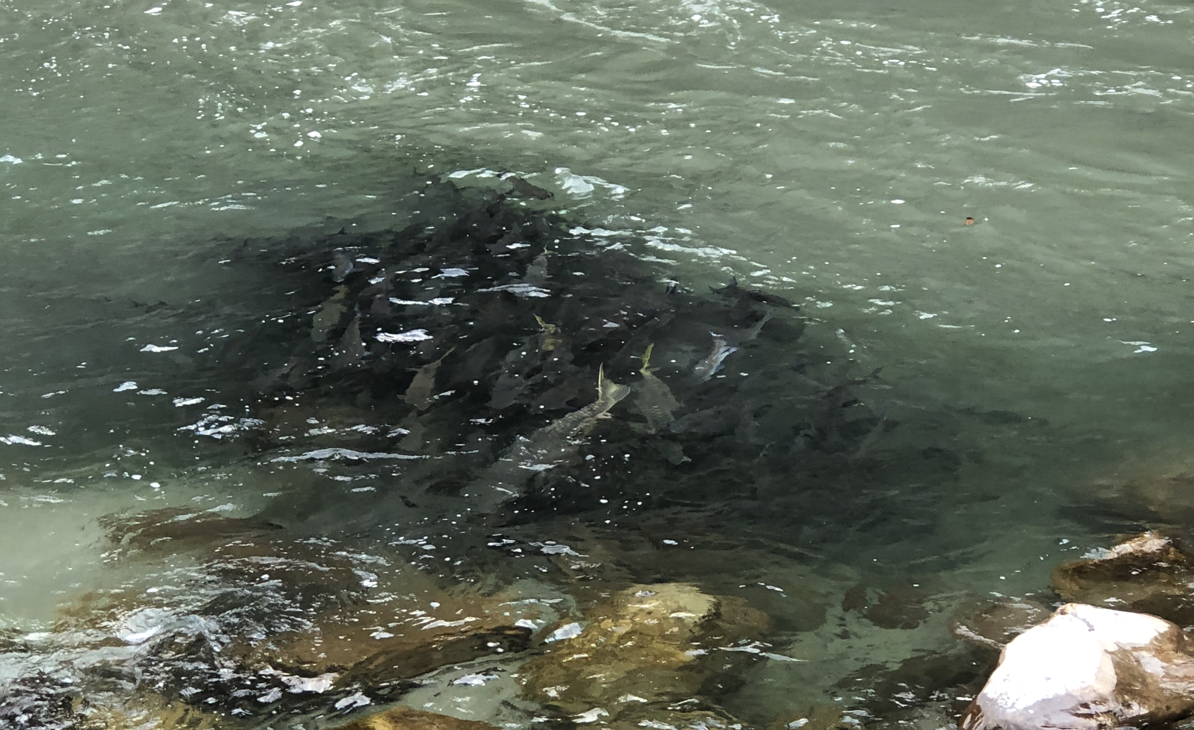
WHY IS THIS IMPORTANT?
David Philipp and Julie Claussen

Slide 31
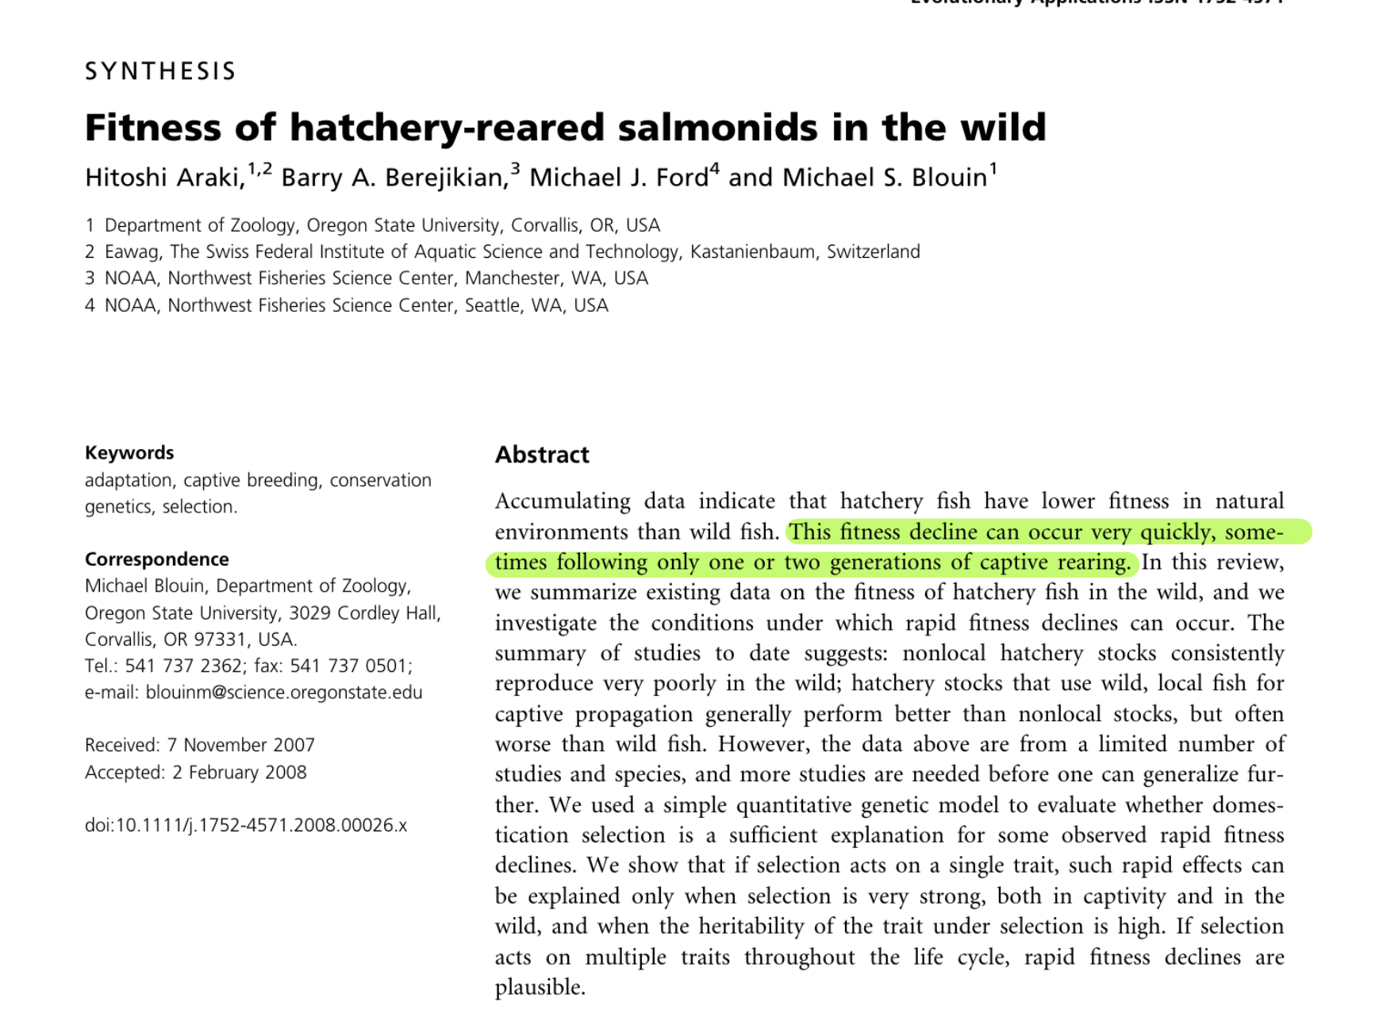
David Philipp and Julie Claussen

Slide 32
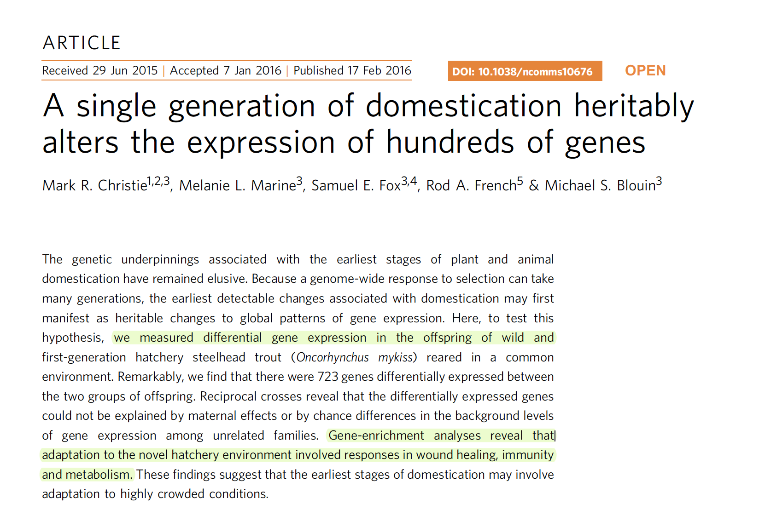
David Philipp and Julie Claussen

Slide 33
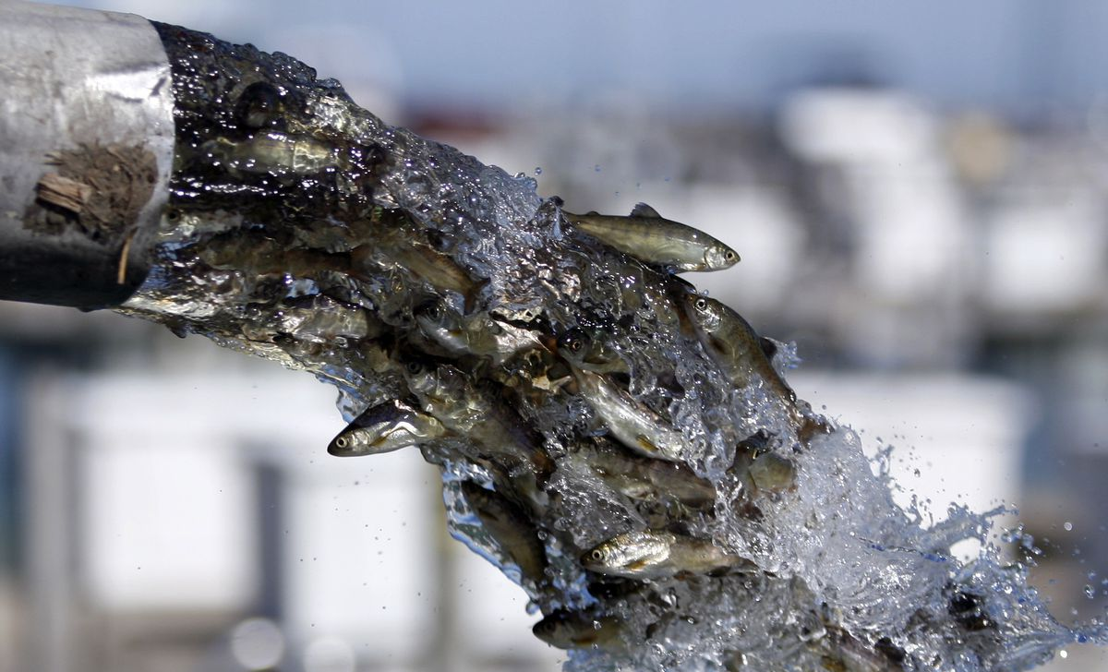
Risks associated with stocking
ecological RISKS
Genetic RISKS
David Philipp and Julie Claussen

Slide 34

ECOLOGICAL RISKS
COMPETITION
Stocked fish compete for food resources and space with native juveniles.
David Philipp and Julie Claussen

Slide 35

ECOLOGICAL RISKS
COMPETITION
Stocked fish compete for food resources and space with native juveniles.
David Philipp and Julie Claussen

Slide 36
ECOLOGICAL RISKS
COMPETITION
David Philipp and Julie Claussen

Slide 37
ECOLOGICAL RISKS
COMPETITION
David Philipp and Julie Claussen

Slide 38
ECOLOGICAL RISKS
COMPETITION
David Philipp and Julie Claussen

Slide 39
ECOLOGICAL RISKS
ECOLOGICAL RISKS
PREDATION:
Hatchery juveniles are often stocked at largeR sizes than native juveniles fish in the wild.
Predation by the stocked hatchery fish can reduce native fish numbers.
David Philipp and Julie Claussen

Slide 40
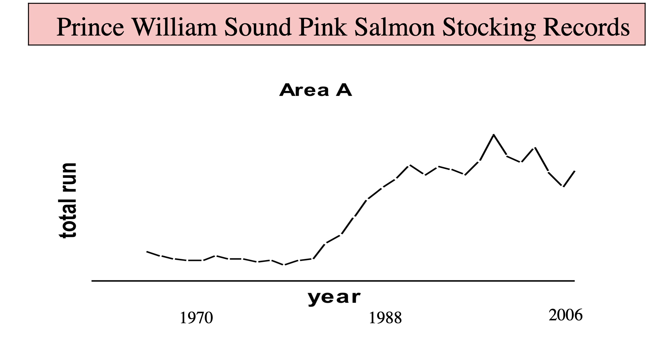
David Philipp and Julie Claussen

Slide 41
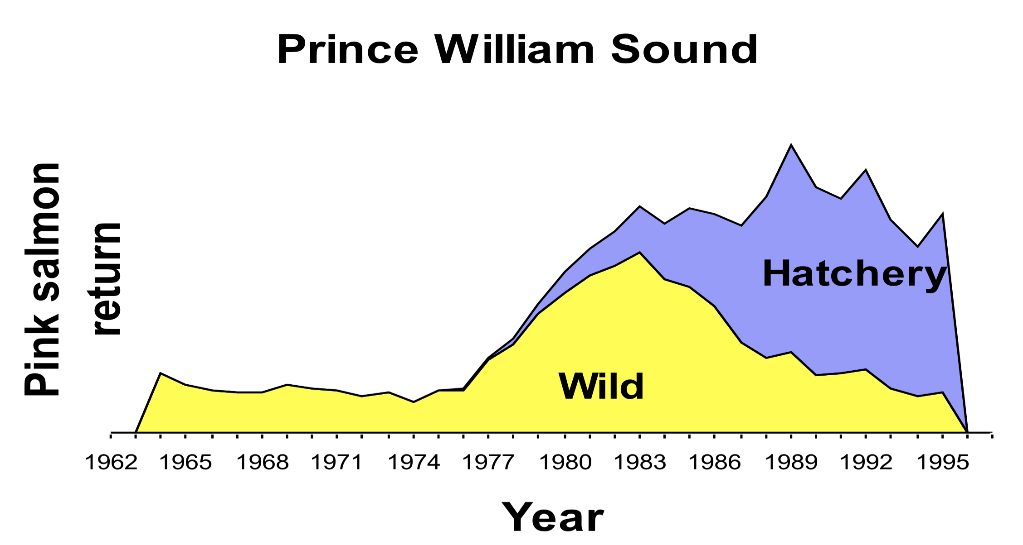
David Philipp and Julie Claussen

Slide 42
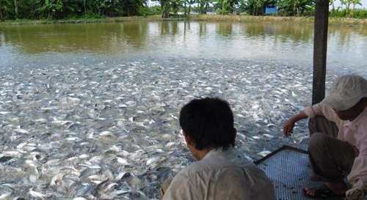
ECOLOGICAL RISKS
DISEASE
Crowded conditions within hatchery are a breeding ground for protozoans, ciliates, myxosporodians, worms, opportunistic bacteria and fungi.
Transmission of diseases to wild populations that have little resistance have had disastrous consequences throughout history.
David Philipp and Julie Claussen
Notes:
Crowded conditions within hatchery are a breeding ground for protozoans, ciliates, myxosporodians, worms, opportunistic bacteria and fungi.
Importing eggs or fish from other river basins risks of introducing news diseases.
Transmission of these diseases to wild populations that have little resistance can have disastrous consequences.

Slide 43
GENETIC RISKS
GENETIC RISKS
Loss of Genetic Variation
Inbreeding Depression
Outbreeding Depression
Domestication Selection
David Philipp and Julie Claussen

Slide 44
GENETIC RISKS
Loss of Genetic Variation:
Need > 50 pairs (Ne = 100)
Ne = (4*Nm*Nf )/(Nm + Nf )
50 females + 20 Males Ne = 57
Skewed success… Ne = as low as 10
(very rapid loss in variation)
TRANSFER GRAPHIC

Slide 45
GENETIC RISKS
Inbreeding Depression:
Reduction in fitness – unmasking of harmful alleles, parents too closely related
Overt Signs: pugnose, bent backs, malformed fins, crossed eyes
Survival in hatchery vs wild environments
Captive broodstocks
Impacts of Stocking on top of wild population.
TRANSFER GRAPHIC

Slide 46
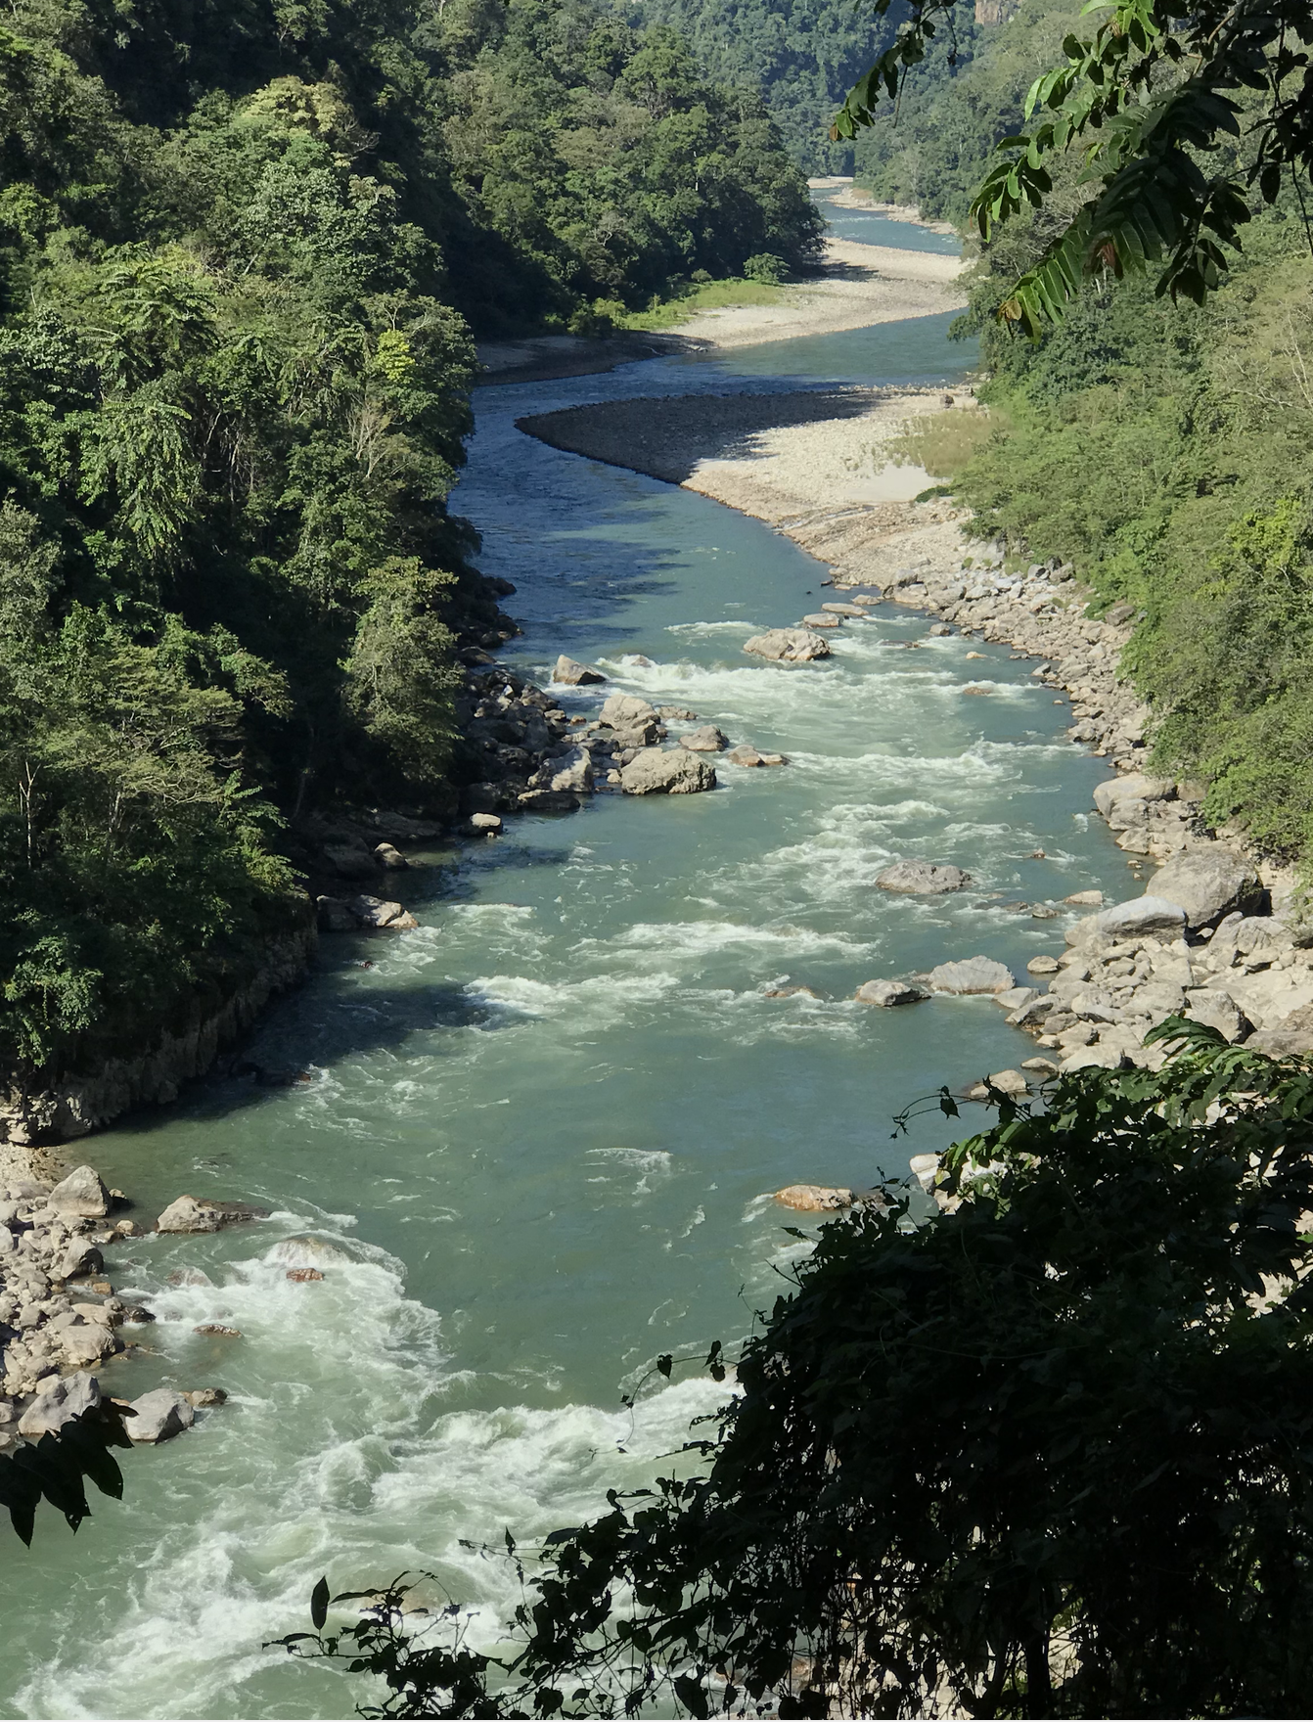
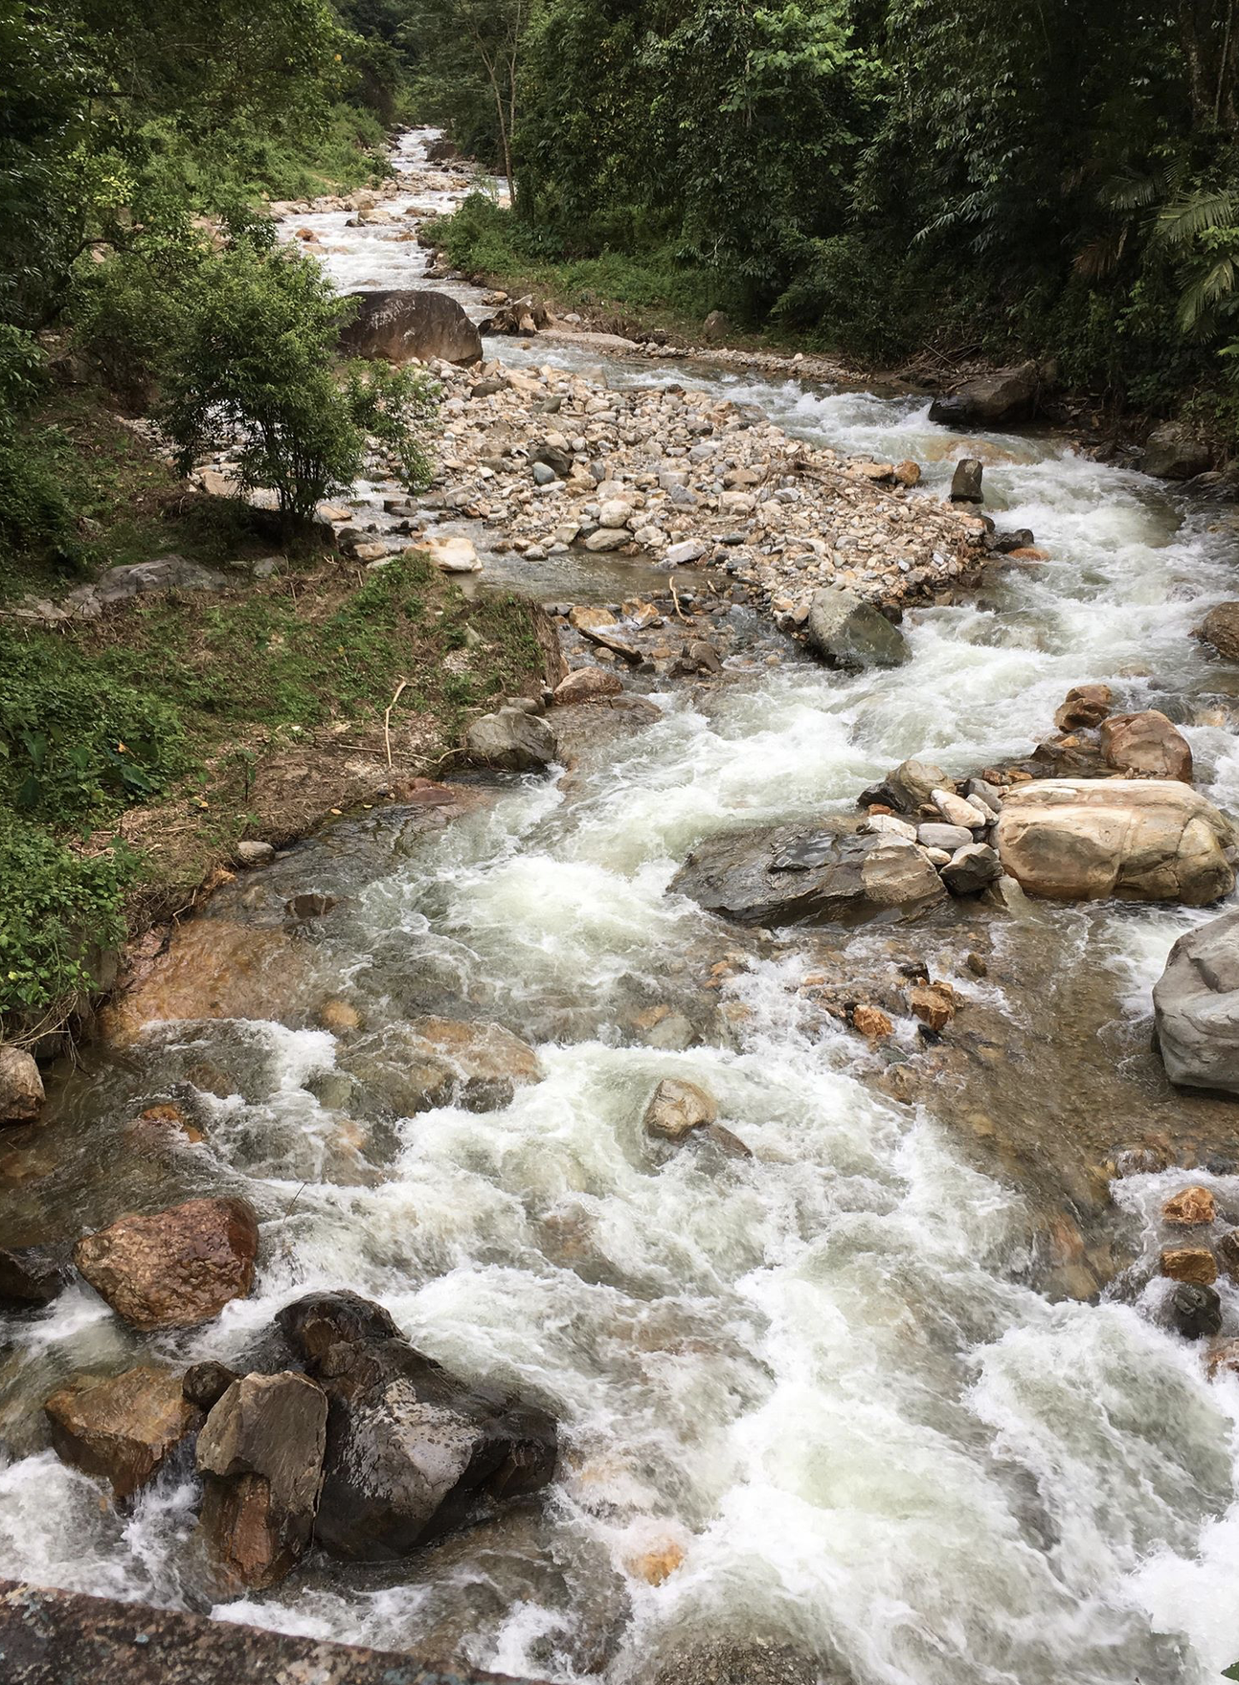
GENETIC RISKS
Outbreeding Depression
In the wild, fish population are adapted to their local environments.
If hatcheries breed broodstock from different populations, the co-adapted gene complexes that have evolved over time are broken down.
When these fish are stocked in the wild, outbreeding depressiona can decreased reproductive success as a result.
RIVER ONE:
higher flow, colder temperatures, fish mature at age 4
RIVER TWO:
variable flows, deeper pools, fish mature at age 5

Slide 47
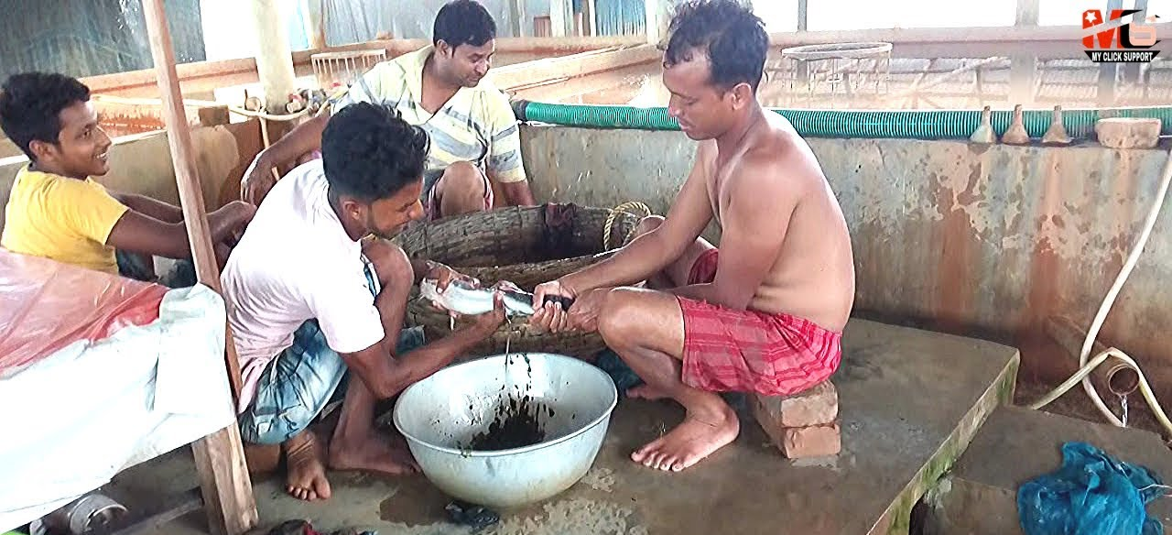
GENETIC RISKS
Domestication Selection:
Hatcheries can unintentionally select for traits that are advantageous for a hatchery environment, but these traits may not be an advantage if interbreeding occurs.
Overt signs: smaller eggs, smaller fins, less shy
ALWAYS begins in the first generation
Huge impact on survival in wild to adulthood / reproduction

Slide 48
One Hypothetical Stocking Program:
Issue: The population of Golden Mahseer in the Best Ever River (BER) seems to be dropping (fishermen are complaining and sightings have decreased)
Response: The State Fish Hatchery three watersheds over (with its own GM broodstock and production program) is tasked with producing GM fingerlings to stock into the BER.
Action: State hatchery personnel go to the BER and spend two weeks collecting 17 adult GM, 10 males and 7 females.
TRANSFER GRAPHIC
David Philipp and Julie Claussen

Slide 49
One Hypothetical Stocking Program:
Production: The collected BER population of adult GM is spawned
[eggs from 3 females (10,000, 1,000 and 500 eggs respectively) are fertilized with sperm from 6 males 9) Ne = 3.5]
Additional: The State Fish Hatchery also spawned excess non-BER broodstock (a combination of fish from several other watersheds) three watersheds over) to produce very large numbers of offspring.
Action: State hatchery personnel stocked all 11,500 BER offspring, together with 15,000 non-BER offspring into the three best GM spawning tributaries on the BER…that had 2-300 wild offspring each.
TRANSFER GRAPHIC
David Philipp and Julie Claussen

Slide 50
One Hypothetical Stocking Program:
Potential OutcomeS:
Wild offspring in the three stocked tributaries experienced heavy competition, resulting in decreased growth/increased mortality.
The surviving population had large numbers of siblings/half siblings, creating the opportunity for high levels of inbreeding after they mature.
The surviving populations also now had large numbers of individuals that were genetically distinct from the BER population (and already compromised via outbreeding depression) which added the opportunity for more outbreeding depression when they matured…and disease from neighboring carp pond that got mixed.
TRANSFER GRAPHIC
David Philipp and Julie Claussen

Slide 51
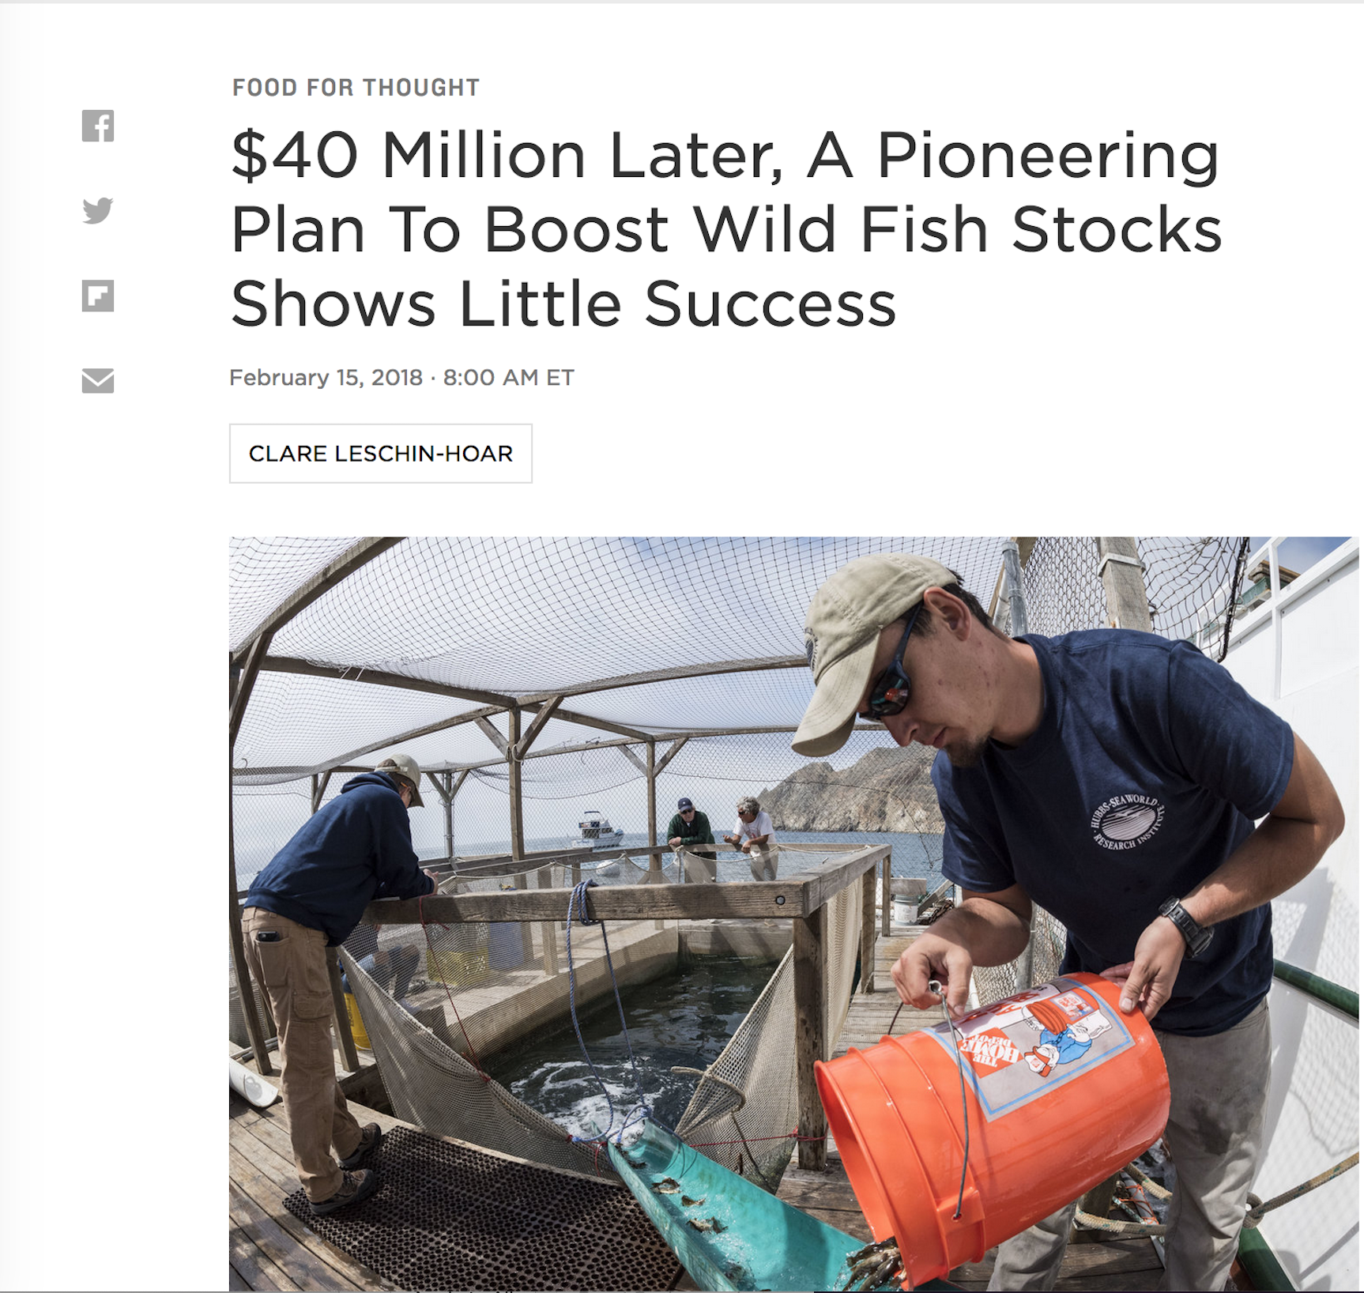
David Philipp and Julie Claussen

Slide 52
THE DECISION PROCESS
TO STOCK OR NOT TO STOCK?
HOW DO WE MAKE THAT DECISION?
WHAT INFORMATION DO WE NEED?
WHO MAKES THAT DECISION? …AND HOW?
TRANSFER GRAPHIC
David Philipp and Julie Claussen

Slide 53
THE DECISION PROCESS
A MODEL OF THE PROCESS:
A PLAN THAT DESCRIBES PROPOSED ACTIONS
EVALUATION PROCESS – TO WEIGH COSTS/BENEFITS
TRANSFER GRAPHIC
David Philipp and Julie Claussen

Slide 54
THE DECISION PROCESS
PLAN CONTENTS:
WHY
WHAT
HOW
WHERE
WHEN
COST ANALYSIS
MONITORING AND EVALUATION PLAN
TRANSFER GRAPHIC
David Philipp and Julie Claussen

Slide 55
THE DECISION PROCESS
WHY
[THE RATIONALE FOR RAISING AND STOCKING FISH]
DETERMINE IF THE STOCKING INVOLVES PUTTING FISH:
A. INTO A CONTAINED ENVIRONMENT TO RAISE FOR FOOD
B. INTO THE WILD FOR:
SUPPLEMENTING AN EXISTING POPULATION,
RE-INTRODUCING AN EXTIRPATED POPULATION
ESTABLISHING A NEW POPULATION
FOOD CULTURE PICTURE
PHIL PISTER WITH BUCKETS PICTURE
TRANSFER GRAPHIC
David Philipp and Julie Claussen

Slide 56
THE DECISION PROCESS
IF THE STOCKING INVOLVES PUTTING FISH INTO A CONTAINED ENVIRONMENT TO RAISE FOR FOOD,
THEN CONCERNS REALLY CENTER AROUND THE POTENTIAL FOR ESCAPE INTO THE WILD.
PHOTO EXAMPLES
David Philipp and Julie Claussen

Slide 57
THE DECISION PROCESS
IF THE STOCKING INVOLVES PUTTING FISH INTO THE WILD FOR:
SUPPLEMENTING AN EXISTING POPULATION
RE-INTRODUCING AN EXTIRPATED POPULATION
ESTABLISHING A NEW POPULATION
THEN THE PLAN NEEDS TO:
DEFINE THE ISSUE:
STATE THE OBJECTIVE OF THE STOCKING:
DESCRIBE THE EXPECTED/DESIRED OUTCOME(S):
TRANSFER GRAPHIC
David Philipp and Julie Claussen

Slide 58
THE DECISION PROCESS
IF THE STOCKING INVOLVES PUTTING FISH INTO THE WILD FOR:
SUPPLEMENTING AN EXISTING POPULATION
RE-INTRODUCING AN EXTIRPATED POPULATION
ESTABLISHING A NEW POPULATION
THEN THE PLAN NEEDS TO:
DEFINE THE ISSUE
DECREASING NUMBERS OF INDIVIDUALS
OVERFISHING
HABITAT ALTERATION -- TRIBS=GRAVEL MINING
-- OW=AGRICULTURE
-- MIGRATION=DAMS/ROADS
DISEASE
David Philipp and Julie Claussen

Slide 59
THE DECISION PROCESS
IF THE STOCKING INVOLVES PUTTING FISH INTO THE WILD FOR:
SUPPLEMENTING AN EXISTING POPULATION
RE-INTRODUCING AN EXTIRPATED POPULATION
ESTABLISHING A NEW POPULATION
THEN THE PLAN NEEDS TO:
DEFINE THE ISSUE:
STATE THE OBJECTIVE OF THE STOCKING:
DESCRIBE THE EXPECTED/DESIRED OUTCOME(S):
EXAMPLE STRATEGY FOR OVERHARVEST

Slide 60
THE DECISION PROCESS
IF THE STOCKING INVOLVES PUTTING FISH INTO THE WILD FOR:
SUPPLEMENTING AN EXISTING POPULATION
RE-INTRODUCING AN EXTIRPATED POPULATION
ESTABLISHING A NEW POPULATION
THEN THE PLAN NEEDS TO:
DEFINE THE ISSUE:
STATE THE OBJECTIVE OF THE STOCKING:
DESCRIBE THE EXPECTED/DESIRED OUTCOME(S):
EXAMPLE STRATEGY FOR HABITAT ALTERATION
TRANSFER GRAPHIC
David Philipp and Julie Claussen

Slide 61
THE DECISION PROCESS
COSTS:
WHAT IS THE COST OF PRODUCING/OBTAINING, RAISING, AND STOCKING?
WHAT ARE THE MANPOWER AND FACILITY NEEDS…AND COSTS?
WHAT ARE THE FINANCIAL SOURCES FOR COVERING THOSE COSTS?
David Philipp and Julie Claussen

Slide 62
THE DECISION PROCESS
MONITORING AND EVALUATION:
PLAN FOR DETERMINING SUCCESS OR FAILURE OF THE STOCKING
IF A FAILURE, PLAN FOR TERMINATING OR EVEN REVERSING THE STOCKING
David Philipp and Julie Claussen

Slide 63
David Philipp and Julie Claussen

Slide 64

QUESTIONS AND DISCUSSION

