Slide 1

EAP ESG ADVISORY WEBINAR SERIES #2
TRAINING-OF-TRAINERS
Attracting capital through disclosure
Jerome Lavigne-Delville
Senior Consultant, IFC

Slide 2
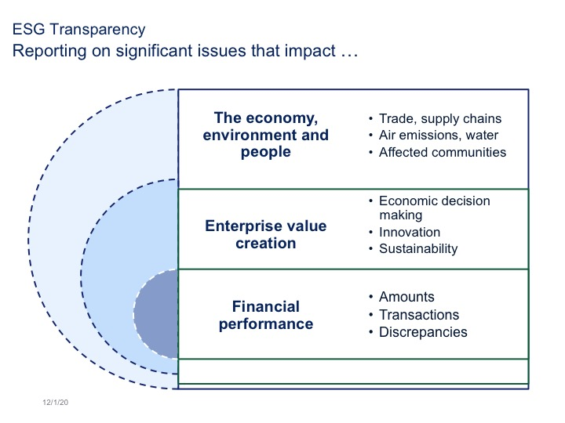
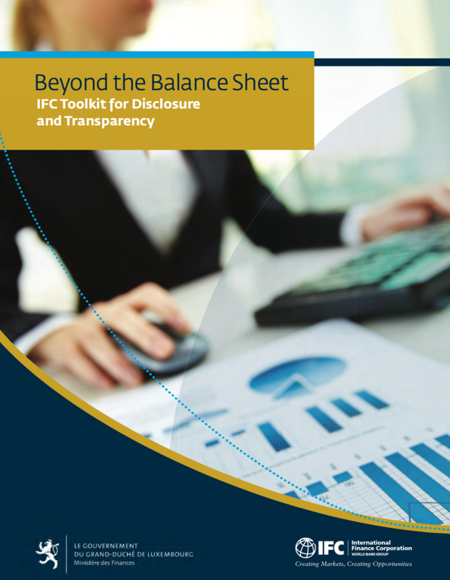
INTRODUCTION
Why is ESG transparency important when everyone is focused on financial sustainability?

Slide 3
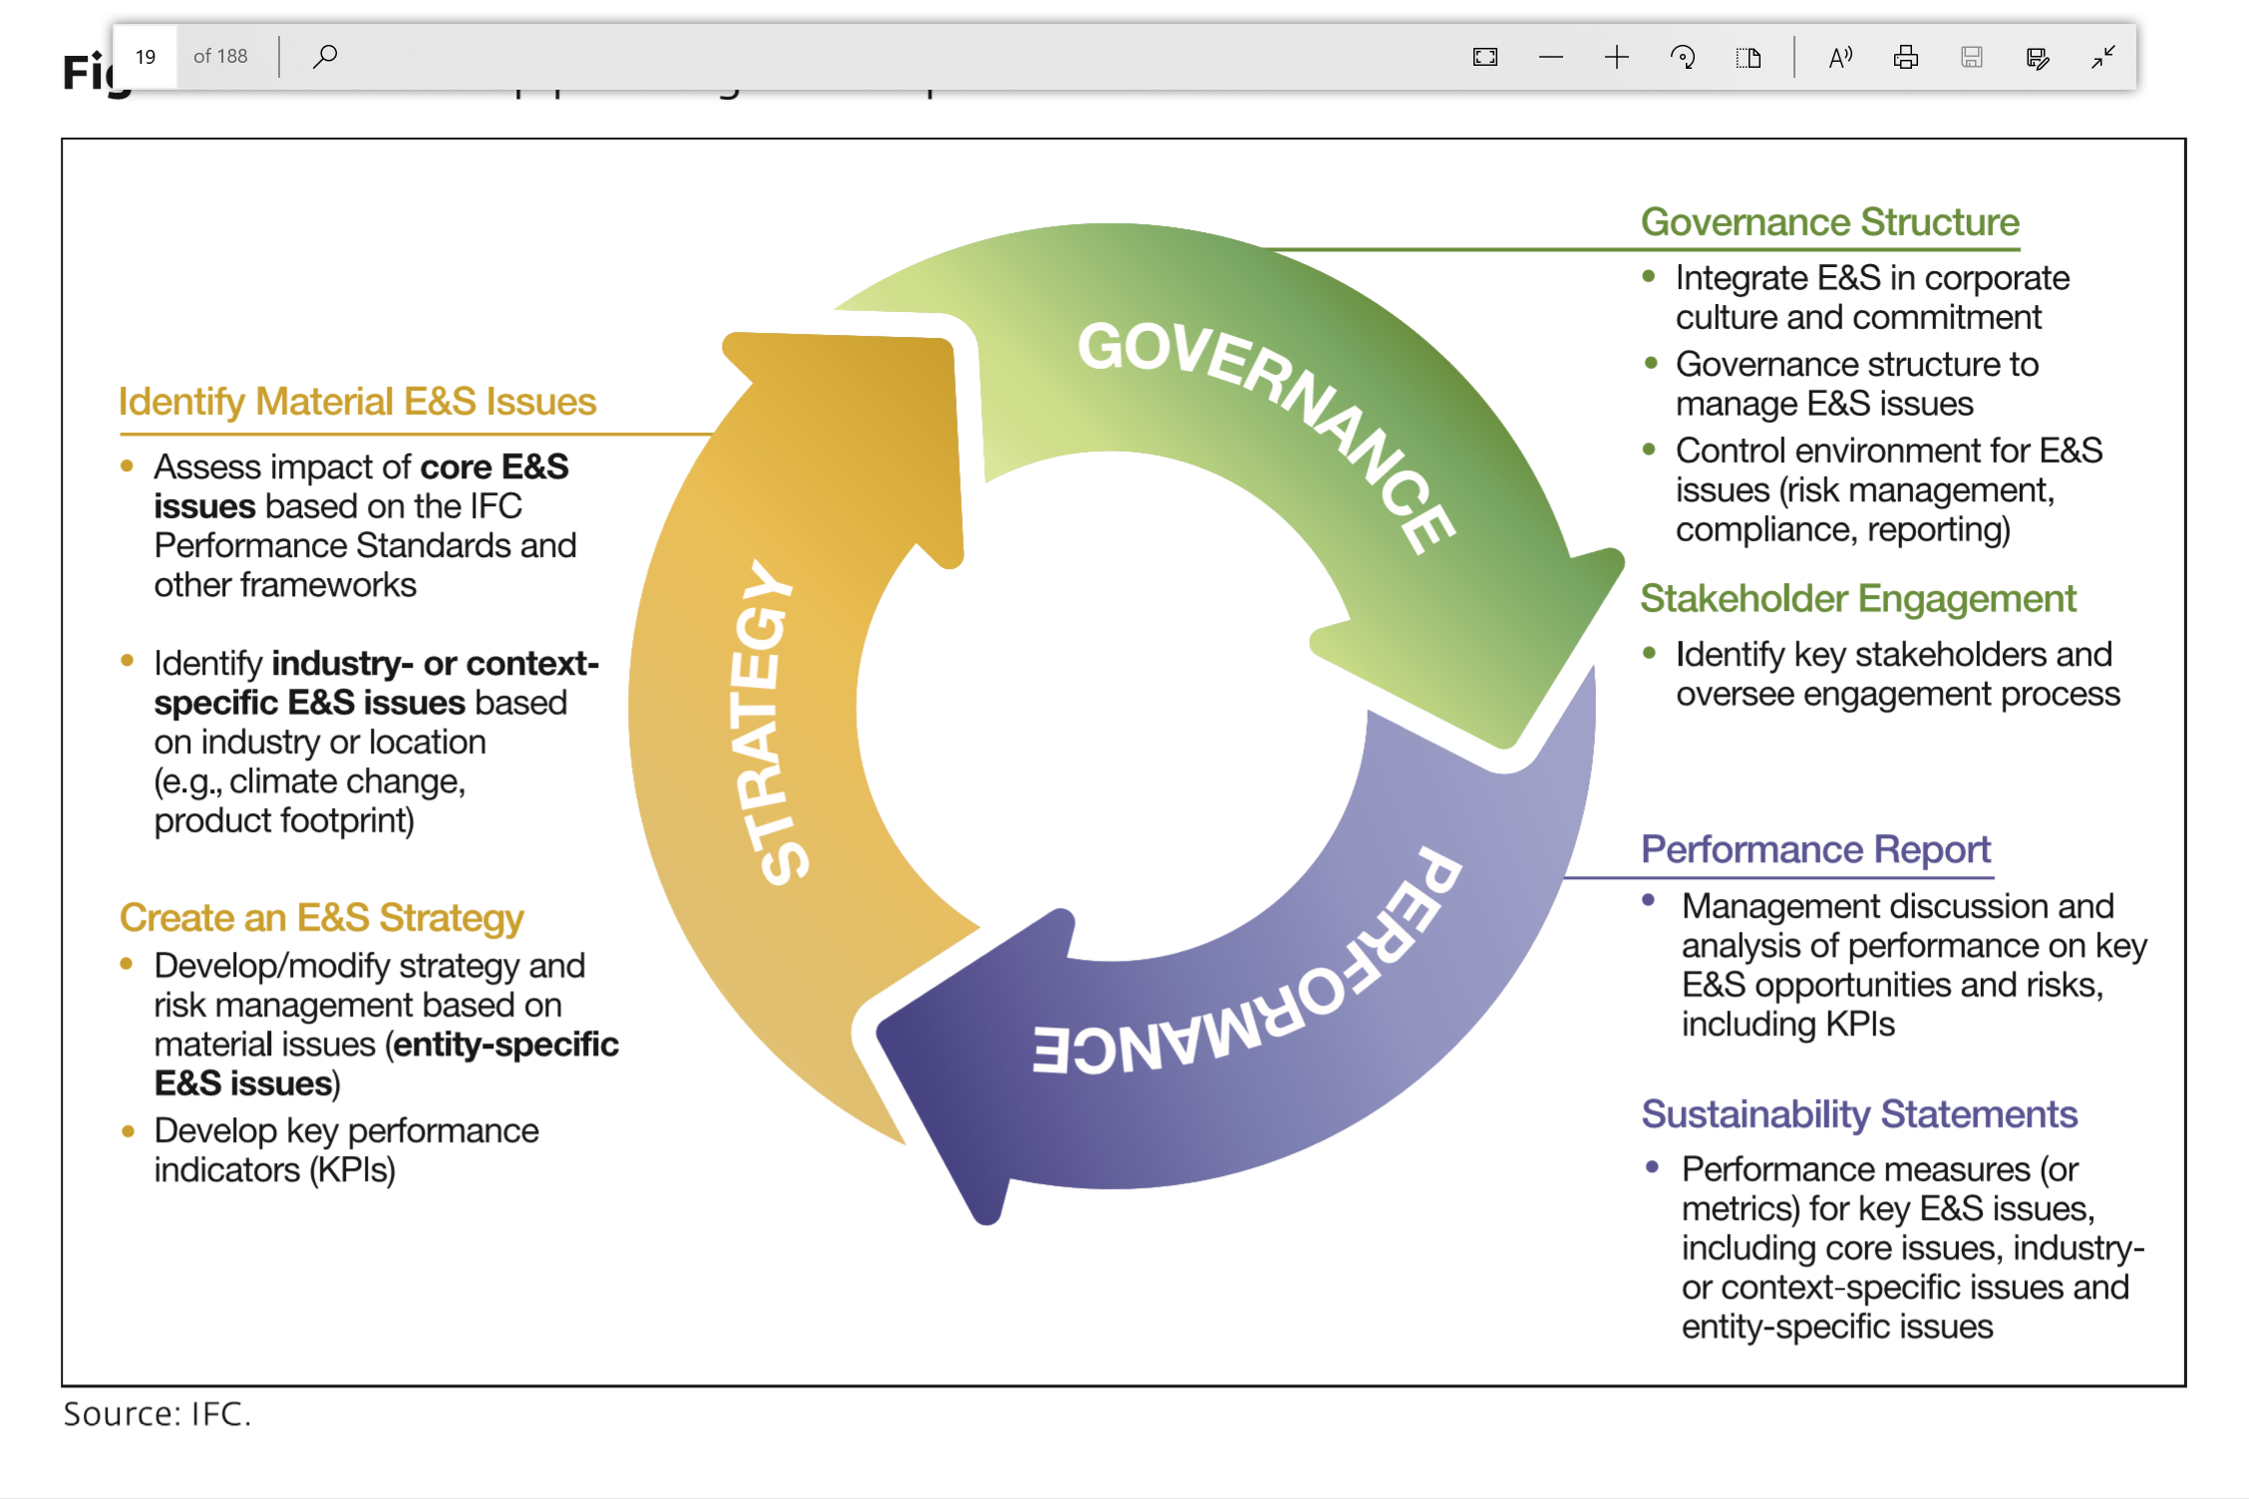
INTRODUCTION
How do companies report material ESG issues on their strategy, governance and performance?
Strategy
  Business Model and Environment
  Strategic Objectives
  Risk Analysis and Response
  Sustainability Opportunities and Risks
  Introducing Key Performance Indicators
Corporate Governance
  Leadership and Culture Commitment to ESG
  Structure and Functioning of Board of Directors
  Control Environment
  Treatment of Minority Shareholders
  Governance of Stakeholder Engagement
Financial Position and Performance
  Performance Report
  Financial Statements
  Sustainability Statements

Slide 4
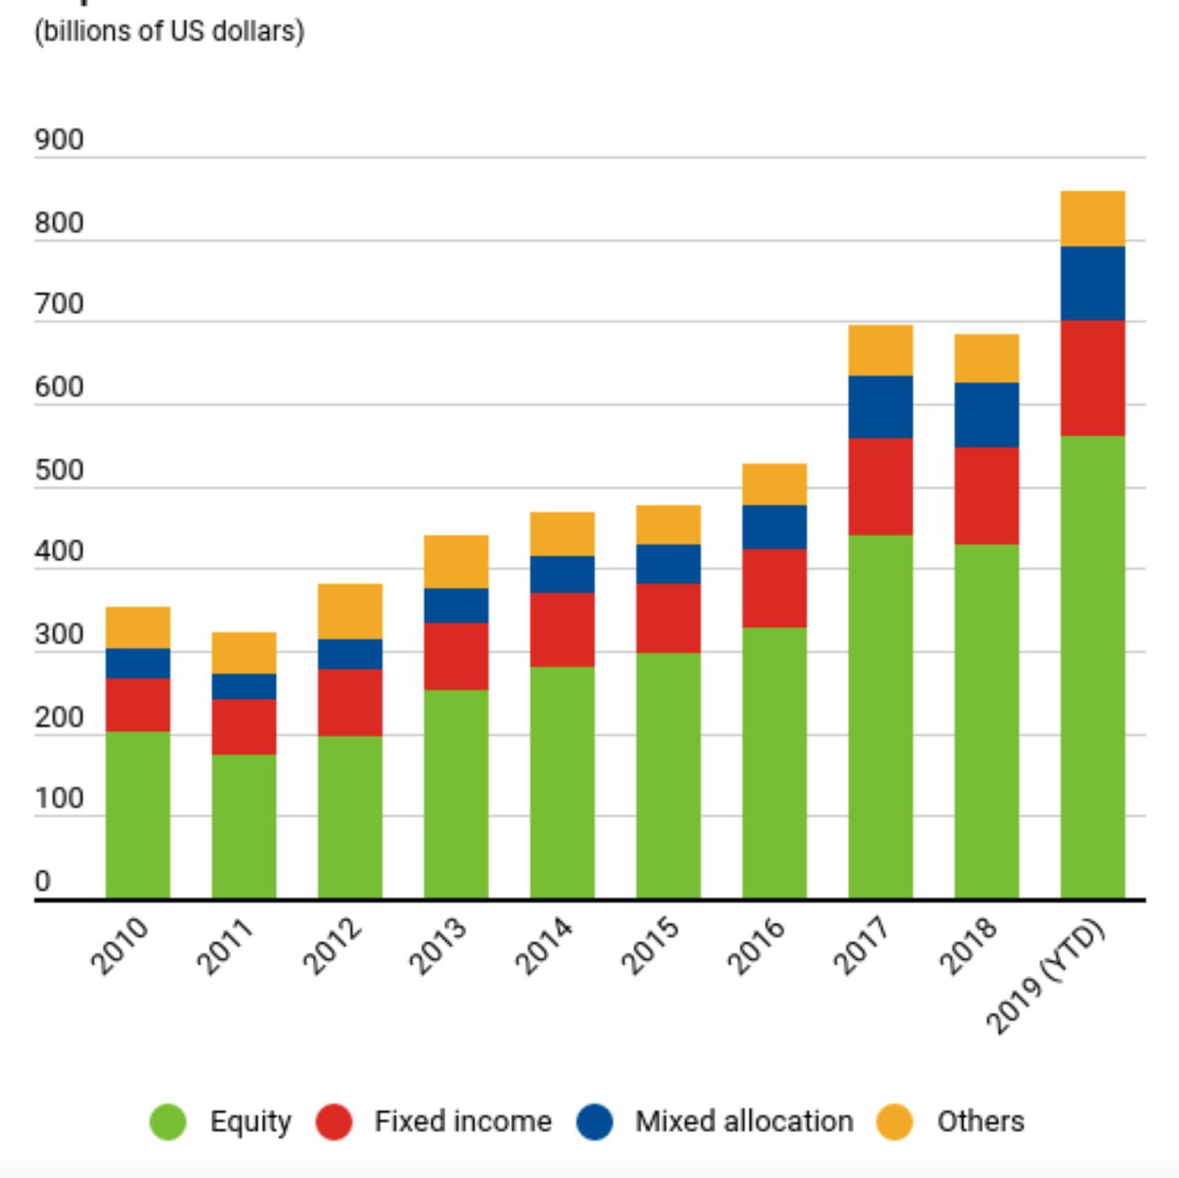
GROWTH OF Sustainable Finance
Growth on the Demand Side

Slide 5
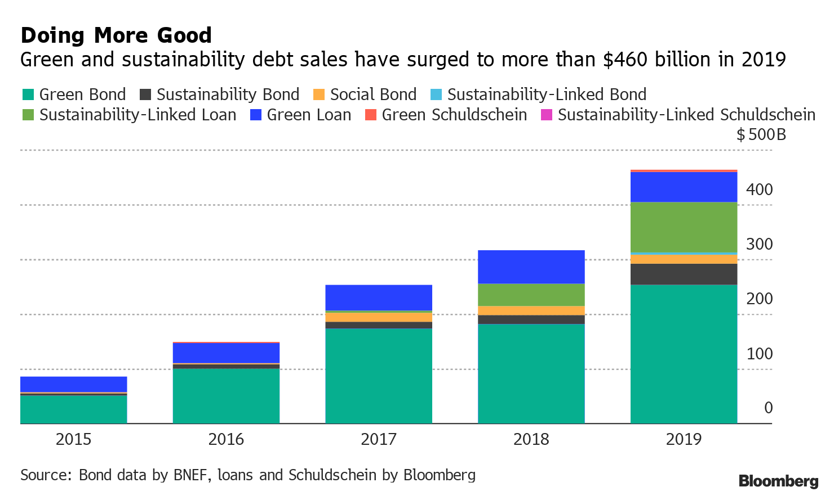
GROWTH OF Sustainable Finance
Growth on the Supply Side

Slide 6
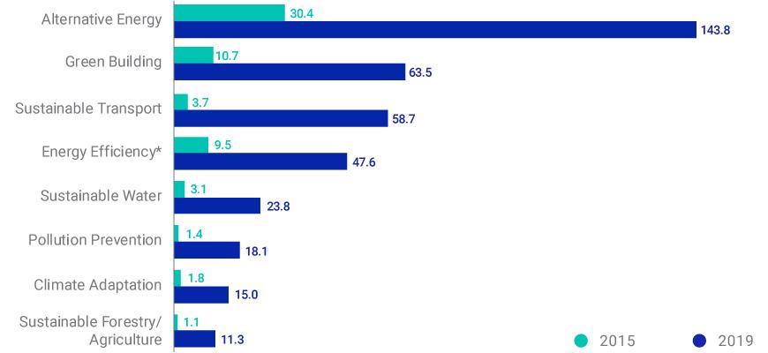
GROWTH OF Sustainable Finance
Expanding Scope of Use-of-proceed Bonds
Expansion of themes covered by use-of-proceed bonds
Many companies issuing green bonds have social dimension (e.g. Verizon)
Green Blue ESG | Sustainability Social Climate | Ocean Plastic waste reduction
Green-bond funding has increased for a variety of purposes (USD bn)

Slide 7
GROWTH OF Sustainable Finance
Growing market of sustainability-linked finance
What’s sustainability-linked finance
Corporate debt instruments – bonds, loans, credit lines – linked to the issuer’s performance on sustainability goals and targets – allowing general-purpose uses of funds and based on integrated management and governance of sustainability.
Examples of recent transactions
Bonds: ENEL, Chanel, Novartis, Suzano, Hulic Co, Schneider Electric, LafargeHolcim
Loans: Aligned, Johnson Controls (USA), JetBlue (USA), Empresas CMPC, International Seaways, Sistema (Russia)
Credit lines: ENEL, Schneider, Lafarge, Tesco, Moncler, WSP, Neuberger, Brookfield Renewable, Bunge, Maple Leaf Food, Norsk Hydro

Slide 8

GROWTH OF Sustainable Finance
Increasing use of sustainable finance frameworks
Outline the entity’s strategy and targets on key sustainability issues
Allow multiple issues and different types of instruments
Complement definition of use-of-proceed bonds
Addresses the entity’s overall impact and introduce performance-based approach

Slide 9



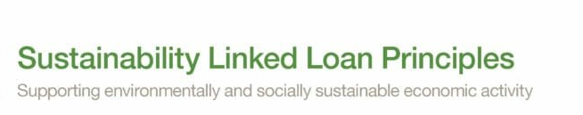
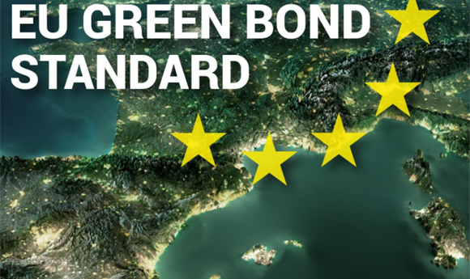
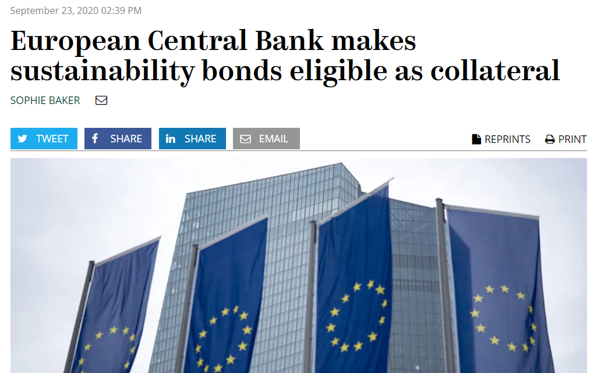
GROWTH OF Sustainable Finance
Normative Frameworks
International Capital Market Association (ICMA)
Climate Bond Initiative
Loan Market Association (LMA)
European Union (EU)

Slide 10
IFC FRAMEWORK FOR TRANSPARENCY and disclosure
Enabling Sustainable Corporate Finance
Framework built on three pillars of strategy, governance and performance provides a ready-made framework for sustainable finance
As contemplated in emerging models for sustainable corporate finance, the framework guides companies to:
Set strategic goals and targets on material sustainability issue
Incorporate sustainability issues in corporate governance oversight and controls
account and report on performance

Slide 11
IFC FRAMEWORK FOR TRANSPARENCY and disclosure
Enabling Sustainable Corporate Finance

Slide 12
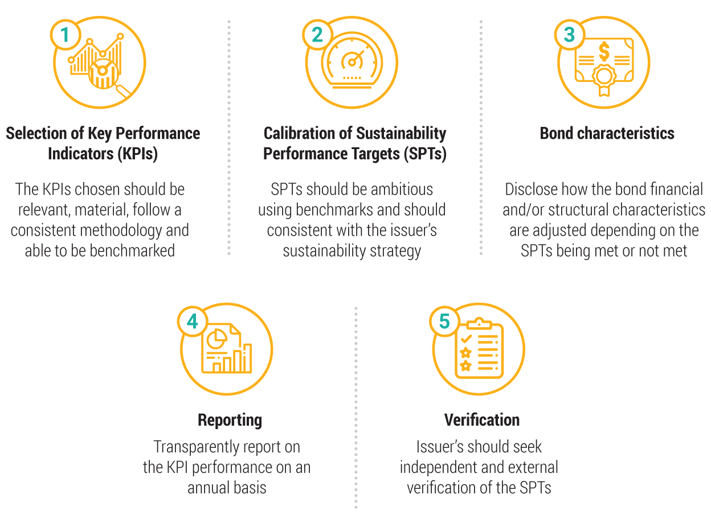
IFC FRAMEWORK FOR TRANSPARENCY and disclosure
Comparing with the Sustainability-Linked Bond Principles

Slide 13
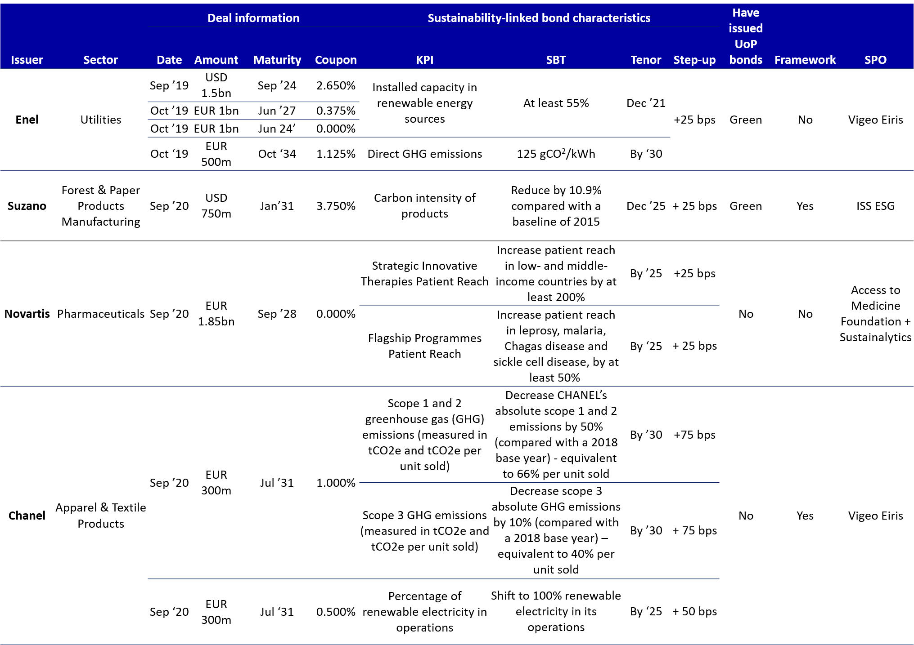
IFC FRAMEWORK FOR TRANSPARENCY and disclosure
Comparing with emerging good practices in sustainability-linked bonds

